Slide 1

ME 453
HEAT EXCHANGER DESIGN
2024-2025 / SPRING
Heat Exchangers Pressure Drop and Pumping Power
Dr. Yağmur NALBANT ATAK
Atılım University
Department of Mechanical Engineering

Slide 2
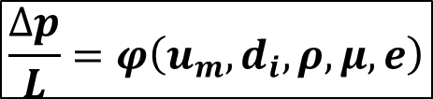
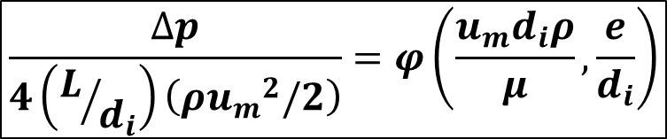
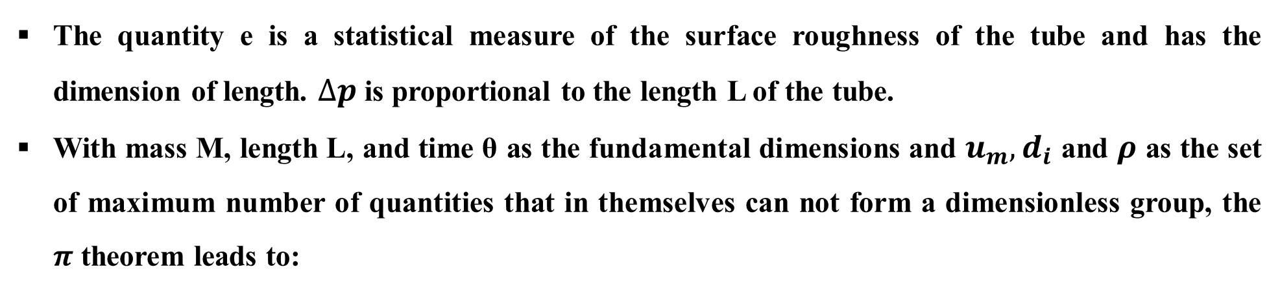
Tube-Side Pressure Drop
In fully-developed flow in tube, the following functional relatinship can be written for the frictional pressure drop for either laminar or turbulent flow:
$$\frac{∆p}{L}=φ\left(u_{m},d_{i},ρ,μ,e\right)$$
The quantity e is a statistical measure of the surface roughness of the tube and has the dimension of length. $∆p$ is proportional to the length L of the tube.
With mass M, length L, and time θ as the fundamental dimensions and $u_{m},d_{i}$ and $ρ$ as the set of maximum number of quantities that in themselves can not form a dimensionless group, the $π$ theorem leads to:
$$\frac{∆p}{4\left(L/{d_{i}}\right)\left(ρ{u_{m}}^{2}/2\right)}=φ\left(\frac{u_{m}d_{i}ρ}{μ}, \frac{e}{d_{i}}\right)$$

Slide 3
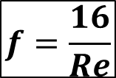

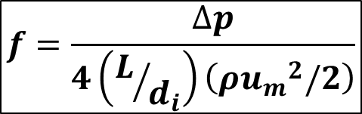
Tube-Side Pressure Drop
The preceding dimensionless group involving $∆p$ has been defined as the Fanning friction factor, $f$ :
$$f=\frac{∆p}{4\left(L/{d_{i}}\right)\left(ρ{u_{m}}^{2}/2\right)}$$
$$f=φ\left(Re, e/d_{i}\right)$$
In laminar region, existing empirical data on the frictional pressure drop within circular tubes can be correlated by a simple relationship between f and Re, independent of the surface roughness:
$$f=\frac{16}{Re}$$
The transition from laminar to turbulent flow is somewhere in the neighborhood of Reynolds number from 2300 to 4000.

Slide 4
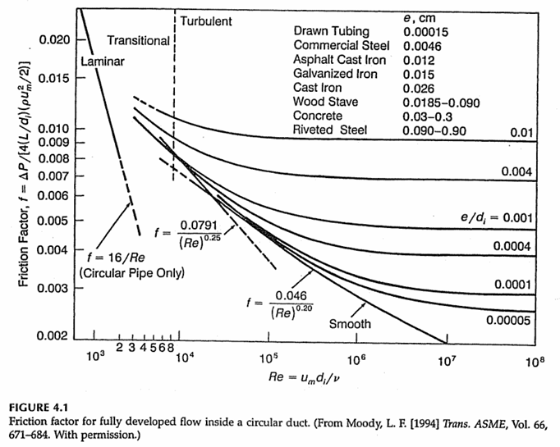
MOODY Diagram

Slide 5
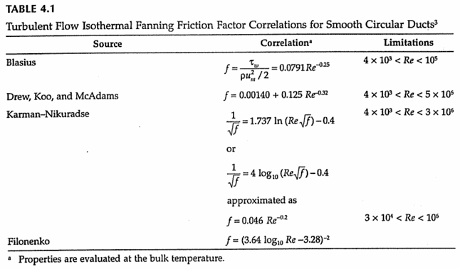
Tube-Side Pressure Drop
The f vs Re relation for smooth tubes in turbulent flow are given in Table 4.1.

Slide 6
Tube-Side Pressure Drop
Two linear approximations shown by dotted lines in Fig 4.1 for turbulent flow are:
$$f=0.046{Re}^{−0.2 } for 3x10^{4}<Re<10^{6}$$
and
$$f=0.079{Re}^{−0.25 } for 4x10^{3}<Re<10^{5}$$
f can be read from the graph, but the correlations for f are useful for computer analysis of heat exchanger.

Slide 7
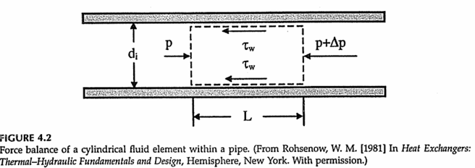

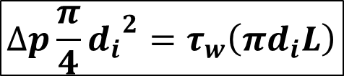
Tube-Side Pressure Drop
For fully developed flow in tube, a simple force balance yields (Figure 4.2):
$$∆p\frac{π}{4}{d_{i}}^{2}=τ_{w}\left(πd_{i}L\right)$$
$$f=\frac{τ_{w}}{ρ{u_{m}}^{2}/2}$$
An equivalent form for the friction factor:

Slide 8
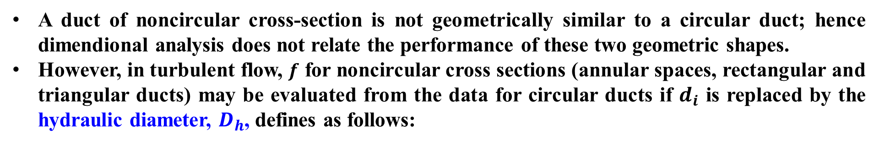

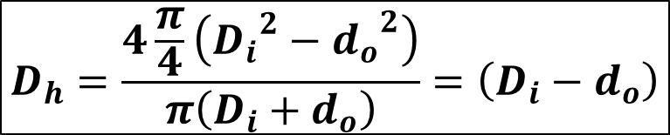
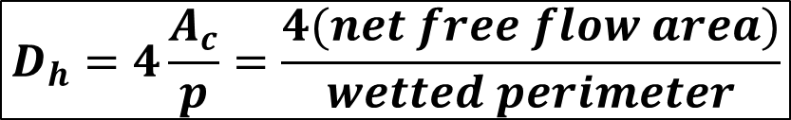
Tube-Side Pressure Drop
Noncircular Cross-Sectional Ducts:
A duct of noncircular cross-section is not geometrically similar to a circular duct; hence dimendional analysis does not relate the performance of these two geometric shapes.
However, in turbulent flow, $f$ for noncircular cross sections (annular spaces, rectangular and triangular ducts) may be evaluated from the data for circular ducts if $d_{i}$ is replaced by the hydraulic diameter, $D_{h}$, defines as follows:
$$D_{h}=4\frac{A_{c}}{p}=\frac{4(net free flow area)}{wetted perimeter}$$
The hydraulic diameter of an annulus of inner and outer diameters $D_{i}$ and $d_{o}, respectively:$
$$D_{h}=\frac{4\frac{π}{4}\left({D_{i}}^{2}−{d_{o}}^{2}\right)}{π\left(D_{i}+d_{o}\right)}=\left(D_{i}−d_{o}\right)$$
**For a circular duct, $D_{h}=d_{i}$

Slide 9
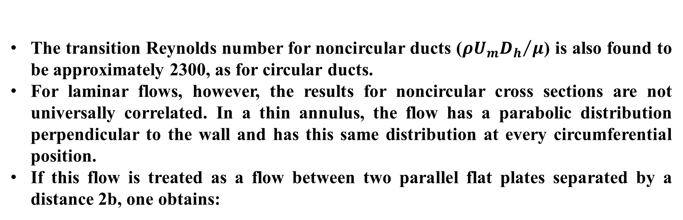
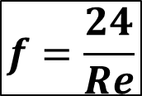
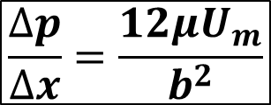
Tube-Side Pressure Drop
The transition Reynolds number for noncircular ducts (${ρU_{m}D_{h}}/μ$) is also found to be approximately 2300, as for circular ducts.
For laminar flows, however, the results for noncircular cross sections are not universally correlated. In a thin annulus, the flow has a parabolic distribution perpendicular to the wall and has this same distribution at every circumferential position.
If this flow is treated as a flow between two parallel flat plates separated by a distance 2b, one obtains:
$$\frac{∆p}{∆x}=\frac{12μU_{m}}{b^{2}}$$
Here, $D_{h}=2b$ and above equation can written in the form:
$$f=\frac{24}{Re}$$

Slide 10
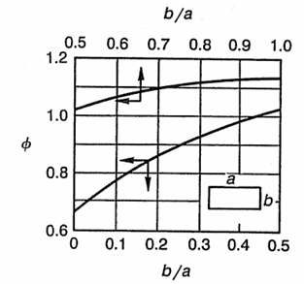

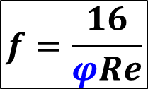
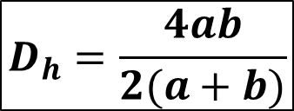
Tube-Side Pressure Drop
Flow in a rectangular duct (dimensions axb) in which b<<a is similar to this annular flow. For rectangular ducts of other aspect ratios (b/a):
$$f=\frac{16}{φRe}$$
where
$$D_{h}=\frac{4ab}{2(a+b)}$$

Slide 11
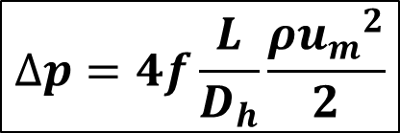
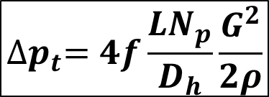

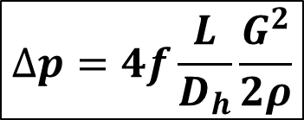
Tube-Side Pressure Drop
The frictional pressure drop for flow through a duct of length L is generally expressed as:
$$∆p=4f\frac{L}{D_{h}}\frac{ρ{u_{m}}^{2}}{2}$$
$$∆p=4f\frac{L}{D_{h}}\frac{G^{2}}{2ρ}$$
or
$$G=u_{m}ρ$$
The pressure drop experienced by a single-phase fluid in the tubes of a Shell-and-tube heat exchanger must include the effects of all the tubes. The pressure drop for all tubes can be calculated by:
$${∆p}_{t}=4f\frac{LN_{p}}{D_{h}}\frac{G^{2}}{2ρ}$$
Where $N_{p}$ is the number of tube passes and $D_{h}=d_{i}$.

Slide 12
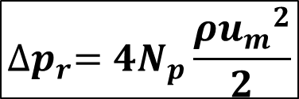
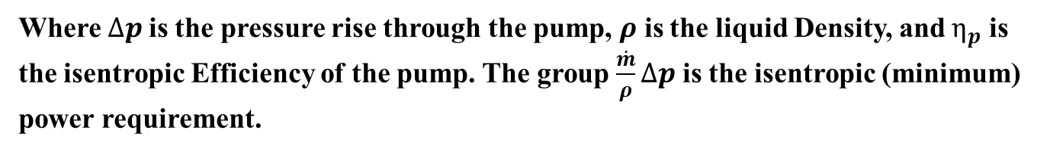
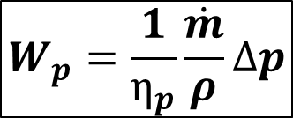
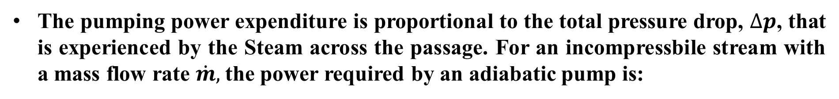
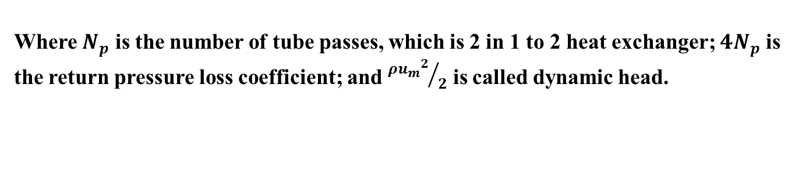
Tube-Side Pressure Drop
The fluid will experience an additional loss due to sudden expansions and contractions that the tube undergoes during a return. Experiments show that the return pressure loss is given by:
$${∆p}_{r}=4N_{p}\frac{ρ{u_{m}}^{2}}{2}$$
Where $N_{p}$ is the number of tube passes, which is 2 in 1 to 2 heat exchanger; $4N_{p}$ is the return pressure loss coefficient; and ${ρ{u_{m}}^{2}}/2$ is called dynamic head.
The pumping power expenditure is proportional to the total pressure drop, $∆p$, that is experienced by the Steam across the passage. For an incompressbile stream with a mass flow rate $\dot{m},$the power required by an adiabatic pump is:
$$W_{p}=\frac{1}{η_{p}}\frac{\dot{m}}{ρ}∆p$$
Where $∆p$is the pressure rise through the pump, $ρ$ is the liquid Density, and $η_{p}$ is the isentropic Efficiency of the pump. The group $\frac{\dot{m}}{ρ}∆p$ is the isentropic (minimum) power requirement.

Slide 13
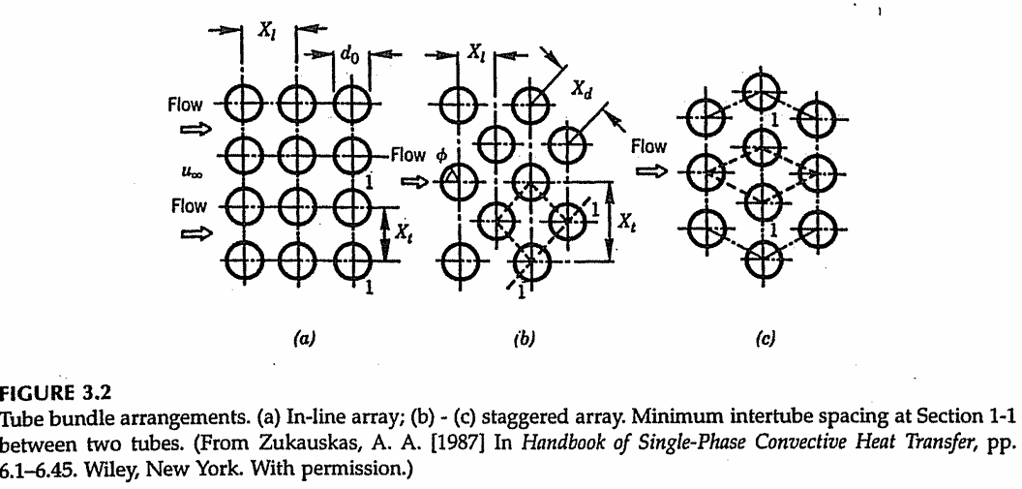
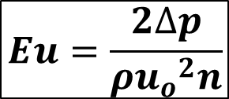
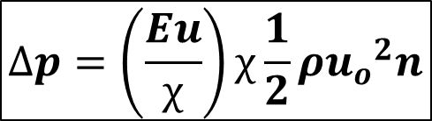
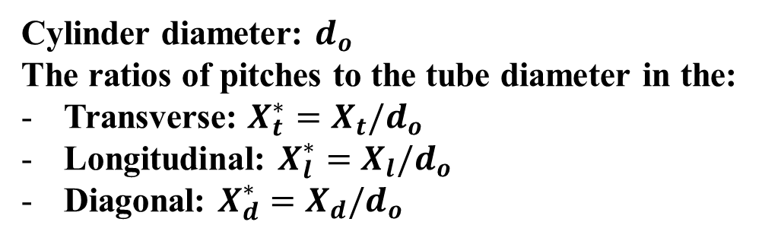
Pressure Drop in Tube Bundles in Crossflow
Circular tube bundle is one of the most common heat transfer surfaces, especially in Shell and tube heat exchangers. Two most commont tube arrangemets are staggered and in-line. In-line tubes form rectangulars with the centers of their cross sections, while staggered tubes form isosceles triangles.
Cylinder diameter: $d_{o}$
The ratios of pitches to the tube diameter in the:
Transverse: $X_{t}^{∗}=X_{t}/d_{o}$
Longitudinal: $X_{l}^{∗}=X_{l}/d_{o}$
Diagonal: $X_{d}^{∗}=X_{d}/d_{o}$
The pressure drop of a multirow bundle is given by:
$$∆p=\left(\frac{Eu}{χ}\right)χ\frac{1}{2}ρ{u_{o}}^{2}n$$
$$Eu=\frac{2∆p}{ρ{u_{o}}^{2}n}$$

Slide 14
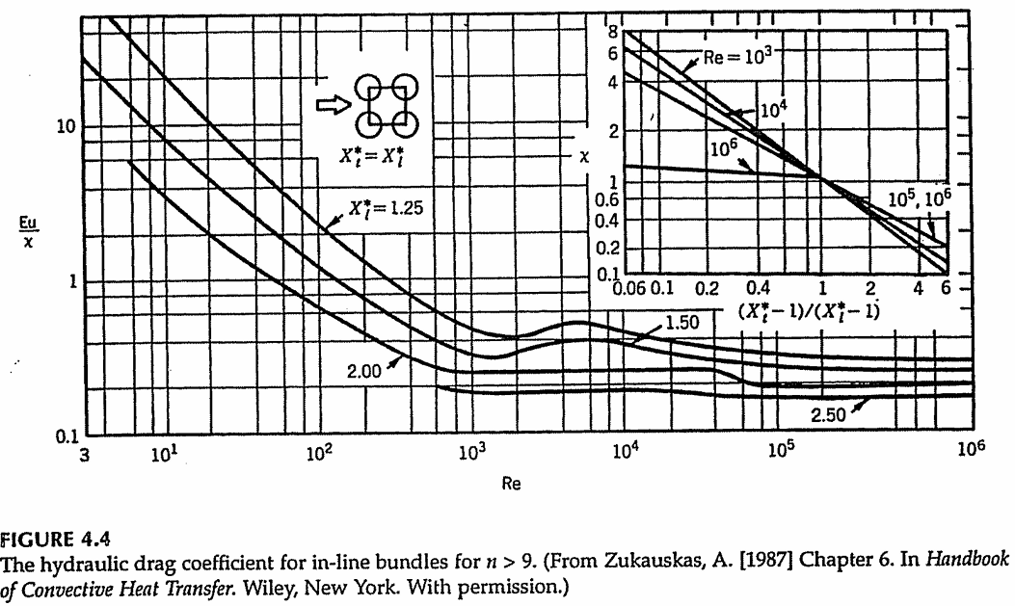

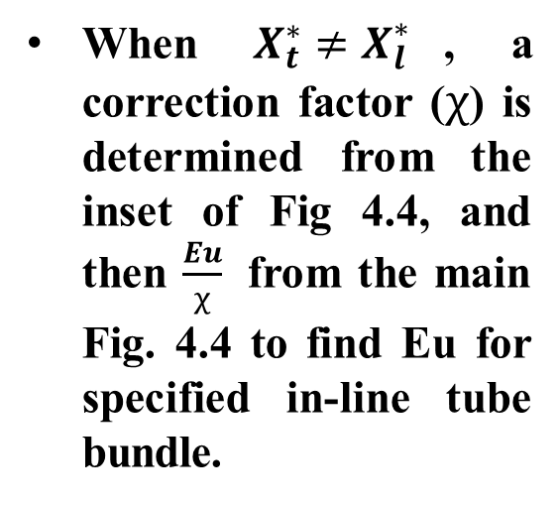
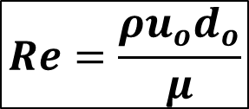
Average Euler Number for in-line tube bundle
When $X_{t}^{∗}=X_{l}^{∗}$, Eu can be find using Re.
When $X_{t}^{∗}≠X_{l}^{∗}$, a correction factor ($χ$) is determined from the inset of Fig 4.4, and then $\frac{Eu}{χ}$ from the main Fig. 4.4 to find Eu for specified in-line tube bundle.
ISOTHERMAL CONDITIONS
$$Re=\frac{ρu_{o}d_{o}}{μ}$$

Slide 15
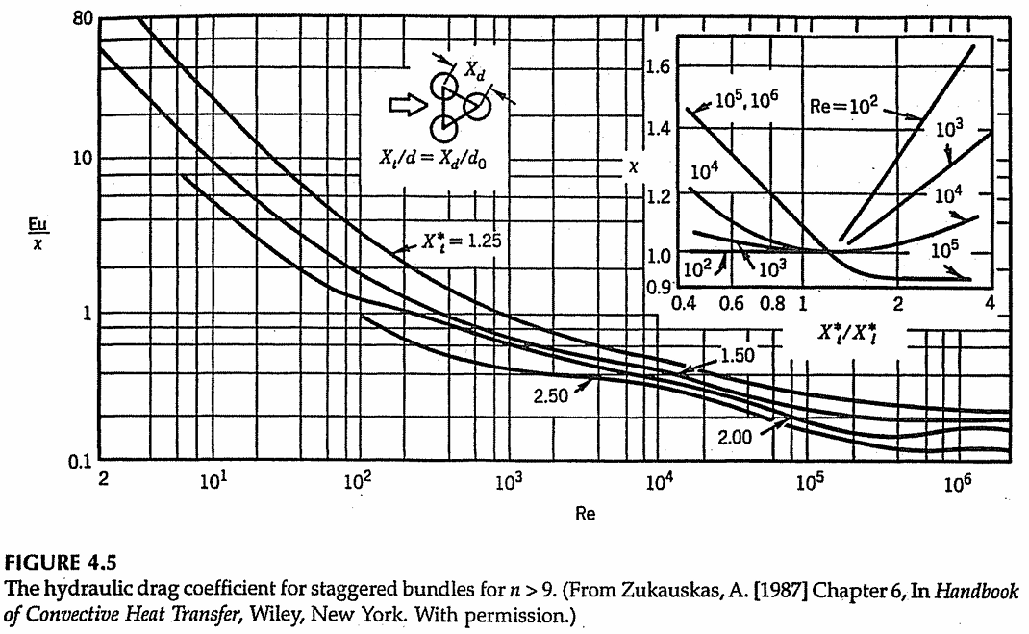
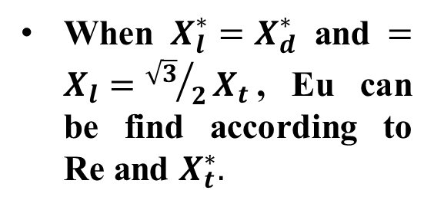
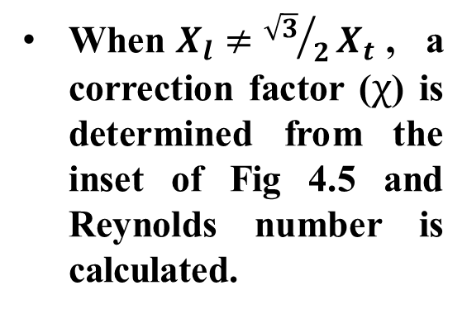
Average Euler Number for staggered tube bundle
When $X_{l}^{∗}=X_{d}^{∗}$ and $=X_{l}={\sqrt{3}}/2X_{t}$, Eu can be find according to Re and $X_{t}^{∗}.$
When$X_{l}≠{\sqrt{3}}/2X_{t}$, a correction factor ($χ$) is determined from the inset of Fig 4.5 and Reynolds number is calculated.
ISOTHERMAL CONDITIONS

Slide 16
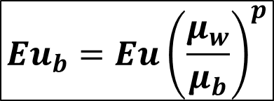

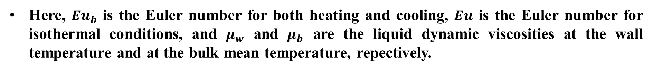
Pressure Drop in Tube Bundles in Crossflow
For nonisothermal conditions, if the fluid properties are evaluated at the bulk temperature and a correction is applied to account for variable fluid properties for liquids as follows:
$${Eu}_{b}=Eu{\left(\frac{μ_{w}}{μ_{b}}\right)}^{p}$$
Here, ${Eu}_{b}$ is the Euler number for both heating and cooling, $Eu$ is the Euler number for isothermal conditions, and $μ_{w}$ and $μ_{b}$ are the liquid dynamic viscosities at the wall temperature and at the bulk mean temperature, repectively.
$$p=0 for Re>10^{3}$$
$$p=−0.0018Re+0.28 (for liquid heating) for Re≤10^{3}$$
$$p=−0.0026Re+0.43 (for liquid cooling) for Re≤10^{3}$$

Slide 17

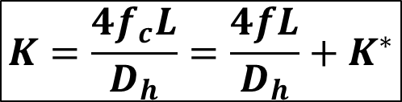
Pressure Drop in Bends and Fittings
Pressure Drop in Bends:
Friction factor correlations in smooth bends with circular cross section for laminar flow of Newtonian fluids are given in this section.
Total pressure drop in a bend is the sum of the frictional head loss due to the length of the bend, head loss due to curvature and head loss due to excess pressure drop in the downstream pipe because of the velocity profile distortion.
$$∆p=K\frac{ρ{u_{m}}^{2}}{2}$$
$$K=\frac{4f_{c}L}{D_{h}}=\frac{4fL}{D_{h}}+K^{∗}$$
A total loss coefficient, K :
$f_{c}$ is the bend friction factor, $f$ is the friction factor for a straight pipe at Reynolds number in the bend, and $K^{∗}$ represents a combined loss coefficient other than friction loss.

Slide 18
Pressure Drop in Bends and Fittings
Here, $f$ is given by:
$$f=0.0791{Re}^{−0.25 } for 10^{4}<Re<10^{5}$$
and
$$f=0.0008+0.005525{Re}^{−0.237 } for 10^{5}<Re<10^{7}$$
Idelchik reported the following correlation to calculate laminar friction factors in smooth bends of any degree $φ<360°$.
$$f_{c}=5 {Re}^{−6.5}{\left(R/a\right)}^{−0.175} for 50<De≤600$$
$$f_{c}=2.6 {Re}^{−0.55}{\left(R/a\right)}^{−0.225} for 600<De≤1400$$
$$f_{c}=1.25 {Re}^{−0.45}{\left(R/a\right)}^{−0.275} for 1400<De≤5000$$
Notes:
De=Re karekök(Dh/2R)​​ R: eğrilik yarıçapı

Slide 19
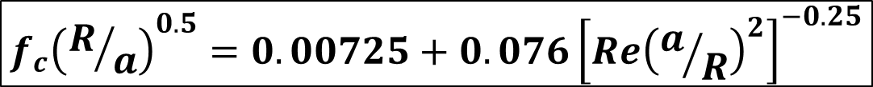
Pressure Drop in Bends and Fittings
For turbulent flow, Ito obtained extensive experimental data, for 45°, 90°, and 180° bends for different values of R/a; he proposed the following correlation for 2x10⁴<Re<4x10⁵.
$$K=0.00873φf_{c}\left(R/a\right) for Re{\left(R/a\right)}^{−2}<91$$
$$K=0.00241φ{Re}^{−0.17}{\left(R/a\right)}^{0.84} for Re{\left(R/a\right)}^{−2}≥91$$
Where $φ$ is a bend angle in degrees and $f_{c}$ is the curved tube friction factor obtained from:
$$f_{c}{\left(R/a\right)}^{0.5}=0.00725+0.076{\left[Re{\left(a/R\right)}^{2}\right]}^{−0.25}$$

Slide 20
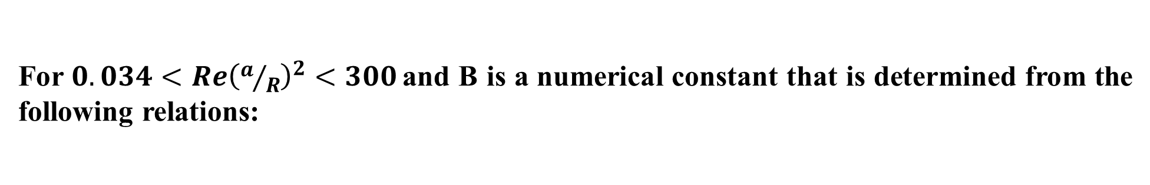
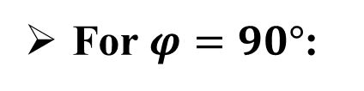


Pressure Drop in Bends and Fittings
For $0.034<Re{\left(a/R\right)}^{2}<300$ and B is a numerical constant that is determined from the following relations:
$$B=1+14.2{\left(R/a\right)}^{−1.47}$$
For $φ=45°$:
For $φ=90°$:
$$B=0.95+17.2\left(R/a\right) for R/a<19.7$$
$$B=1 for R/a>19.7$$
$$B=1+116{\left(R/a\right)}^{−4.52}$$
For $φ=180°$:

Slide 21
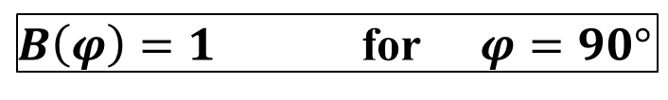
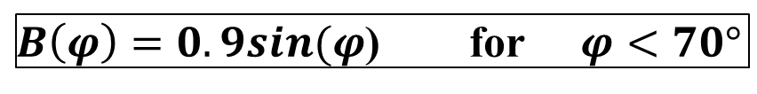
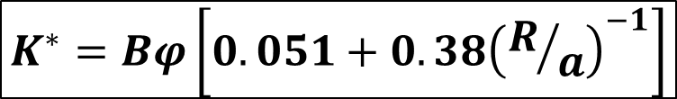
Pressure Drop in Bends and Fittings
For turbulent flow, Powle also recommended the use of the following loss coefficient of $K^{∗}$:
$$K^{∗}=Bφ\left[0.051+0.38{\left(R/a\right)}^{−1}\right]$$
where
$B\left(φ\right)=1$for $φ=90°$
$B\left(φ\right)=0.9sin(φ$) for $φ<70°$
$B\left(φ\right)=0.7+0.35sin(φ/90$) for $φ≥70°$

Slide 22
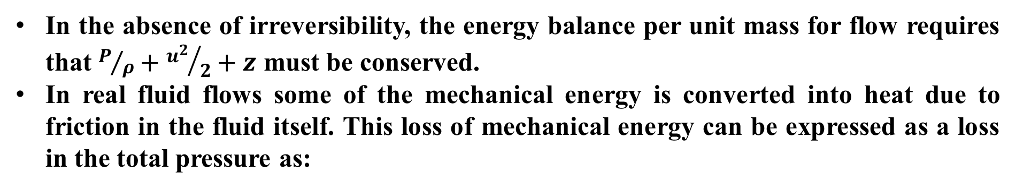
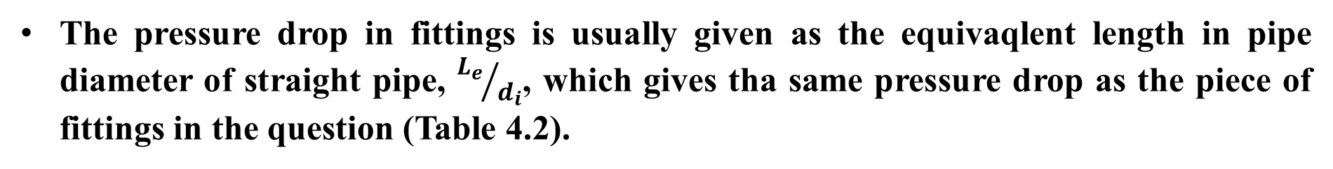
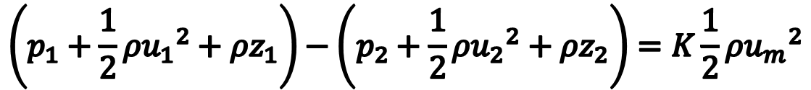
Pressure Drop in Bends and Fittings
Pressure Drop in Fittings:
In the absence of irreversibility, the energy balance per unit mass for flow requires that $P/ρ+{u^{2}}/2+z$ must be conserved.
In real fluid flows some of the mechanical energy is converted into heat due to friction in the fluid itself. This loss of mechanical energy can be expressed as a loss in the total pressure as:
$$\left(p_{1}+\frac{1}{2}{{ρu}_{1}}^{2}+{ρz}_{1}\right)−\left(p_{2}+\frac{1}{2}{{ρu}_{2}}^{2}+{ρz}_{2}\right)=K\frac{1}{2}ρ{u_{m}}^{2}$$
The pressure drop in fittings is usually given as the equivaqlent length in pipe diameter of straight pipe, ${L_{e}}/{d_{i}}$, which gives tha same pressure drop as the piece of fittings in the question (Table 4.2).

Slide 23


Slide 24

Pressure Drop in Bends and Fittings
The pressure drop is calculated, as a total loss coefficient K by which the dynamic head:
$$\frac{ρ{u_{m}}^{2}}{2}$$
has to multiplied to give the pressure drop (Table 4.3).
Hooper also compiled available laminar and turbulent flow pressure drop data for Standard and long radius elbows (45°, 90°, 180°), miter bends, tees, and valves. The compiled data were presented as the following single correlation:
$$K^{∗}=K_{l}{Re}^{−1}+K_{∞}\left(1+0.5a^{∗}\right)$$

Slide 25



Slide 26
EXAMPLE 4.1
Consider a piping circuit of a heat exchanger. In the circuit there are four 90° standard elbows, three close pattern return bends, two check valves (clearway swing type), two angle valves (with no obstruction in a flat-type seat), and three gate valves (conventional wedge type); the valves are fully open. The straight part of the circuit pipe is 150 m, and water at 50°C flows with a velocity of 4 m/s. The pressure drop through the heat exchanger is 12 kPa. Nominal pipe size is 2 in. O.D. (I.D. = 0.052 m).
Calculate the total pressure drop in the system.
Calculate the mass flow rate and the pumping Power (kW), by assuming the isentropic efficiecny of the pump to be 0.8.

Slide 27


EXAMPLE 4.1
The total pressure drop can be calculated by the use following equation:
$$∆p=4f\frac{ρ{u_{m}}^{2}}{2}\sum{\frac{L}{d_{i}}}+{∆p}_{hex}$$
From Table 4.2, the following equivalent length in pipe diameters can be obtained:
4
3
2
2
3

Slide 28








EXAMPLE 4.1
The properties of water at 50°C from Appendix B (Table b-2) are:
$$c_{p}=4181.2\frac{J}{kgK}$$
$$ρ=987.9\frac{kg}{m^{3}}$$
$$Pr=3.62$$
$$k=0.640\frac{W}{mK}$$
$$μ=5.531x10^{−4}Pa∙s$$
Turbulent flow
Reynolds number:
$$Re=\frac{u_{m}d_{i}ρ}{μ}$$
$$Re=\frac{4∙0.052∙987.9}{5.531x10^{−4}}$$
$$Re=371512>2300$$

Slide 29





EXAMPLE 4.1
The friction coefficient for turbulent flow can be calculated using one of the correlations given in Table 4.1.
$$f=0.046{Re}^{−0.2 } for 3x10^{4}<Re<10^{6}$$
$$f=0.046{\left(371512\right)}^{−0.2 }$$
$$f=0.00354$$
Total pressure drop:
$$∆p=4f\frac{ρ{u_{m}}^{2}}{2}\sum{\frac{L}{d_{i}}}+{∆p}_{hex}$$
$$∆p=4\left(0.00354\right)\frac{987.9∙{16}^{2}}{2}\sum{\frac{L}{d_{i}}+{∆p}_{hex}}$$
$$∆p=4\left(0.00354\right)\frac{987.9∙4^{2}}{2}\left(\frac{150}{0.052}+4x30+3x50+2x50+2x145+3x13\right)+12$$
$$∆p=413.042 kPa$$

Slide 30






EXAMPLE 4.1
The pumping Power can be calculated as follows:
$$\dot{m}=\frac{π}{4}{d_{i}}^{2}u_{m}ρ$$
$\dot{m}=\frac{π}{4}{0.052}^{2}∙4∙$987.9
$$\dot{m}=8.4\frac{kg}{s}$$
$$P=\frac{\dot{m}∙∆p}{ρ∙η_{p}}$$
$$P=\frac{8.4∙413.042}{987.9∙0.80}$$
$$P=4.36 kW$$

Slide 31

Pressure drop for abrupt contraction, expansion and momentum change
In heat exchangers, the streams can experience a sudden contraction followed by a sudden enlargement, when flowing in and out of a heat exchanger core, such as the cases in the tube side of shell-and-tube heat exchangers and compact tube-fin and plate-fin heat exchangers.
Pressure drop is expressed in terms of the contracting loss coefficient, K_{c}, and the enlargement loss coefficient, K_{e}, and the dynamic head. Therefore, the total pressure drop of the stream is:
$$∆p=K_{c}\frac{ρ{u_{m}}^{2}}{2}+{∆p}_{s}+K_{e}\frac{ρ{u_{m}}^{2}}{2}$$
The straight-duct pressure drop

