Slide 1

ME 453
HEAT EXCHANGER DESIGN
2024-2025 / SPRING
Fouling of Heat Exchanger
Dr. Yağmur NALBANT ATAK
Atılım University
Department of Mechanical Engineering

Slide 2
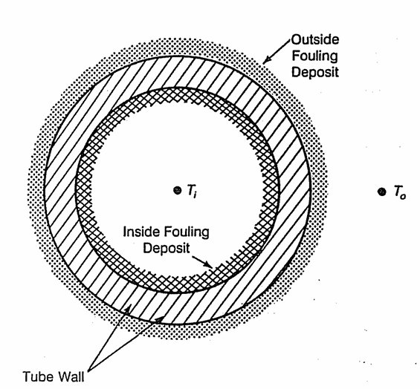


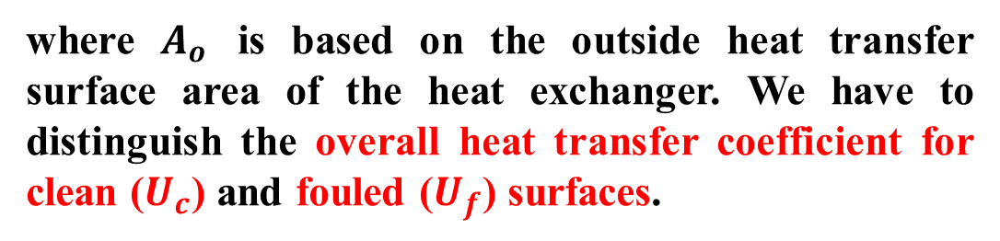
Basic Considerations
Thermal analysis of a heat exchanger is governed by the conservation of energy in that the heat release by the hot fluid stream equals the heat gain by the cold fluid.
The heat transfer, Q, is related to the exchanger geometry and flow parameters as:
$$Q=U∙A_{o}∙{∆T}_{m}$$
where $A_{o}$ is based on the outside heat transfer surface area of the heat exchanger. We have to distinguish the overall heat transfer coefficient for clean ($U_{c}$) and fouled ($U_{f}$) surfaces.

Slide 3

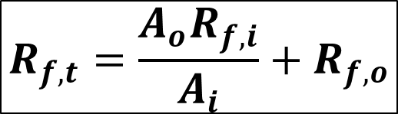
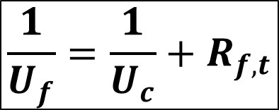
Basic Considerations
$U_{f}$ can be related to the clean surface overall heat transfer coefficient, $U_{c}$, as:
$$\frac{1}{U_{f}}=\frac{1}{U_{c}}+R_{f,t}$$
$$R_{f,t}=\frac{A_{o}R_{f,i}}{A_{i}}+R_{f,o}$$
where $R_{f,t}$ is the total fouling resistance given as:
The heat transfer rate under fouled conditions, $Q_{f}$, can be expressed as:
$Q_{f}=U_{f}$ $A_{f}$ ${∆T}_{mf}$

Slide 4
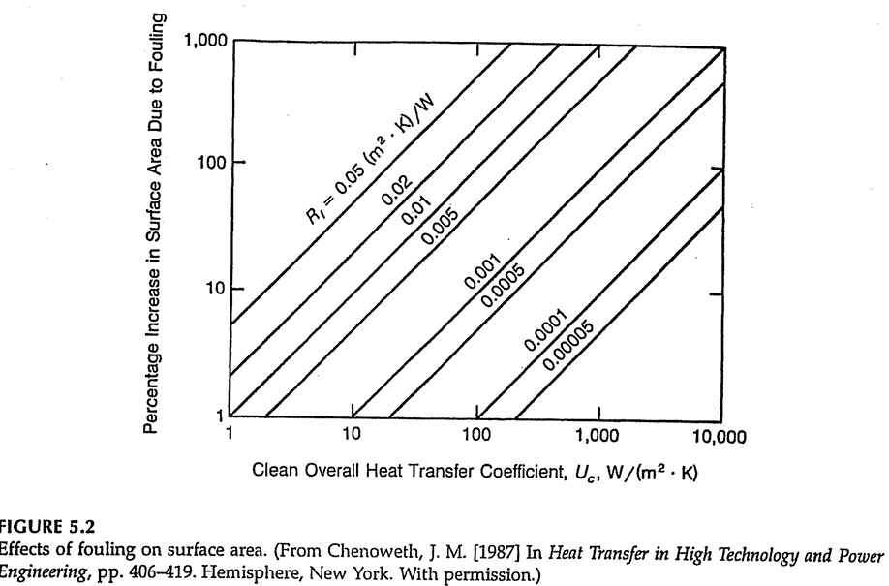
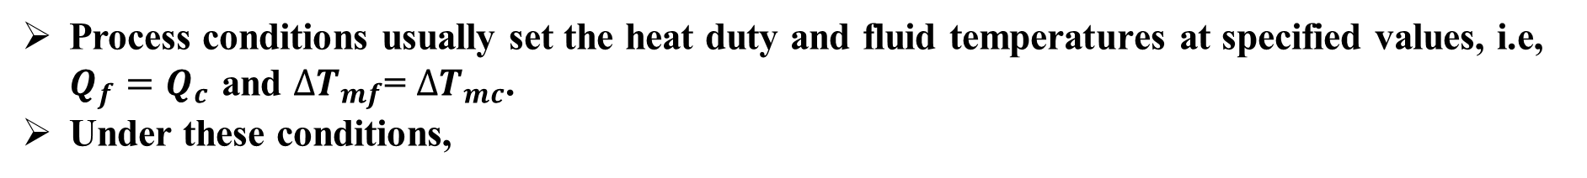
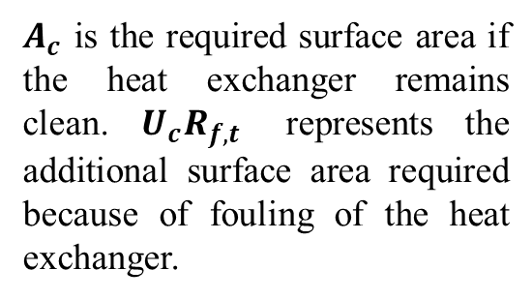
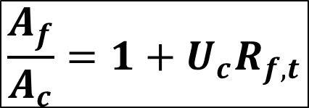
Basic Considerations
Process conditions usually set the heat duty and fluid temperatures at specified values, i.e, $Q_{f}=Q_{c }$and ${∆T}_{mf}$= ${∆T}_{mc}$.
Under these conditions,
$$\frac{A_{f}}{A_{c}}=1+U_{c}R_{f,t}$$
$A_{c}$ is the required surface area if the heat exchanger remains clean. $U_{c}R_{f,t}$ represents the additional surface area required because of fouling of the heat exchanger.

Slide 5
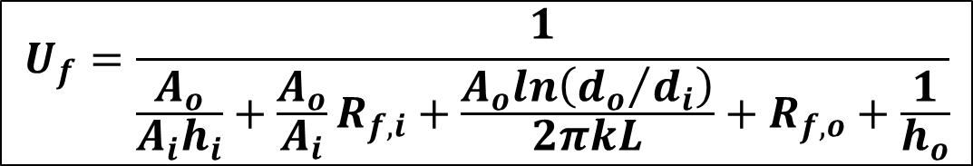
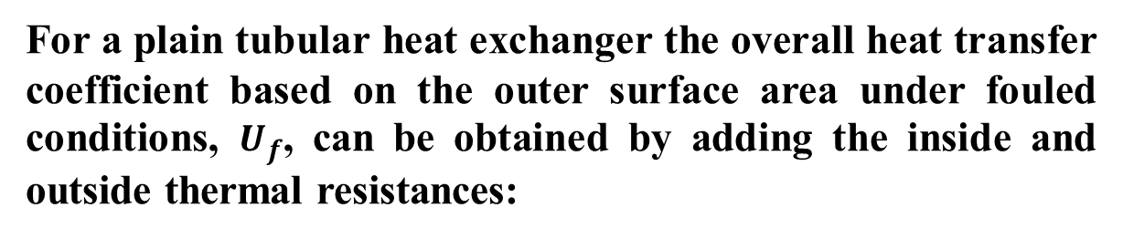
Effects of Fouling
Lower heat transfer and increased pressure drop resulting from fouling decrease the effectiveness of a heat exchanger.
Effect of Fouling on Heat Transfer:
For a plain tubular heat exchanger the overall heat transfer coefficient based on the outer surface area under fouled conditions, $U_{f}$, can be obtained by adding the inside and outside thermal resistances:
$$U_{f}=\frac{1}{\frac{A_{o}}{A_{i}h_{i}}+\frac{A_{o}}{A_{i}}R_{f,i}+\frac{A_{o}ln\left({d_{o}}/{d_{i}}\right)}{2πkL}+R_{f,o}+\frac{1}{h_{o}}}$$

Slide 6
Effects of Fouling
Average total fouling resistance values specified in the design of some 750 shell-and-tube heat exchangers, by five different manufacturers, are shown in Table 5.1.
By using the typical values of heat transfer coefficients for boiling, condensation, and gas flow- and an average total fouling resistance given in Table 5.1, Table 5.2 can be prepared; the latter shows the percentage increase in the heat transfer surface area for shell-and-tube boiler, and evaporator and condenser applications with single-phase flow in the tube side.
It should be noted that if liquids are used for sensible heating and cooling, fouling may sub- stantially increase the required surface area by a factor of 2 or even 3. For high heat transfer applications, fouling may even dictate the design of the heat exchange device.

Slide 7
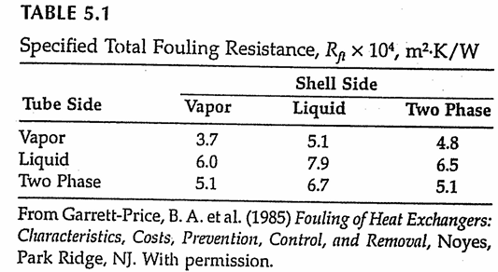
Effects of Fouling

Slide 8
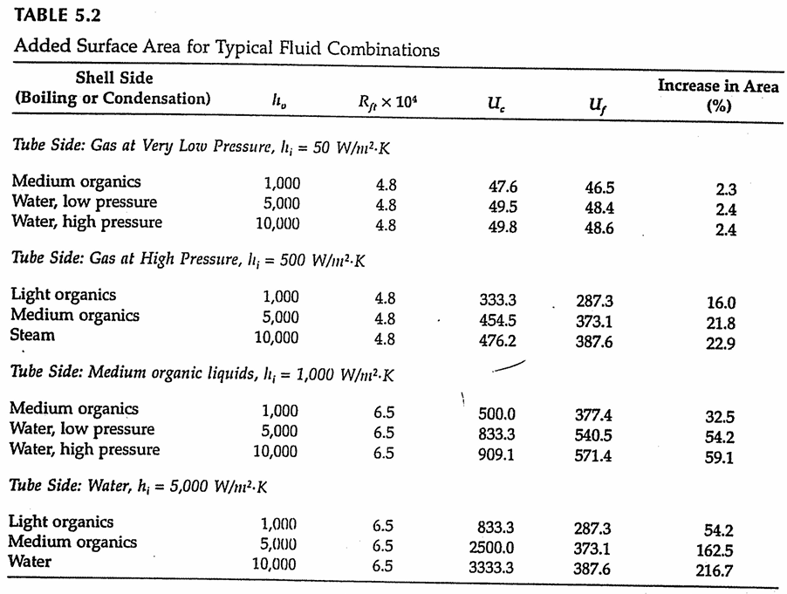
Effects of Fouling

Slide 9
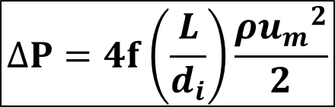
Effects of Fouling
Effect of Fouling on Pressure Drop:
Fouling always has a finite, although sometimes small thickness. The change in the flow geometry due to fouling affects the flow field and the pressure drop (or pumping Power).
For example, in a tubular heat exchanger, fouling Layer roughens the surface, decreases the inner diameter, and increases the outer diameter.
$$∆P=4f\left(\frac{L}{d_{i}}\right)\frac{ρ{u_{m}}^{2}}{2}$$

Slide 10
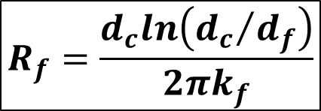

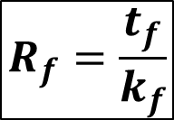
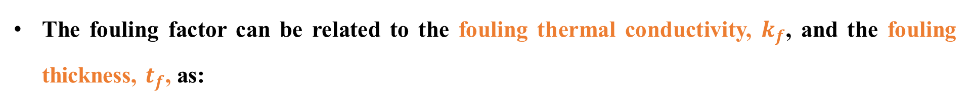
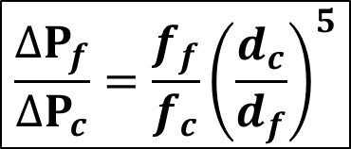
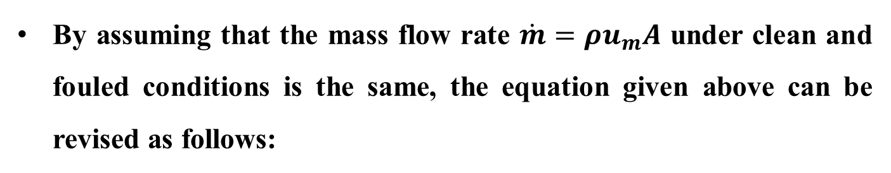
Effects of Fouling
Pressure drop under fouled and clean conditions can be related as:
$$\frac{{∆P}_{f}}{{∆P}_{c}}=\frac{f_{f}d_{c}}{f_{c}d_{f}}{\left(\frac{u_{f}}{u_{c}}\right)}^{2}$$
By assuming that the mass flow rate $\dot{m}=ρu_{m}A$ under clean and fouled conditions is the same, the equation given above can be revised as follows:
$$\frac{{∆P}_{f}}{{∆P}_{c}}=\frac{f_{f}}{f_{c}}{\left(\frac{d_{c}}{d_{f}}\right)}^{5}$$
The fouling factor can be related to the fouling thermal conductivity, $k_{f}$, and the fouling thickness, $t_{f}$, as:
$$R_{f}=\frac{t_{f}}{k_{f}}$$
For a plane wall
$$R_{f}=\frac{d_{c}ln\left({d_{c}}/{d_{f}}\right)}{2πk_{f}}$$
For a cylindrical tube wall

Slide 11
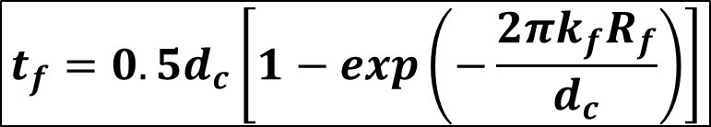
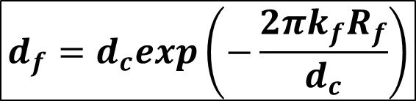
Effects of Fouling
Inner diameter under fouled conditions, $d_{f}$, can be obtained by rearranging:
$$d_{f}=d_{c}exp\left(−\frac{2πk_{f}R_{f}}{d_{c}}\right)$$
The fouling thickness, $t_{f}$, is expressed as:
$$t_{f}={0.5d}_{c}\left[1−exp\left(−\frac{2πk_{f}R_{f}}{d_{c}}\right)\right]$$

Slide 12
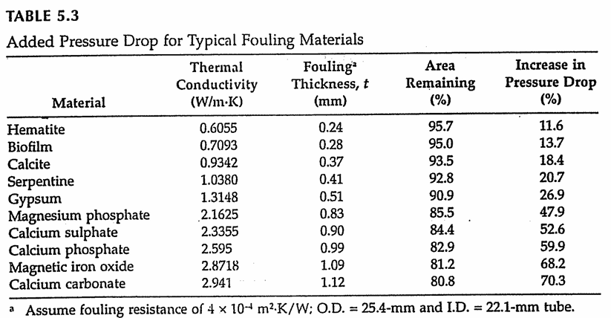
Effects of Fouling
In general, the fouling layer consists of several materials. Thermal conductivity may also be nonuniform. Approximate thermal conductivities of pure materials that can constitute fouling deposits are given in the second column of Table 5.3.
The percentage of remaining flow area and percentage increase in the pressure drop are given in columns 3 and 4 of Table 5.3, respectively.

Slide 13
Aspects of Fouling
Categories of Fouling:
In heat exchangers, "fouling" refers to the accumulation of unwanted materials (such as dirt, scale, biological growth, or corrosion products) on heat transfer surfaces. This accumulation reduces the efficiency of heat exchange by providing an additional thermal resistance and impeding the flow of fluids.
Fouling depends on the type of heat transfer service (boiling, condensation), the type of fluid stream (liquid or gas), or the kind of applications (refrigeration, Power generation).
Particulate Fouling
Polymeric Fouling
Fouling due to fluid dynamics
Scaling Fouling (inorganic fouling)
Corrosion Fouling
Aging Fouling
Biological Fouling
Organic Fouling
Chemical Reaction Fouling
Crystallization Fouling

Slide 14
Aspects of Fouling
Key Factors Affecting Fouling:
Temperature: Higher temperatures can accelerate scaling, biological growth, and other types of fouling.
Flow Velocity: Low flow velocities tend to promote fouling, as they allow materials to settle on heat transfer surfaces.
Fluid Composition: High concentrations of certain minerals, oils, or organic matter can increase fouling tendencies.
Surface Roughness: Rougher surfaces tend to attract more fouling materials, as they provide more area for deposition.

Slide 15
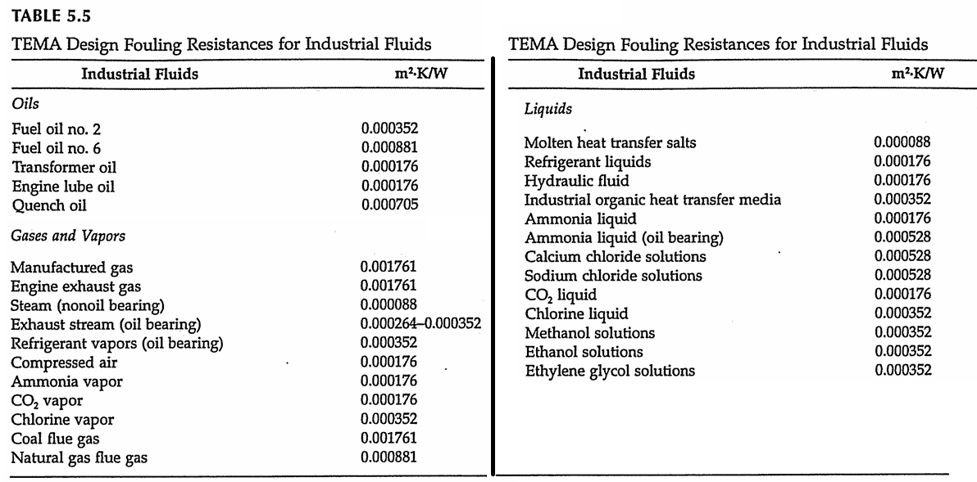
Design of Heat Exchangers Subject to Fouling

Slide 16
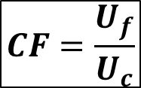
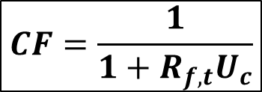
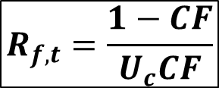
Design of Heat Exchangers Subject to Fouling
Cleanliness Factor (CF) relates the overall heat transfer coefficient when the heat exchanger is fouled to when it is clean:
$$CF=\frac{U_{f}}{U_{c}}$$
It is apparent from above equation that this approach provides a fouling allowance that varies directly with the clean surface overall heat transfer coefficient. The cleanless factor can be related to the total fouling resistance:
$$R_{f,t}=\frac{1−CF}{U_{c}CF}$$
$$CF=\frac{1}{{1+R_{f,t}U}_{c}}$$

Slide 17
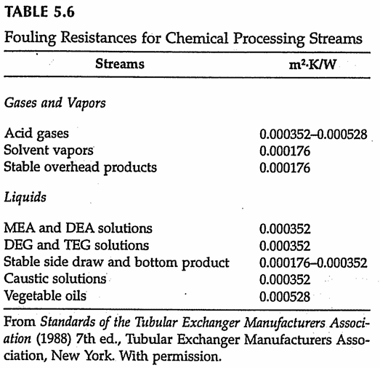
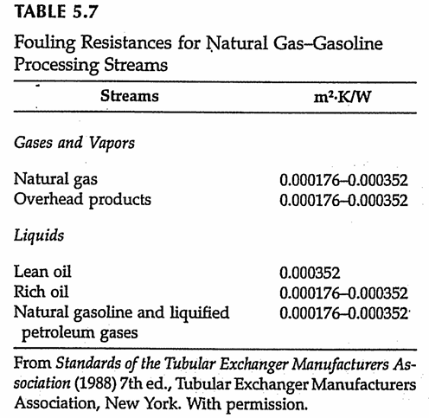
Design of Heat Exchangers Subject to Fouling

Slide 18
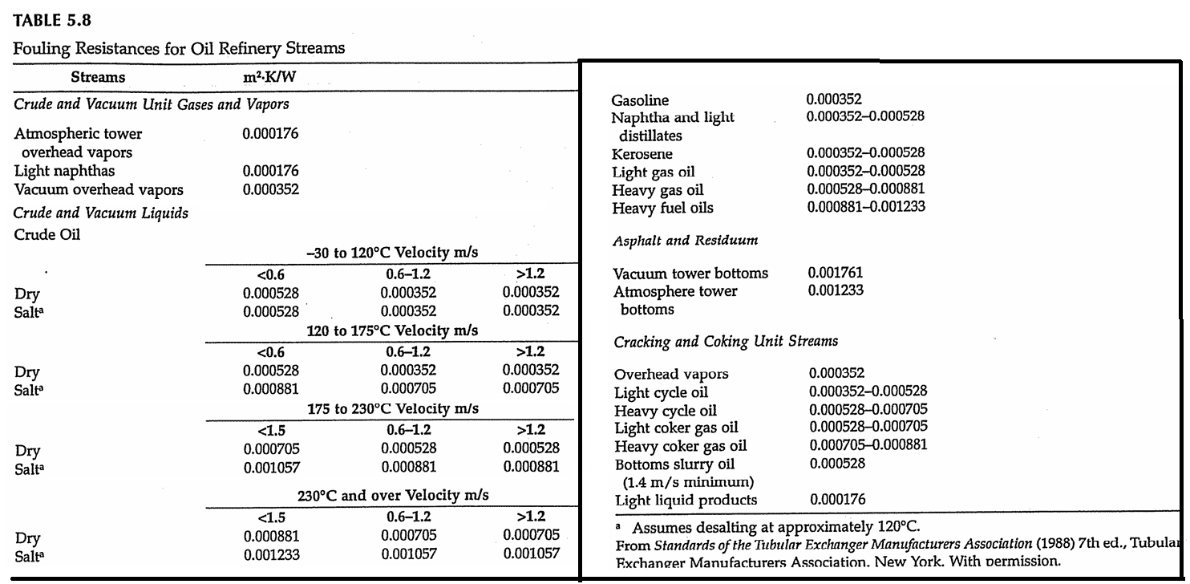
Design of Heat Exchangers Subject to Fouling

Slide 19
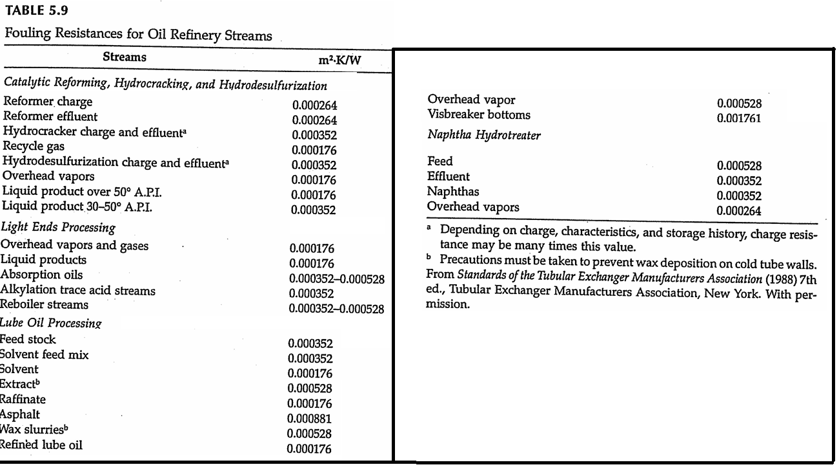
Design of Heat Exchangers Subject to Fouling

Slide 20
Design of Heat Exchangers Subject to Fouling

Slide 21
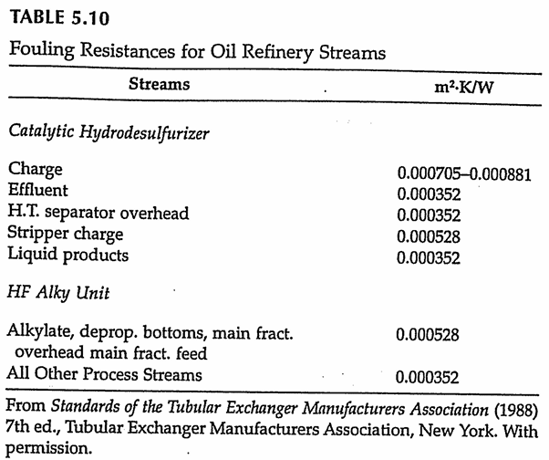
Design of Heat Exchangers Subject to Fouling

Slide 22
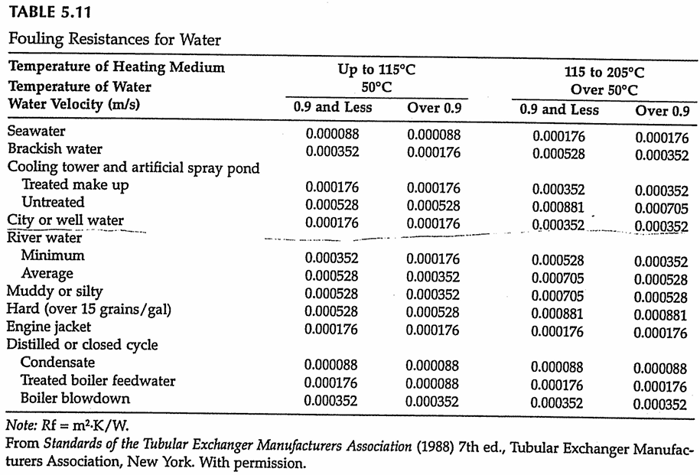
Design of Heat Exchangers Subject to Fouling

Slide 23
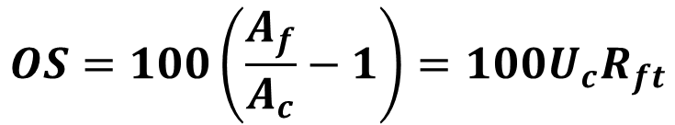
Design of Heat Exchangers Subject to Fouling
If heat transfer rate and fluid temperatures under clean and fouled conditions are the same $\left(Q_{f}=Q_{c} and {∆T}_{inf}={∆T}_{inc}\right),$ the percentage over surface (OS) can be obtained as follows:
$$OS=100\left(\frac{A_{f}}{A_{c}}−1\right)=100U_{c}R_{ft}$$
In a Shell and tube heat exchanger, the additional surface can be provided either by incresing the length of tubes or by increasing the number of tubes (hence the Shell diameter). Such a change will affect the design conditions such as flow velocities, number of cross passes, or baffle spacing. Therefore, the new design with the increased surface should be related to achieve optimum conditions.

Slide 24
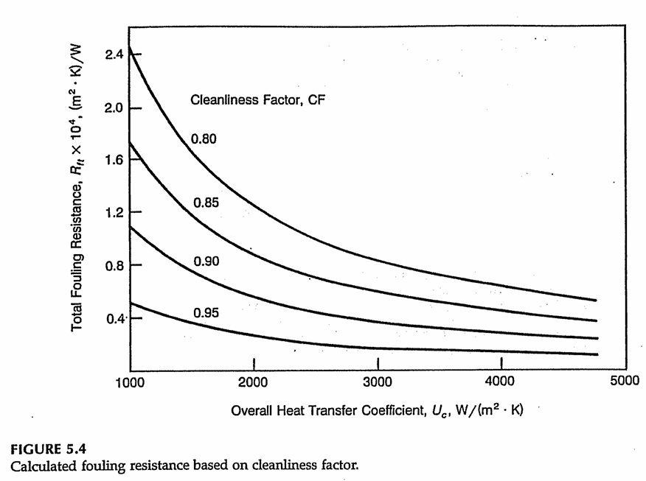
Design of Heat Exchangers Subject to Fouling

Slide 25
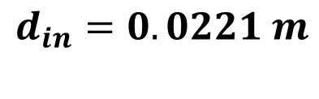
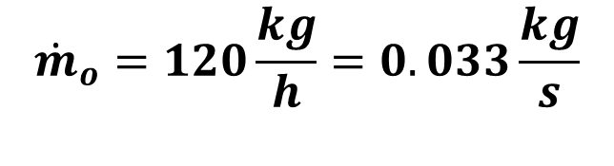
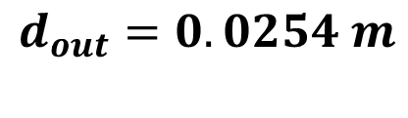
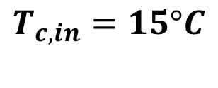

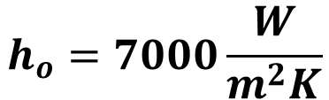

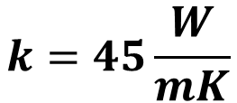
EXAMPLE 5.1
A double-pipe of heat exchanger is used to condense steam at a rate of 120 kg/h at 45°C. Cooling water (seawater) enters through the inner tube at a rate of 1.2 kg/s at 15°C. The tube with 25.4 mm outer diameter and 22.1 mm inner diameter is made of mild steel, k=45 W/m-K. The heat transfer coefficient on the steam side, h_{o}, is 7000 W/m²K. Calculate the overall heat transfer coefficient under clean and fouled conditions. (For water: c_{p}=4.18 kJ/kgK and h_{fg}=2392 kJ/kg)
$${\dot{m}}_{o}=120\frac{kg}{h}=0.033\frac{kg}{s}$$
Condense Steam:
$$T_{h}=45°C$$
$${\dot{m}}_{i}=1.2\frac{kg}{s}$$
Cooling water (seawater):
$$T_{c,in}=15°C$$
$$d_{out}=0.0254 m$$
$$k=45\frac{W}{mK}$$
$$h_{o}=7000\frac{W}{m^{2}K}$$
$$d_{in}=0.0221 m$$

Slide 26

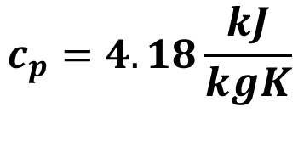



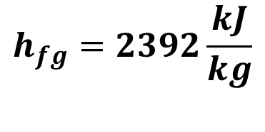
EXAMPLE 5.1
The exit temperature of the water can be obtained from the heat balance equation:
$$c_{p}=4.18\frac{kJ}{kgK}$$
$$h_{fg}=2392\frac{kJ}{kg}$$
$$Q={\dot{m}}_{o}h_{fg}={\dot{m}}_{i}c_{p}\left(T_{out}−T_{in}\right)$$
$$Q={\dot{m}}_{o}h_{fg}=0.033x(2392)$$
$$Q=79.73 kW$$
$$Q={\dot{m}}_{i}c_{p}\left(T_{out}−T_{in}\right)$$
$$79.73x10^{3}=1.2(4.18x10^{3}) \left(T_{out}−15\right)$$
$$T_{out}=30.89°C$$

Slide 27
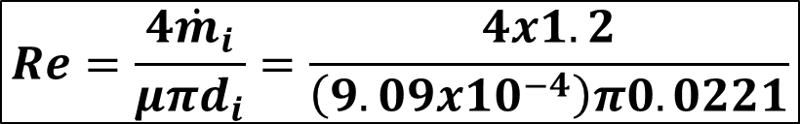
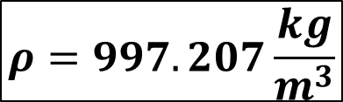
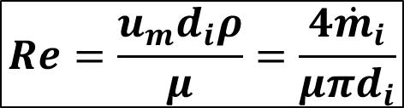

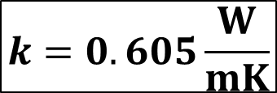


EXAMPLE 5.1
At the mean temperature of 23°C, the properties of water are:
$$ρ=997.207\frac{kg}{m^{3}}$$
$$k=0.605\frac{W}{mK}$$
$$Pr=6.29$$
$$μ=9.09x10^{−4}Pa∙s$$
Reynolds number:
$$Re=\frac{u_{m}d_{i}ρ}{μ}=\frac{4{\dot{m}}_{i}}{μπd_{i}}$$
$$Re=\frac{4{\dot{m}}_{i}}{μπd_{i}}=\frac{4x1.2}{\left(9.09x10^{−4}\right)π0.0221}$$
$$Re=76056>2300$$
The flow is turbulent.

Slide 28


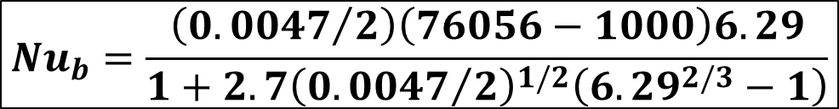
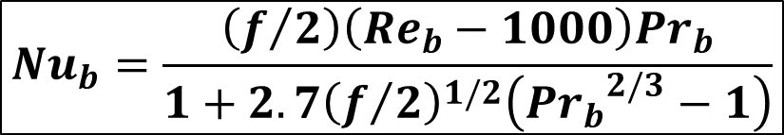





EXAMPLE 5.1
The heat transfer coefficient inside the tube can be calculated by the use of the correlation given for turbulent flow. The Gnielinski correlation for constant properties is used here:
$$f={\left(1.58ln\left(Re\right)−3.28\right)}^{−2}$$
$$f={\left(1.58ln\left(76056\right)−3.28\right)}^{−2}$$
$$f=0.0047$$
$${Nu}_{b}=\frac{\left(f/2\right)\left({Re}_{b}−1000\right){Pr}_{b}}{1+2.7{\left(f/2\right)}^{1/2}\left({{Pr}_{b}}^{2/3}−1\right)}$$
$${Nu}_{b}=\frac{\left({0.0047}/2\right)\left(76056−1000\right)6.29}{1+2.7{\left({0.0047}/2\right)}^{1/2}\left({6.29}^{2/3}−1\right)}$$
$${Nu}_{b}=447$$
$$h_{i}=\frac{{Nu}_{b}k}{d_{i}}$$
$$h_{i}=\frac{447x0.605}{0.0221}$$
$$h_{i}=12236.9\frac{W}{m^{2}K}$$

Slide 29




EXAMPLE 5.1
The overall heat transfer coefficient for the clean and fouled surfaces based on the oturside surface area of the tube are:
$$U_{c}=\frac{1}{\frac{d_{o}}{d_{i}}\frac{1}{h_{i}}+\frac{d_{o}ln\left({d_{o}}/{d_{i}}\right)}{2k}+\frac{1}{h_{o}}}$$
$$U_{f}=\frac{1}{\frac{d_{o}}{d_{i}}\frac{1}{h_{i}}+\frac{d_{o}}{d_{i}}R_{f,i}+\frac{d_{o}ln\left({d_{o}}/{d_{i}}\right)}{2k}+R_{f,o}+\frac{1}{h_{o}}}$$
From Table 5.11:
$$R_{f,i}=0.0088\frac{m^{2}K}{kW}$$
for seawater
$$R_{f,o}=0.0088\frac{m^{2}K}{kW}$$
for condensate

Slide 30



EXAMPLE 5.1
The overall heat transfer coefficient for the clean and fouled surfaces based on the oturside surface area of the tube are:
$$U_{c}=\frac{1}{\frac{0.0254}{0.0221}\frac{1}{12236.9}+\frac{0.0254ln\left({0.0254}/{0.0221}\right)}{2x45}+\frac{1}{7000}}$$
$$U_{c}=3621.9 W/m^{2}K$$
$$U_{f}=\frac{1}{\frac{0.0254}{0.0221}\frac{1}{12236.9}+\frac{0.0254}{0.0221}0.0088x10^{−3}+\frac{0.0254ln\left({0.0254}/{0.0221}\right)}{2x45}+0.0088x10^{−3}+\frac{1}{7000}}$$
$$U_{f}=3391.96 W/m^{2}K$$

