Slide 1

ME 453
HEAT EXCHANGER DESIGN
2024-2025 / SPRING
Epsilon-NTU METHOD
Dr. Yağmur NALBANT ATAK
Atılım University
Department of Mechanical Engineering

Slide 2
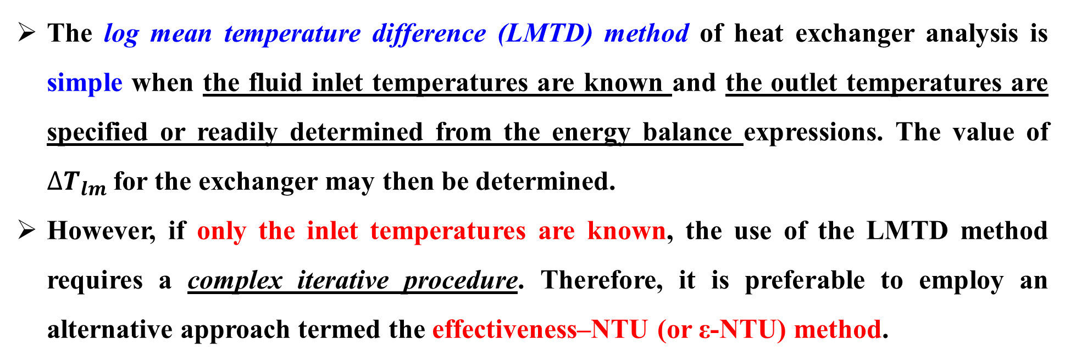
INTRODUCTION TO ε-NTU METHOD
The log mean temperature difference (LMTD) method of heat exchanger analysis is simple when the fluid inlet temperatures are known and the outlet temperatures are specified or readily determined from the energy balance expressions. The value of ${∆T}_{lm}$for the exchanger may then be determined.
However, if only the inlet temperatures are known, the use of the LMTD method requires a complex iterative procedure. Therefore, it is preferable to employ an alternative approach termed the effectiveness–NTU (or ε-NTU) method.

Slide 3
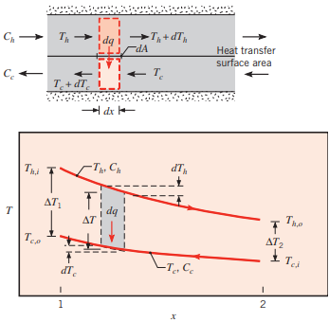

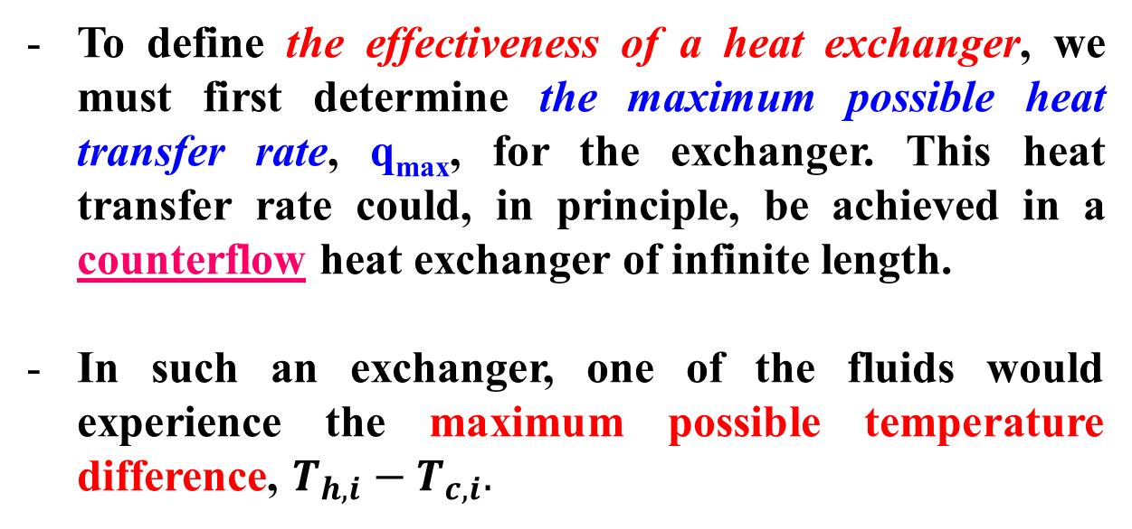


DEFINITIONS FOR ε-NTU METHOD
To define the effectiveness of a heat exchanger, we must first determine the maximum possible heat transfer rate, q_{max}, for the exchanger. This heat transfer rate could, in principle, be achieved in a counterflow heat exchanger of infinite length.
In such an exchanger, one of the fluids would experience the maximum possible temperature difference, $T_{h,i}−T_{c,i}.$
$dq={−\dot{m}}_{h}∙c_{p,h}∙{dT}_{h}=−C_{h}$ ${dT}_{h}$
$dq={\dot{m}}_{c}∙c_{p,c}∙{dT}_{c}=C_{c}$ ${dT}_{c}$
$C_{h}$ and $C_{c}:$ Hot and cold fluid heat capacity rates
$$C_{c}={\dot{m}}_{c}∙c_{p,c}$$
$$C_{h}={\dot{m}}_{h}∙c_{p,h}$$

Slide 4
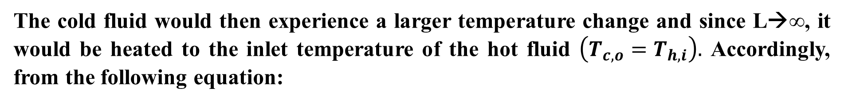







DEFINITIONS FOR ε-NTU METHOD
FOR EXAMPLE: Consider a situation for which $C_{c}<C_{h},$in which case, from the following equations,
$dq={−\dot{m}}_{h}∙c_{p,h}∙{dT}_{h}=−C_{h}$ ${dT}_{h}$
$$−C_{h} {dT}_{h}=C_{c} {dT}_{c}$$
$$\left|{dT}_{h}\right|<\left|{dT}_{c}\right|$$
$dq={\dot{m}}_{c}∙c_{p,c}∙{dT}_{c}=C_{c}$ ${dT}_{c}$
The cold fluid would then experience a larger temperature change and since L→∞, it would be heated to the inlet temperature of the hot fluid $\left(T_{c,o}=T_{h,i}\right).$ Accordingly, from the following equation:
$$q={\dot{m}}_{c}∙c_{p,c}∙\left(T_{c,o}−T_{c,i}\right)$$
$$q_{max}=C_{c}∙\left(T_{h,i}−T_{c,i}\right)$$
$C_{h}$ and $C_{c}:$ Hot and cold fluid heat capacity rates
$$C_{c}={\dot{m}}_{c}∙c_{p,c}$$
$$C_{h}={\dot{m}}_{h}∙c_{p,h}$$

Slide 5





DEFINITIONS FOR ε-NTU METHOD
To calculate maximum possible heat transfer rate ($q_{max}$):
If
$$C_{c}<C_{h}$$
$$q_{max}=C_{c}∙\left(T_{h,i}−T_{c,i}\right)$$
If
$$C_{h}<C_{c}$$
$$q_{max}=C_{h}∙\left(T_{h,i}−T_{c,i}\right)$$
From the foregoing results, we are then prompted to write the general expression
$$q_{max}=C_{min}∙\left(T_{h,i}−T_{c,i}\right)$$

Slide 6
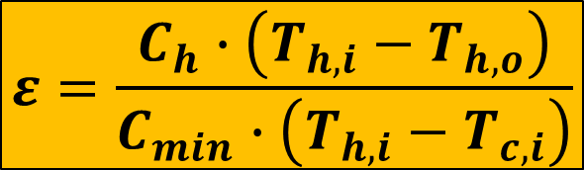

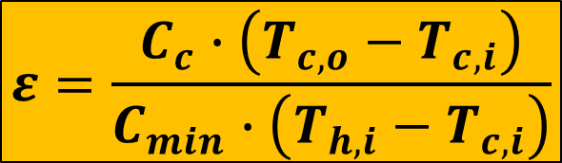



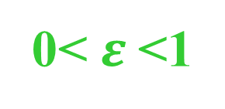
DEFINITIONS FOR ε-NTU METHOD
It is now logical to define the effectiveness, ε, as the ratio of the actual heat transfer rate for a heat exchanger to the maximum possible heat transfer rate:
$$ε=\frac{q}{q_{max}}$$
Actual heat transfer rate
0< $ε$<1
Maximum possible heat transfer rate
$$q=C_{c}∙\left(T_{c,o}−T_{c,i}\right)$$
$$ε=\frac{C_{c}∙\left(T_{c,o}−T_{c,i}\right)}{C_{min}∙\left(T_{h,i}−T_{c,i}\right)}$$
OR
OR
$$q=C_{h}∙\left(T_{h,i}−T_{h,o}\right)$$
$$ε=\frac{C_{h}∙\left(T_{h,i}−T_{h,o}\right)}{C_{min}∙\left(T_{h,i}−T_{c,i}\right)}$$
$$q_{max}=C_{min}∙\left(T_{h,i}−T_{c,i}\right)$$

Slide 7
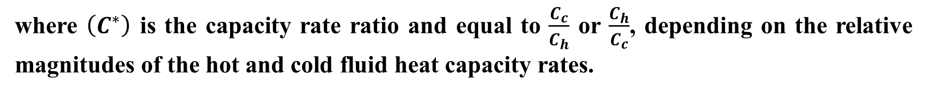
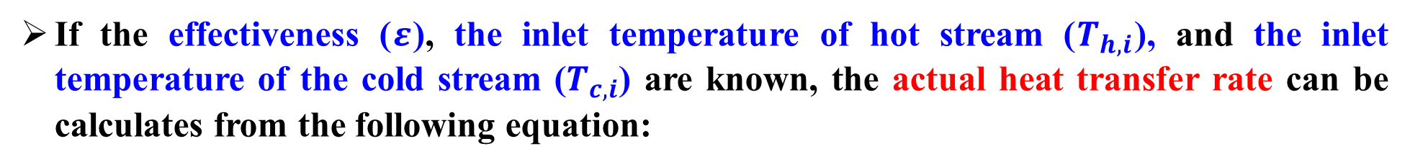


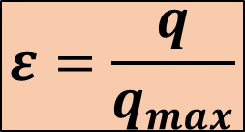
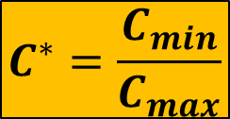


DEFINITIONS FOR ε-NTU METHOD
If the effectiveness ($ε$), the inlet temperature of hot stream ($T_{h,i}$), and the inlet temperature of the cold stream ($T_{c,i}$) are known, the actual heat transfer rate can be calculates from the following equation:
$$ε=\frac{q}{q_{max}}$$
$$q_{max}=C_{min}∙\left(T_{h,i}−T_{c,i}\right)$$
$$q=ε∙C_{min}∙\left(T_{h,i}−T_{c,i}\right)$$
For any heat exchanger it can be shown that:
$$C^{∗}=\frac{C_{min}}{C_{max}}$$
$$ε=f\left(NTU, C^{∗}\right)$$
where $\left(C^{∗}\right)$ is the capacity rate ratio and equal to $\frac{C_{c}}{C_{h}}$ or $\frac{C_{h}}{C_{c}}$, depending on the relative magnitudes of the hot and cold fluid heat capacity rates.
Number of Transfer Units (NTU) or heat transfer area number is a dimensionless parameter that is widely used for heat exchanger analysis and is defined as:
$$NTU≡\frac{U∙A}{C_{min}}=\frac{1}{C_{min}}\int{UdA}$$

Slide 8

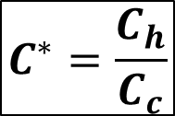


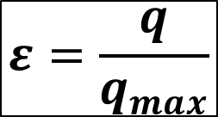
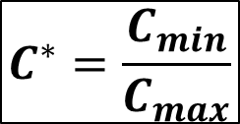

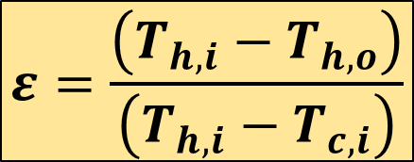
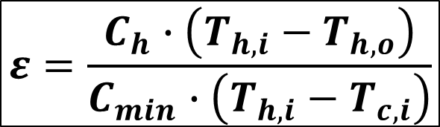

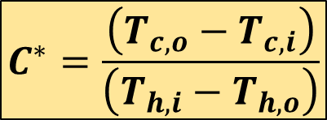
Effectiveness-NTU Relations-Parallel Flow
FOR EXAMPLE: Consider a parallel flow heat exchanger for which $C_{min}=C_{h}.$ To determine a specific form of the effectiveness-NTU relation can be found as follows:
$$C_{min}=C_{h}$$
$$C_{max}=C_{c}$$
$$ε=\frac{C_{h}∙\left(T_{h,i}−T_{h,o}\right)}{C_{min}∙\left(T_{h,i}−T_{c,i}\right)}$$
$$ε=\frac{q}{q_{max}}$$
$$C^{∗}=\frac{C_{min}}{C_{max}}$$
$$ε=\frac{\left(T_{h,i}−T_{h,o}\right)}{\left(T_{h,i}−T_{c,i}\right)}$$
$$q=C_{c}∙\left(T_{c,o}−T_{c,i}\right)$$
OR
$$q=C_{h}∙\left(T_{h,i}−T_{h,o}\right)$$
$$C^{∗}=\frac{C_{h}}{C_{c}}$$
$$C^{∗}=\frac{\left(T_{c,o}−T_{c,i}\right)}{\left(T_{h,i}−T_{h,o}\right)}$$
$$q_{max}=C_{min}∙\left(T_{h,i}−T_{c,i}\right)$$

Slide 9
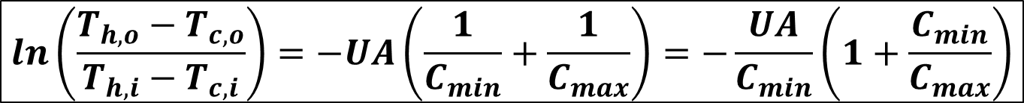
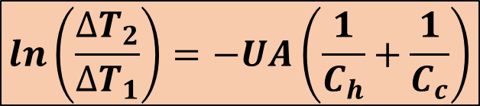


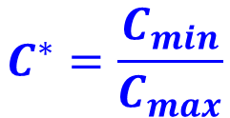



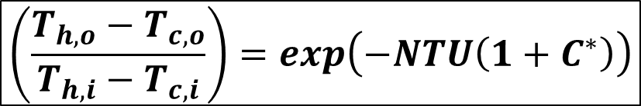
Effectiveness-NTU Relations-Parallel Flow
$$ln\left(\frac{{∆T}_{2}}{{∆T}_{1}}\right)=−UA\left(\frac{1}{C_{h}}+\frac{1}{C_{c}}\right)$$
Now, consider the following equation:
We know the temperature difference for the parallel flow:
$${∆T}_{1}=T_{h,i}−T_{c,i}$$
$${∆T}_{2}=T_{h,o}−T_{c,o}$$
When we combined the given equations:
$$C_{min}=C_{h}$$
$$C_{max}=C_{c}$$
$$NTU≡\frac{U∙A}{C_{min}}$$
$$ln\left(\frac{T_{h,o}−T_{c,o}}{T_{h,i}−T_{c,i}}\right)=−UA\left(\frac{1}{C_{min}}+\frac{1}{C_{max}}\right)=−\frac{UA}{C_{min}}\left(1+\frac{C_{min}}{C_{max}}\right)$$
$$C^{∗}=\frac{C_{min}}{C_{max}}$$
$$\left(\frac{T_{h,o}−T_{c,o}}{T_{h,i}−T_{c,i}}\right)=exp\left(−NTU\left(1+C^{∗}\right)\right)$$

Slide 10
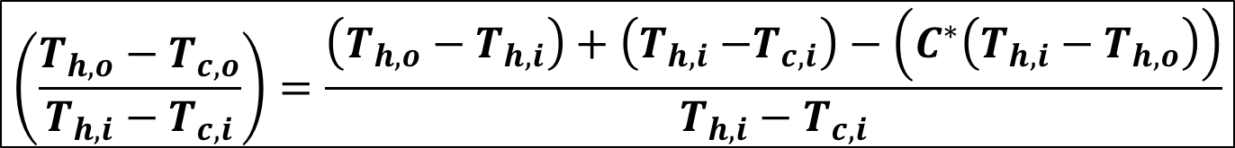
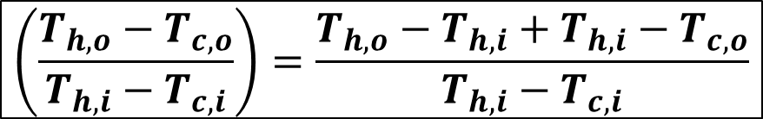
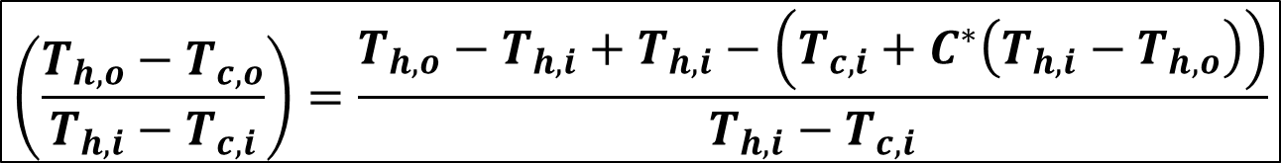
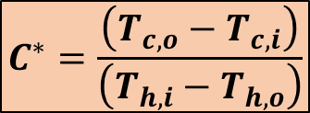

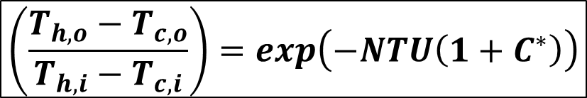
Effectiveness-NTU Relations-Parallel Flow
$$\left(\frac{T_{h,o}−T_{c,o}}{T_{h,i}−T_{c,i}}\right)=exp\left(−NTU\left(1+C^{∗}\right)\right)$$
When we add and subtract $T_{h,i}$ on the left-hand side of the equation:
$$C^{∗}=\frac{\left(T_{c,o}−T_{c,i}\right)}{\left(T_{h,i}−T_{h,o}\right)}$$
$$\left(\frac{T_{h,o}−T_{c,o}}{T_{h,i}−T_{c,i}}\right)=\frac{T_{h,o}−T_{h,i}+T_{h,i}−T_{c,o}}{T_{h,i}−T_{c,i}}$$
$${{T_{c,o}=T}_{c,i}+C}^{∗}\left(T_{h,i}−T_{h,o}\right)$$
$$\left(\frac{T_{h,o}−T_{c,o}}{T_{h,i}−T_{c,i}}\right)=\frac{T_{h,o}−T_{h,i}+T_{h,i}−\left({T_{c,i}+C}^{∗}\left(T_{h,i}−T_{h,o}\right)\right)}{T_{h,i}−T_{c,i}}$$
$$\left(\frac{T_{h,o}−T_{c,o}}{T_{h,i}−T_{c,i}}\right)=\frac{\left(T_{h,o}−T_{h,i}\right)+\left(T_{h,i}{−T}_{c,i}\right)−\left(C^{∗}\left(T_{h,i}−T_{h,o}\right)\right)}{T_{h,i}−T_{c,i}}$$

Slide 11
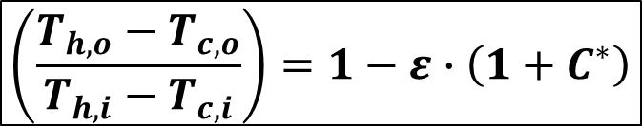
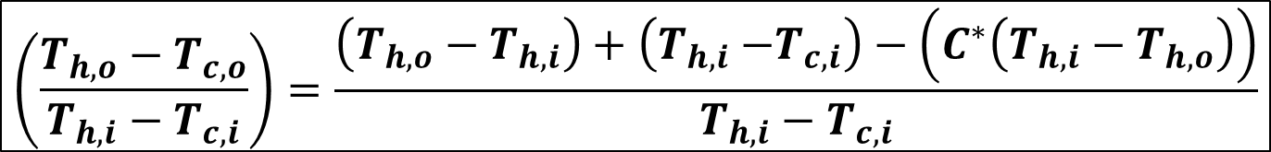

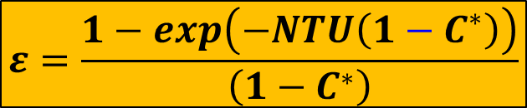
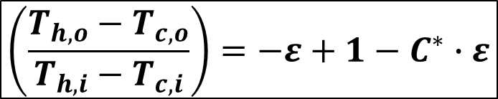
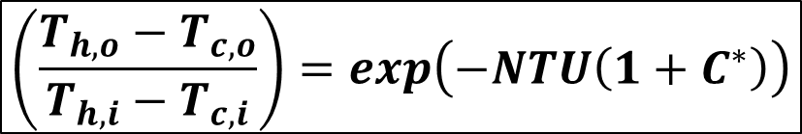

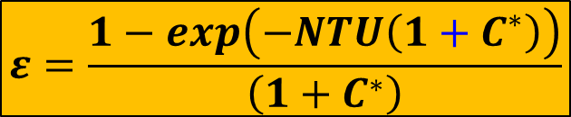
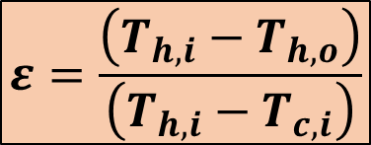
Effectiveness-NTU Relations-Parallel Flow
$$−ε$$
$$ε$$
$$\left(\frac{T_{h,o}−T_{c,o}}{T_{h,i}−T_{c,i}}\right)=\frac{\left(T_{h,o}−T_{h,i}\right)+\left(T_{h,i}{−T}_{c,i}\right)−\left(C^{∗}\left(T_{h,i}−T_{h,o}\right)\right)}{T_{h,i}−T_{c,i}}$$
$$ε=\frac{\left(T_{h,i}−T_{h,o}\right)}{\left(T_{h,i}−T_{c,i}\right)}$$
$$\left(\frac{T_{h,o}−T_{c,o}}{T_{h,i}−T_{c,i}}\right)=−ε+1−C^{∗}∙ε$$
$$1−ε∙\left(1+C^{∗}\right)=exp\left(−NTU\left(1+C^{∗}\right)\right)$$
$$\left(\frac{T_{h,o}−T_{c,o}}{T_{h,i}−T_{c,i}}\right)=1−ε∙\left(1+C^{∗}\right)$$
$$ε=\frac{1−exp\left(−NTU\left(1+C^{∗}\right)\right)}{\left(1+C^{∗}\right)}$$
For Parallel Flow
$$\left(\frac{T_{h,o}−T_{c,o}}{T_{h,i}−T_{c,i}}\right)=exp\left(−NTU\left(1+C^{∗}\right)\right)$$
$$ε=\frac{1−exp\left(−NTU\left(1−C^{∗}\right)\right)}{\left(1−C^{∗}\right)}$$
For Counter Flow

Slide 12
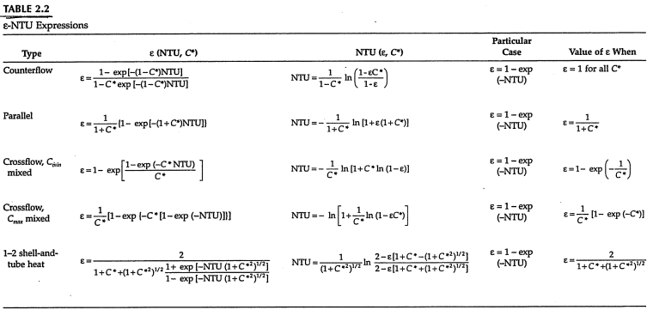
Effectiveness-NTU Relations

Slide 13

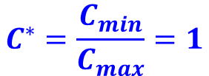
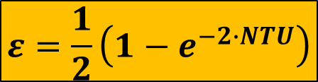
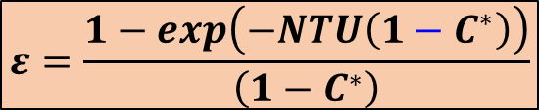
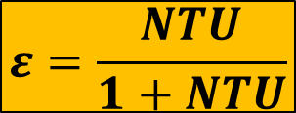
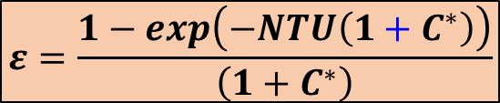

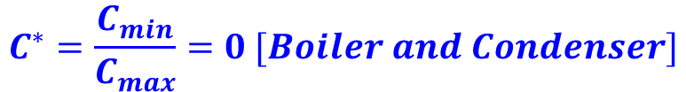

Effectiveness-NTU Relations
For Parallel Flow
For Counter Flow
$$ε=\frac{1−exp\left(−NTU\left(1+C^{∗}\right)\right)}{\left(1+C^{∗}\right)}$$
$$ε=\frac{1−exp\left(−NTU\left(1−C^{∗}\right)\right)}{\left(1−C^{∗}\right)}$$
TWO LIMITING CASES
$$C^{∗}=\frac{C_{min}}{C_{max}}=1$$
$$C^{∗}=\frac{C_{min}}{C_{max}}=0 [Boiler and Condenser]$$
For Parallel Flow:
$$ε=\frac{1}{2}\left(1−e^{−2∙NTU}\right)$$
For Parallel Flow:
$$ε=1−e^{−NTU}$$
For Counter Flow:
$$ε=\frac{0}{0}=indeterminate$$
For Counter Flow:
$$ε=1−e^{−NTU}$$
$$ε=\frac{NTU}{1+NTU}$$

Slide 14



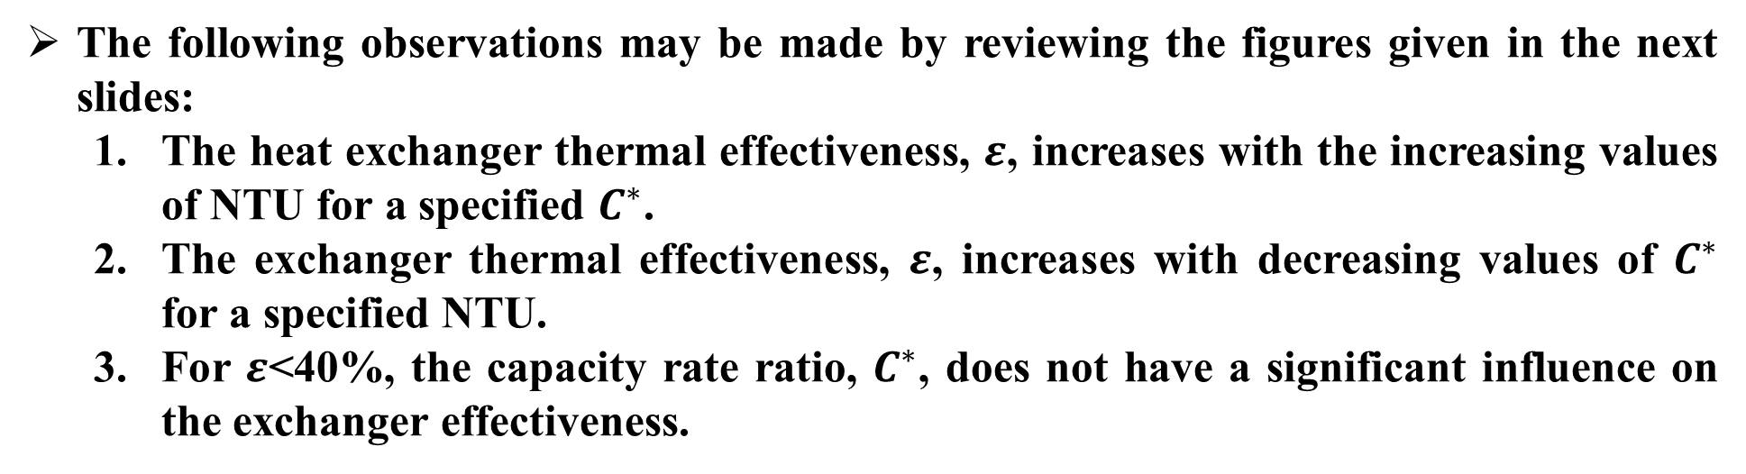
Effectiveness-NTU Relations
Effectiveness is a function of:
$$ε=f(NTU, C^{∗}, flow arrangement)$$
The following observations may be made by reviewing the figures given in the next slides:
  The heat exchanger thermal effectiveness, $ε$, increases with the increasing values of NTU for a specified $C^{∗}$.
  The exchanger thermal effectiveness, $ε$, increases with decreasing values of $C^{∗}$ for a specified NTU.
  For $ε$<40%, the capacity rate ratio, $C^{∗}$, does not have a significant influence on the exchanger effectiveness.
$$ε$$
$$NTU$$
$$C^{∗}$$
The counterflow exchanger has the highest exchanger effectiveness & for specified NTU and C* values compared with those for all other exchanger flow arrangements. Thus, a maximum heat transfer performance is achieved for counterflow compared with all other flow arrangements.

Slide 15
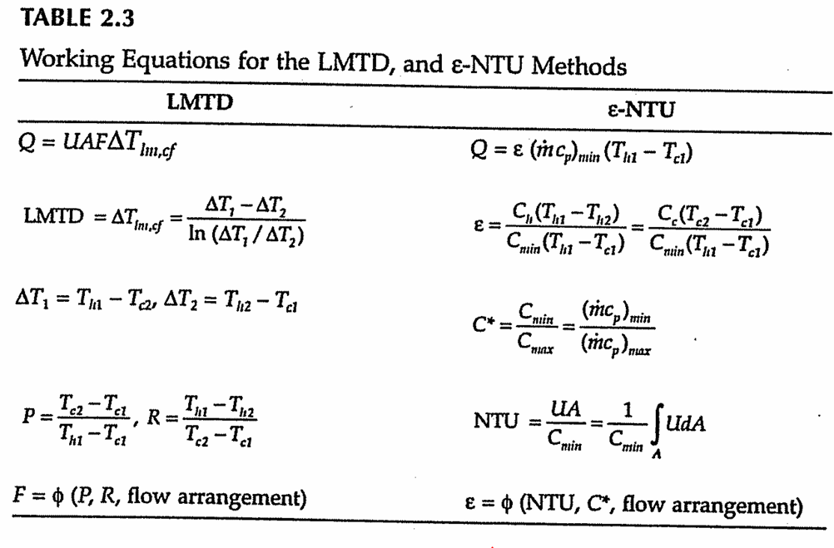
Effectiveness-NTU Relations

Slide 16




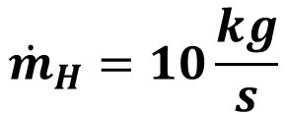
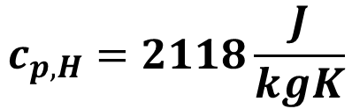
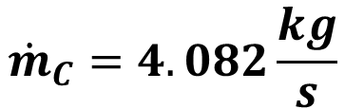
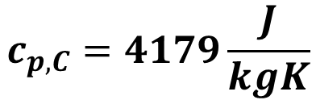
EXAMPLE-1
A two-pass tube, baffled single-pass shell, shell-and-tube heat exchanger is used as an oil cooler. Cooling water flows through the tubes at 20°C at a flow rate of 4.082 kg/s. Engine oil enters the shell side at a flow rate of 10 kg/s. The inlet and outlet temperatures of oil are 90 and 60°C, respectively. Determine the surface area of the heat exchanger by both the LMTD and ε-NTU methods if the overall heat transfer coefficient based on the outside tube area is 262 W/m²K. The specific heats of water and oil are 4179 J/kg∙K and 2118 J/kg∙K, respectively.
$$U=262\frac{W}{m^{2}K}$$
Cooling Water:
Engine Oil:
$$T_{C,i}=20°C$$
$$T_{H,i}=90°C$$
$$T_{H,o}=60°C$$
$${\dot{m}}_{C}=4.082\frac{kg}{s}$$
$${\dot{m}}_{H}=10\frac{kg}{s}$$
$$c_{p,C}=4179\frac{J}{kgK}$$
$$c_{p,H}=2118\frac{J}{kgK}$$

Slide 17
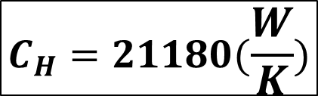

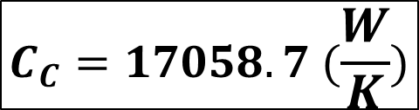






EXAMPLE-1-Solution - LMTD
LMTD Method:
Heat capacity rates for shell fluid (oil) and tube fluid (water):
$$C_{C}=4.082 \left(\frac{kg}{s}\right)∙4179(\frac{J}{kgK})$$
$$C_{C}=17058.7 (\frac{W}{K})$$
$$C_{C}={\dot{m}}_{C}∙c_{p,C}$$
$$C_{H}=10\left(\frac{kg}{s}\right)∙2118(\frac{J}{kgK})$$
$$C_{H}=21180(\frac{W}{K})$$
$$C_{H}={\dot{m}}_{H}∙c_{p,H}$$
Heat transfer rate from the temperature drop of the oil is:
$$Q=C_{H}\left(T_{H,i}−T_{H,o}\right)$$
$$Q=21180\left(90−60\right)$$
$$Q=635400 W$$

Slide 18







EXAMPLE-1-Solution - LMTD
The water outlet temperature from the energy balance is:
$$Q=C_{C}\left(T_{C,o}−T_{C,i}\right)$$
$$Q=17058.7\left(T_{C,o}−20\right)$$
$$T_{C,o}=57.25 °C$$
$$Q=635400 W$$
Now, let us determine ${∆T}_{LM,CF}$:
$${∆T}_{lm,CF}=\frac{\left(\left(T_{h,2}−T_{c,1}\right)−\left(T_{h,1}−T_{c,2}\right)\right)}{ln\left(\frac{T_{h,2}−T_{c,1}}{T_{h,1}−T_{c,2}}\right)}$$
$${∆T}_{lm,CF}=\frac{\left(\left(60−20\right)−\left(90−57.25\right)\right)}{ln\left(\frac{60−20}{90−57.25}\right)}$$
$${∆T}_{lm,CF}=36.3°C$$

Slide 19







EXAMPLE-1-Solution - LMTD
Now, the values of P and R are:
$$P=\frac{\left(T_{c,2}−T_{c,1}\right)}{\left(T_{h,1}−T_{c,1}\right)}=\frac{∆T_{c}}{{∆T}_{max}}$$
$$P=\frac{\left(57.25−20\right)}{\left(90−20\right)}$$
$$P=0.532$$
$$R=\frac{C_{c}}{C_{h}}=\frac{\left(T_{h,1}−T_{h,2}\right)}{\left(T_{c,2}−T_{c,1}\right)}$$
$$R=\frac{\left(90−60\right)}{\left(57.25−20\right)}$$
$$R=0.805$$
OR
$$R=\frac{17058.7}{21180}$$

Slide 20




EXAMPLE-1-Solution - LMTD
$$P=0.532$$
$$R=0.805$$
$$F=0.85$$
One shell pass and two or multiples of two tube passes

Slide 21



EXAMPLE-1-Solution - LMTD
Thus, the heat transfer area is:
$$A =\frac{Q}{U∙F∙{∆T}_{lm,CF}}$$
$$A =\frac{635400}{262∙0.85∙(36.3)}$$
$$A =78.6 m^{2}$$

Slide 22









EXAMPLE-1-Solution - Ꜫ-NTU
In the ɛ-NTU method, we will firstly calculate $ε$ and $C^{∗}$:
In this problem : $C_{min}$= $C_{c}$ and $C_{max}=C_{H}$
$$C^{∗}=\frac{C_{min}}{C_{max}}$$
$$C^{∗}=\frac{17058.7}{21180}$$
$$C^{∗}=0.805$$
$$ε=\frac{C_{c}∙\left(T_{c,o}−T_{c,i}\right)}{C_{min}∙\left(T_{h,i}−T_{c,i}\right)}$$
$$ε=\frac{\left(T_{c,o}−T_{c,i}\right)}{\left(T_{h,i}−T_{c,i}\right)}$$
OR
$C_{min}$= $C_{c}$
$$ε=\frac{C_{h}∙\left(T_{h,i}−T_{h,o}\right)}{C_{min}∙\left(T_{h,i}−T_{c,i}\right)}$$
$$ε=\frac{\left(57.25−20\right)}{\left(90−20\right)}$$
$$ε=0.532$$

Slide 23



EXAMPLE-1-Solution - Ꜫ-NTU
From Table 2.2, for 1 to 2 Shell and tube heat exchanger, we have:
NTU$=\frac{1}{{\left(1+C^{∗^{2}}\right)}^{1/2}}ln\left[\frac{2−ε\left[1+C^{∗}−{\left(1+C^{∗^{2}}\right)}^{1/2}\right]}{2−ε\left[1+C^{∗}+{\left(1+C^{∗^{2}}\right)}^{1/2}\right]}\right]$
NTU$=\frac{1}{{\left(1+{0.805}^{2}\right)}^{1/2}}ln\left[\frac{2−0.532\left[1+0.805−{\left(1+{0.805}^{2}\right)}^{1/2}\right]}{2−0.532\left[1+0.805+{\left(1+{0.805}^{2}\right)}^{1/2}\right]}\right]$
NTU$=1.226$

Slide 24



EXAMPLE-1-Solution - Ꜫ-NTU
Hence, the surface area is:
$$A =\frac{C_{min}}{U}NTU$$
$$A =\frac{17058.7}{262}1.226$$
$$A =79.8 m^{2}$$

Slide 25


Slide 26


Slide 27


Slide 28


Slide 29


Slide 30
Heat Exchanger Design Calculations
General Assumptions:
1. The heat exchanger operates under steady-state, steady-flow conditions.
2. Heat transfer to the surroundings is negligible.
3. There is no heat generation in the heat exchanger.
4. In counterflow and parallel-flow heat exchangers, the temperature of each fluid is uniform over every flow cross section; in crossflow heat exchangers each fluid is considered mixed or unmixed at every cross section depending on the specifications.
5. If there is a phase change in one of the fluid streams flowing through the heat exchanger, phase change occurs at a constant temperature for a single-component fluid at constant pressure.
6. The specific heat at constant pressure is constant for each fluid.
7. Longitudinal heat conduction in the fluid and in the wall is negligible.
8. The overall heat transfer coefficient between the fluids is constant throughout the heat exchanger including the case of phase change.
Assumption 5 is an idealization of a two-phase-flow heat exchanger. Especially, for two- phase flows on both sides, many of the foregoing assumptions are not valid. The design theory of these types of heat exchangers is discussed and practical results are presented in the following chapters.

Slide 31

Heat Exchanger Design Calculations
We have discussed two methods for performing a heat exchanger thermal analysis. The rating and sizing of heat exchangers are two important problems encountered in the thermal analysis of heat exchangers.
For example, if inlet temperatures, one of the fluid outlet temperatures, and mass flow rates are known, then the unknown outlet temperature can be calculated from heat balances and the LMTD method can be used to solve this sizing problem with the following steps:
Calculate Q and the unknown outlet temperature from Equations (2.5) and (2.6).
Calculate ${∆T}_{LM,CF}$from Equation (2.28) and obtain the correction factor F if necessary.
Calculate the overall heat transfer coefficient U.
Determine A from Equation (2.36).
The LMTD method may also be used for rating problems (performance analysis) for an available heat exchanger, but computation would be tedious, requiring iteration because the outlet temperatures are not known.

Slide 32
Heat Exchanger Design Calculations
In such situations the analysis can be simplified by using the ε-NTU method. The rating analysis with the e-NTU method is as follows:
1. Calculate the capacity rate ratio C*= C_{min}/C_{max} and NTU = (UA)/C_{min} from the input data.
2. Determine the effectiveness, ɛ, from the appropriate charts or ε-NTU equations for the given heat exchanger and specified flow arrangement.
3. When ɛ is known, calculate the total heat transfer rate from Equation (2.43).
4. Calculate the outlet temperatures from Equations (2.5) and (2.6).

Slide 33
Heat Exchanger Design Calculations
The ε-NTU method may also be used for the sizing problem, and the procedure is as follows:
1. When the outlet and inlet temperatures are known, calculate ɛ from Equation (2.42).
2. Calculate the capacity rate ratio C* = C_{min}/C_{max}
3. Calculate the overall heat transfer coefficient U.
4. When ε, C*, and the flow arrangement are known, determine NTU from charts or from ε-NTU relations.
5. When NTU is known, calculate the heat transfer surface area A from Equation (2.44).
The use of the ε-NTU method is generally preferred in the design of compact heat exchangers for automotive, aircraft, air-conditioning, and other industrial applications where the inlet temperatures of the hot and cold fluids are specified and the heat transfer rates are to be determined. The LMTD method is traditionally used in the process, power, and petrochemical industries.

Slide 34



Variable Overall Heat Transfer Coefficient
Let us consider a parallel-flow double-pipe heat exchanger. The heat exchanger is divided into increments of surface area ${∆A}_{i}$. For any incremental surface area, the hot- and cold-fluid temperatures are $T_{h,i}$ and $T_{c,i}$, respectively; and it will be assumed that the overall heat transfer coefficient can be expressed as a function of these temperatures:
$$U_{i}=U_{i}\left(T_{h,i},T_{c,i}\right)$$
The increment heat transfer in ${∆A}_{i}$ can be calculated as:
$${∆Q}_{i}=−{\left(\dot{m}∙c_{p}\right)}_{h,i}\left(T_{h,\left(i+1\right)}−T_{h,i}\right)={\left(\dot{m}∙c_{p}\right)}_{c,i}\left(T_{c,\left(i+1\right)}−T_{c,i}\right)$$

Slide 35





Variable Overall Heat Transfer Coefficient
Thus, ${δQ}_{i}$is also given by:
Must be small enough for the accuracy of the solution
$${δQ}_{i}=U_{i}∙{∆A}_{i}\left(T_{h,i}−T_{c,i}\right)$$
$$\frac{d\left(T_{h}−T_{c}\right)}{\left(T_{h}−T_{c}\right)}=−U∙\left(\frac{1}{C_{h}}+\frac{1}{C_{c}}\right)dA$$
For parallel flow arrangement:
In the finite-difference form:
$$\frac{{\left(T_{h}−T_{c}\right)}_{i+1}−{\left(T_{h}−T_{c}\right)}_{i}}{{\left(T_{h}−T_{c}\right)}_{i}}=−U_{i}∙\left(\frac{1}{C_{c,i}}+\frac{1}{C_{h,i}}\right){∆A}_{i}$$
which can be solved for ${\left(T_{h}−T_{c}\right)}_{i+1}$:
$${\left(T_{h}−T_{c}\right)}_{i+1}={\left(T_{h}−T_{c}\right)}_{i}∙\left(1−M_{i}{∆A}_{i}\right)$$
$$M_{i}=U_{i}∙\left(\frac{1}{C_{c,i}}+\frac{1}{C_{h,i}}\right)$$

Slide 36

Variable Overall Heat Transfer Coefficient
The numerical analysis can be conducted as follows:
1. Select a convenient value of ${∆A}_{i}$ for the analysis.
2. Calculate the inner and outer heat transfer coefficients and the value of U for
the inlet conditions and through the initial $∆A$ increment.
3. Calculate the value of ${∆Q}_{i}$; for this increment from Equation (2.54).
4. Calculate the values of $T_{h}$ , $T_{c}$ , and $T_{h}−T_{c}$for the next.

Slide 37



Variable Overall Heat Transfer Coefficient
$$Q_{i}=\sum_{i,=1}^{n}{{∆Q}_{i}}$$
The total heat transfer rate is then calculated from:
For the overall heat transfer coefficient $U$ and $∆T$ varying linearly with $∆A$, Colburn recommended the following expression to calculate Q:
$$Q=U_{m}∙A∙{∆T}_{lm}=\frac{A∙\left(U_{2}{∆T}_{1}−U_{1}{∆T}_{2}\right)}{ln\left[{\left(U_{2}{∆T}_{1}\right)}/{\left(U_{1}{∆T}_{2}\right)}\right]}$$
$$\frac{1}{U_{m}}=\frac{1}{U_{1}}\left[\frac{{∆T}_{lm}−{∆T}_{2}}{{∆T}_{1}−{∆T}_{2}}\right]=\frac{1}{U_{2}}\left[\frac{{∆T}_{1}−{∆T}_{lm}}{{∆T}_{1}−{∆T}_{2}}\right]$$

Slide 38


