Slide 1

ME 453
HEAT EXCHANGER DESIGN
Introduction and Classifications of Heat Exchangers
Dr. Yağmur NALBANT ATAK
Atılım University
Department of Mechanical Engineering

Slide 2
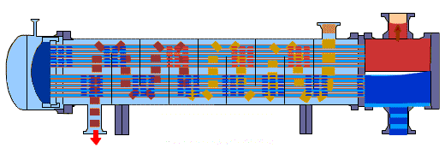
INTRODUCTION
Heat exchangers are devices that provide the flow of thermal energy between two or more fluids at different temperatures.
Power production
Process, chemical, and food industries
Electronics
Environmental engineering
Waste heat recovery
Manufacturing industry
Air-conditioning, refrigeration, and space applications

Slide 3
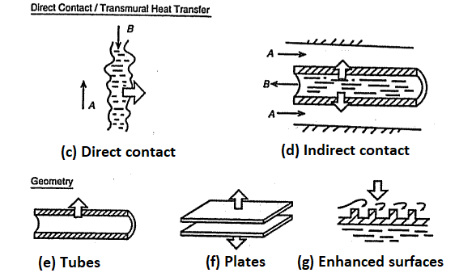
INTRODUCTION
Transfer processes
  Direct contact
  Indirect contact
Geometry of construction
  Tubes
  Plates
  Extended surfaces

Slide 4
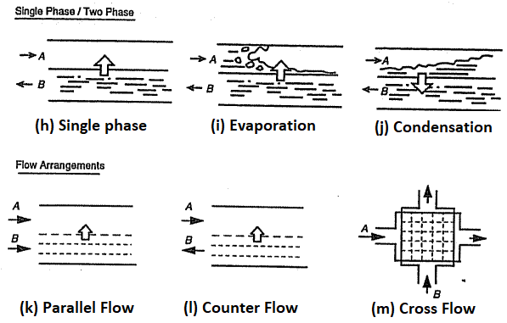
INTRODUCTION
Heat transfer mechanisms
  Single phase
  Two phase
Flow arrangements
  Parallel
  Counter
  Crossflows

Slide 5
1. TRANSFER PROCESSES
DIRECT CONTACT:
INDIRECT CONTACT:
The two fluids come into direct contact with each other, allowing for the transfer of heat through mixing with the physical interaction and intermixing of the fluids.
In this process, the heat is transferred from the hotter fluid to the cooler fluid through conduction, convection, and sometimes evaporation or condensation.
They keep the two fluids physically separated and do not allow them to mix.
The heat transfer occurs through a solid barrier or wall.
The heat is transferred from the hotter fluid to the solid wall through conduction, and then from the solid wall to the cooler fluid on the other side through conduction again.
Steam in
Cold liquid in
Cold liquid in
Steam in
Warm liquid out
Warm liquid out
Hot condensate out
Notes:
These heat exchangers are often efficient at achieving a high degree of heat transfer due to the direct thermal interaction between the fluids.

Slide 6
2. GEOMETRY OF CONSTRUCTION
3.1. TUBULAR
3.2. PLATE
Double pipe
Spiral tube type
Gasketed-plate
Lamella
Shell and tube
Spiral plate
3.3 EXTENDED SURFACE
Plate Fin
Tube Fin

Slide 7
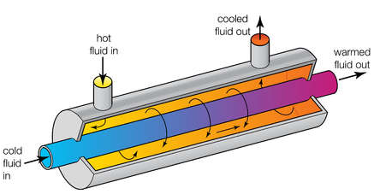
2.1.1 TUBULAR – Double Pipe Heat Exchanger
One pipe is placed concentrically inside another of a larger diameter to direct the flow from one section to the next.
They can have either parallel or counter flow
Heat transfer in a double pipe heat exchanger occurs through conduction across the tube wall.
The process fluid transfers heat to the inner tube wall through convection, and then the heat is conducted through the tube wall to the outer tube.
Advantages of double pipe heat exchangers include their simple design, ease of maintenance, and ability to handle fluids with high-temperature differences.
They are cost-effective and have lower pressure drop than other heat exchangers.
Main limitation is their relatively low heat transfer capacity compared to the others. They are not typically suitable for high-duty applications or situations where large heat transfer areas are required.

Slide 8
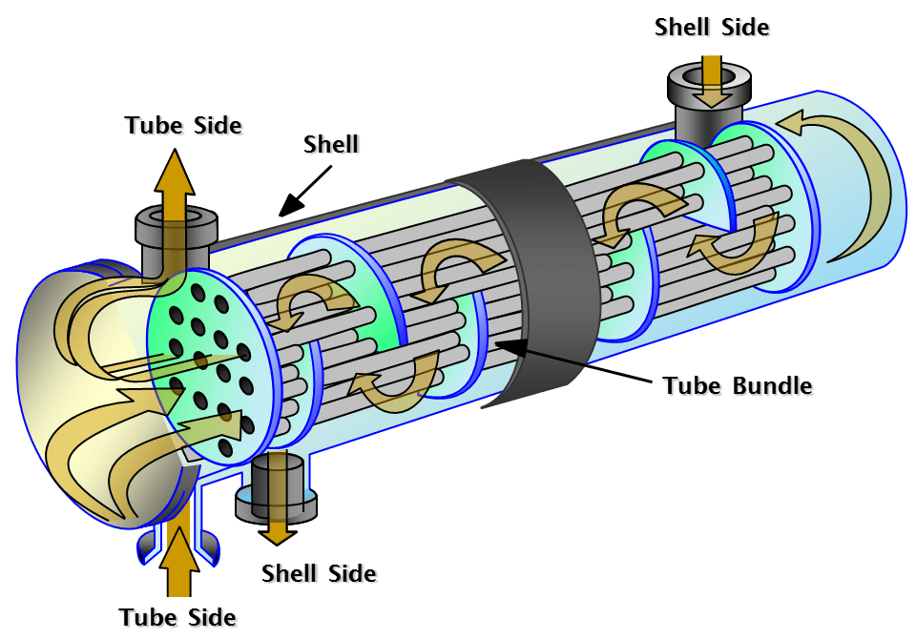
2.1.2. TUBULAR – Shell and Tube Heat Exchanger
They consist of a shell, typically a cylindrical vessel, and a bundle of tubes within the shell. One fluid flows inside the tubes (tube-side fluid), while the other fluid flows outside the tubes within the shell (shell-side fluid).
Shell and tube heat exchangers can have either a parallel flow or a counterflow arrangement.
Heat transfer in a shell and tube heat exchanger occurs through convection and conduction.
Advantages: high heat transfer efficiency, compatibility with high-pressure and high-temperature applications, and ease of maintenance.
Disadvantages: tend to be larger and more complex, higher manufacturing costs and pressure drops compared to other heat exchanger types.

Slide 9
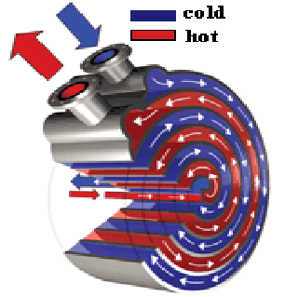
2.1.3. TUBULAR – Spiral Tube Heat Exchanger
Spiral tube heat exchangers, also known as spiral heat exchangers or helical heat exchangers, are specialized types of heat exchangers that feature a unique spiral design.
Spiral tube heat exchangers consist of two flat sheets, that are wound in a spiral pattern to create a series of parallel channels.
Heat transfer in a spiral tube heat exchanger occurs through a combination of conduction and forced convection.
Advantages: Compact design, high heat transfer coefficient, resistance to fouling, Versatility
Disadvantages: Pressure drop and manufacturing complexity

Slide 10
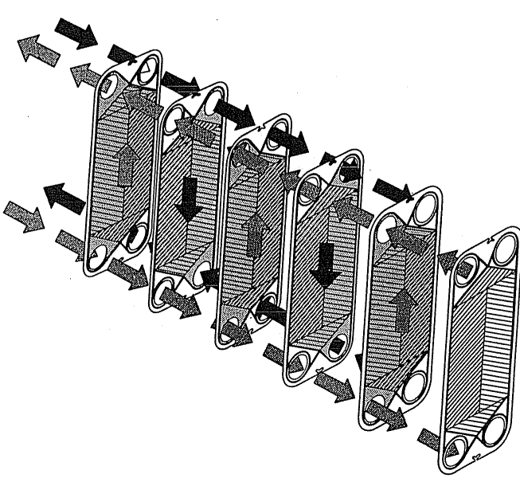
2.2.1 PLATE – Gasketed-plate Heat Exchanger
Gasketed plate heat exchangers consist of multiple plates with alternating patterns. The plates have corrugations that create flow channels for the fluids.
Counterflow: Gasketed plate heat exchangers typically operate in a counterflow arrangement, where the hot and cold fluids flow in opposite directions.
Heat transfer in a gasketed plate heat exchanger occurs through a combination of conduction and forced convection.
Advantages: compact design, high heat transfer efficiency, flexibility and scalability, easy maintenance
Disadvantages: pressure and temperature limitations, fouling sensitivity

Slide 11
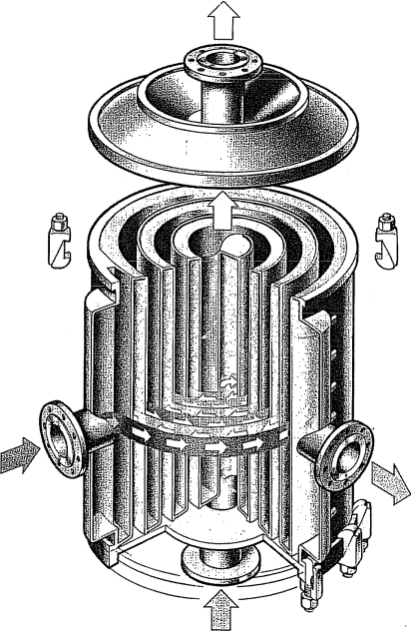
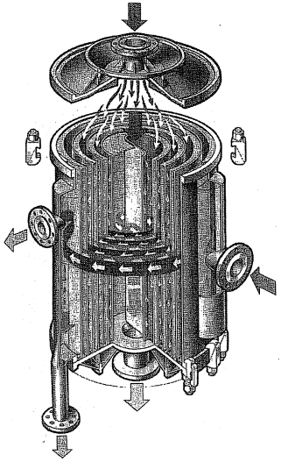
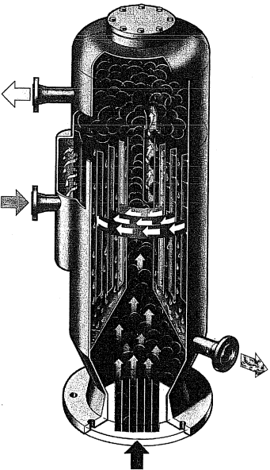
2.2.2 PLATE – Spiral-plate Heat Exchanger
Spiral plate heat exchangers consist of rolling two long, parallel plates into a spiral using a mandrel
Two spiral paths introduce a secondary flow, increasing the heat transfer and reducing fouling deposits.
Compact but relatively expensive

Slide 12
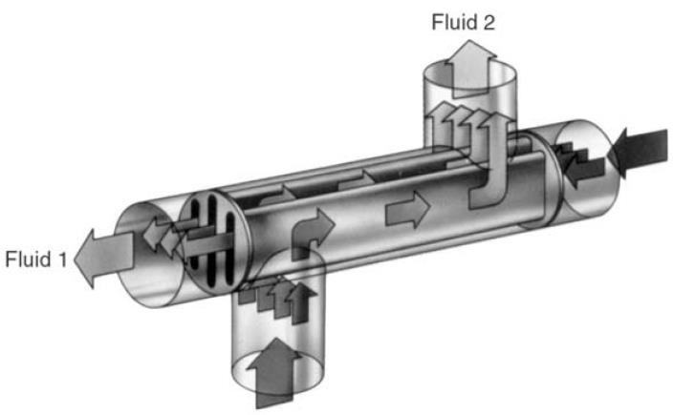
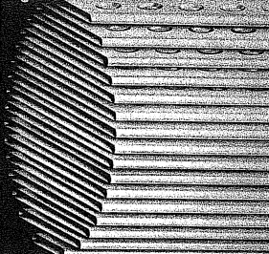
2.2.3 PLATE – Lamella Heat Exchanger
Lamella heat exchangers, also known as plate-and-frame heat exchangers or compact plate heat exchangers
Plate Configuration: Lamella heat exchangers consist of multiple plates with patterns of ridges and grooves on their surfaces.
Counterflow: Lamella heat exchangers usually operate in a counterflow arrangement, where the hot and cold fluids flow in opposite directions.
Heat transfer in a lamella heat exchanger occurs through conduction and forced convection.
Advantages: High heat transfer efficiency, compact, flexibility, and scalability, easy maintenance
Disadvantages: Pressure and temperature limitations and fouling sensitivity

Slide 13
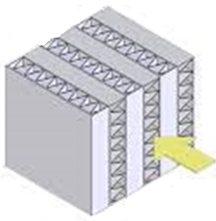
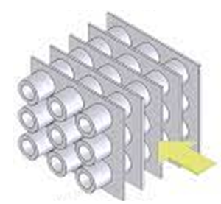
2.3. Extended Surface Heat Exchangers
Finned heat exchangers
To enhance the heat transfer surface area, thereby the overall heat transfer rate
They operate based on the principle of convective heat transfer. The extended surface area provided by the fins increases the contact area between the fluid and the surface
Advantages: Enhanced heat transfer, compact design, flexibility
Disadvantages: Potential fouling, higher pressure drop, cost
Plate-fin
Tube-fin

Slide 14
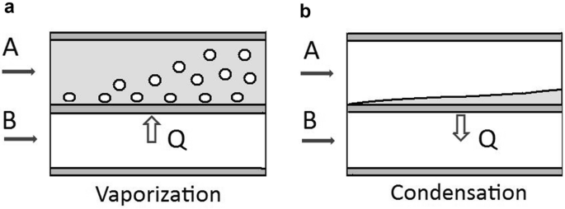
3. Heat Transfer Mechanisms
SINGLE-PHASE
MULTI-PHASE
The fluid's temperature and properties change as heat is transferred, but there is no phase change (such as vaporization or condensation) occurring.
This typically involves the transition between liquid and vapor phases (boiling or evaporation) or vapor to liquid phases (condensation).
Single-phase liquid
Single-phase gas
Boiling/Evaporation
Condensation
Conduction and convection
Convection is the dominant mechanism.
Heat is transferred as the liquid absorbs energy and changes to a vapor phase.
Heat transfer occurs when a vapor changes phase to a liquid.
The heat transfer coefficient is typically higher for liquids compared to gases due to their higher thermal conductivity and higher convective heat transfer coefficients.

Slide 15



4. Flow Arrangements
PARALLEL
COUNTER
CROSS
Hot and cold fluids flow in the same direction
Advantages: Relatively high temperature difference at the entrance → high heat transfer rates and efficient
Disadvantages: The temperature decreases along the length, leading to reduce heat transfer effectiveness. Lower heat transfer rates compared to others.
Hot and cold fluids flow in the opposite direction
Advantages: highest overall heat transfer rates. Nearly constant temperature difference along the length → efficient heat transfer
Disadvantages: At the entrance, lower temperature differences can result in larger heat exchanger sizes or higher surface areas.
Hot and cold fluids flow perpendicular to each other
Advantages: good heat transfer rates and compact heat exchanger designs
Disadvantages: Lower heat transfer rates compared to counter flow. The temperature difference is not as high as in the parallel or counter flow, which may impact the overall heat transfer effectiveness.

Slide 16
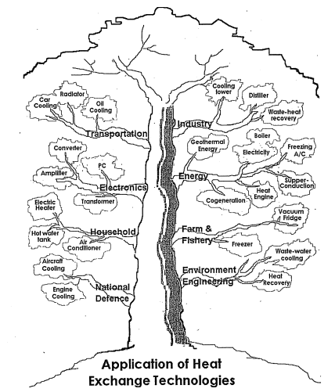
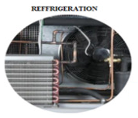
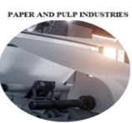
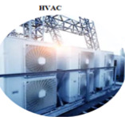
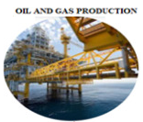
APPLICATION AREAS

Slide 17
Selection Criteria for Heat Exchangers
Heat Transfer Requirements:
Determine the heat transfer rate and the temperature difference required for the application. This includes considering factors such as the heat load, fluid flow rates, and desired outlet temperatures.
Efficiency and Effectiveness: Consider factors such as heat transfer coefficient, pressure drop, fouling potential, and overall thermal performance to ensure optimal heat transfer efficiency and minimal energy losses.
Environmental Considerations:
Consider any environmental regulations, energy efficiency goals, or sustainability targets. Evaluate the environmental impact of the heat exchanger materials, potential emissions, and energy consumption.
Cost Considerations:
Evaluate the initial investment cost as well as the operational and maintenance costs. Consider factors such as equipment cost, installation costs, and energy consumption for cost-effectiveness.
Flow Configuration:
The most suitable flow configuration (parallel, counter, or cross flow) for the application requirements, temperature profiles, and desired heat transfer characteristics.
Fluid Compatibility:
chemical compatibility, corrosion resistance, and fouling tendencies
Material Selection:
fluid compatibility, operating temperature, pressure, and corrosion resistance for the cost-effectiveness and longevity of the materials
Maintenance and Cleaning:
Assess the accessibility and ease of maintenance, inspection, and cleaning of the heat exchanger.
Space and Size Constraints: Evaluate the available space (physical dimensions, layout, and footprint of the heat exchanger)

