Slide 1

ME 453
HEAT EXCHANGER DESIGN
2024-2025 / SPRING
Basic Design Methods of Heat Exchangers-1
Dr. Yağmur NALBANT ATAK
Atılım University
Department of Mechanical Engineering

Slide 2
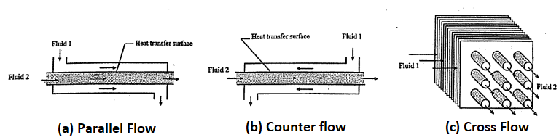
INTRODUCTION
Basic design methods for two-fluid direct-transfer heat exchangers (recuperators)
Rating problems including
  The heat transfer rate and the fluid outlet temperatures for prescribed fluid flow rates, inlet temperatures, and allowable pressure drop for an existing heat exchanger: hence the heat transfer surface area and the flow passage dimensions are available.
Sizing problems including
  Determination of the dimensions and the size to meet the specified hot and cold fluids inlet and outlet temperatures, flow rates, and pressure drop requirements.

Slide 3
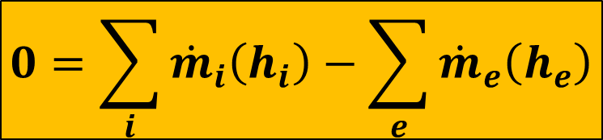
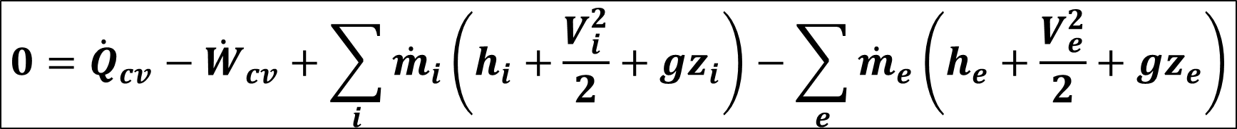
Basic Equations in Design
General form of the energy balance equation for the Heat Exchangers:
$$0={\dot{Q}}_{cv}−{\dot{W}}_{cv}+\sum_{i}{{\dot{m}}_{i}\left(h_{i}+\frac{V_{i}^{2}}{2}+{gz}_{i}\right)}−\sum_{e}{{\dot{m}}_{e}\left(h_{e}+\frac{V_{e}^{2}}{2}+{gz}_{e}\right)}$$
${\dot{W}}_{cv}=0$
If heat transfer with surroundings is negligible, ${\dot{Q}}_{cv}$ drops out.
If the change in kinetic energy of flowing matter is negligible,$\frac{V_{i}^{2}}{2}$ and $\frac{V_{e}^{2}}{2}$ drop out.
If the change in potential energy of flowing matter is negligible,${ gz}_{i}$ and ${gz}_{e}$drop out.
$$0=\sum_{i}{{\dot{m}}_{i}\left(h_{i}\right)}−\sum_{e}{{\dot{m}}_{e}\left(h_{e}\right)}$$

Slide 4

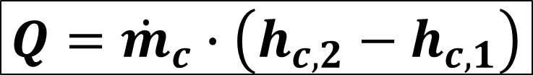
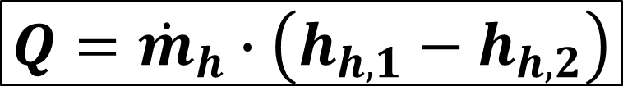

Basic Equations in Design
The change of enthalpy of one of the fluid streams:
$$δQ=\dot{m}∙dh$$
$$Q=\dot{m}∙\left(h_{2}−h_{1}\right)$$
Specific Enthalpy
Heat Transfer Rate
Mass Flow Rate
Outlet Enthalpy
Inlet Enthalpy
The change of enthalpy of hot and cold fluid streams:
$$Q={\dot{m}}_{h}∙\left(h_{h,1}−h_{h,2}\right)$$
h: Hot
c: Cold
1: inlet
2: outlet
Hot fluid:
Cold fluid:
$$Q={\dot{m}}_{c}∙\left(h_{c,2}−h_{c,1}\right)$$

Slide 5




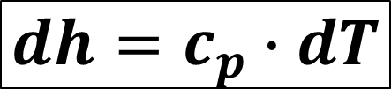
Basic Equations in Design
If the fluids do not undergo a phase change and have constant specific heat with;
$$dh=c_{p}∙dT$$
Hot fluid:
Cold fluid:
$$Q={\dot{m}}_{h}∙\left(h_{h,1}−h_{h,2}\right)$$
$$Q={\dot{m}}_{c}∙\left(h_{c,2}−h_{c,1}\right)$$
$$Q={\left(\dot{m}∙c_{p}\right)}_{h}∙\left(T_{h,1}−T_{h,2}\right)$$
$$Q={\left(\dot{m}∙c_{p}\right)}_{c}∙\left(T_{c,2}−T_{c,1}\right)$$

Slide 6
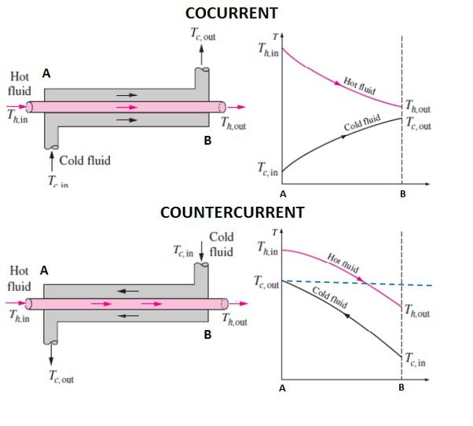
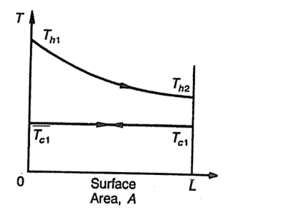
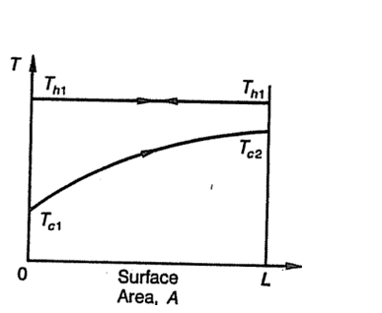




Basic Equations in Design
Cold fluid evaporating at a constant temperature
$$∆T_{out}$$
$$∆T_{in}$$
Hot fluid condensing at a constant temperature
$$∆T_{in}$$
$$∆T_{out}$$

Slide 7
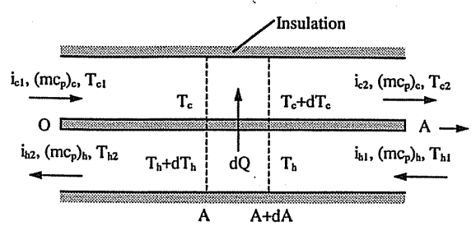
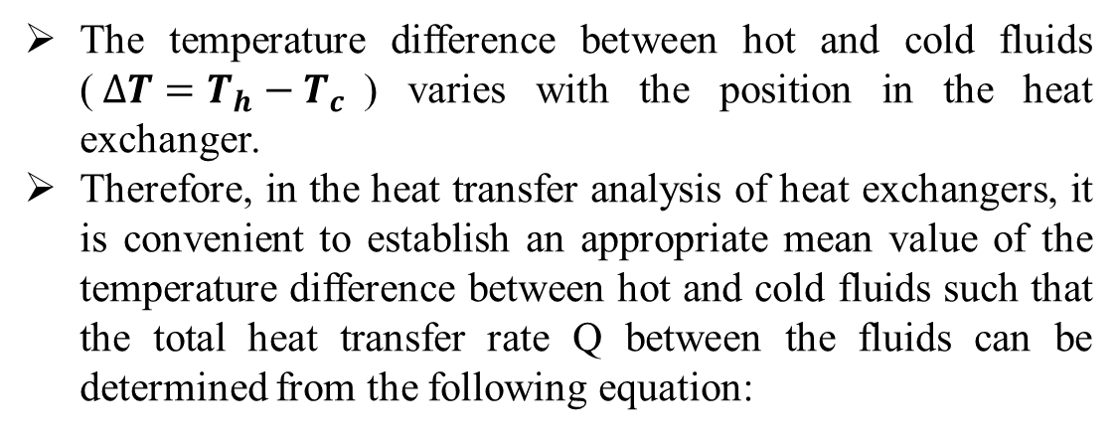
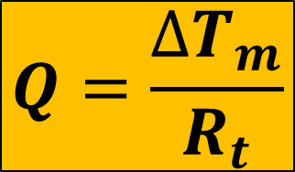
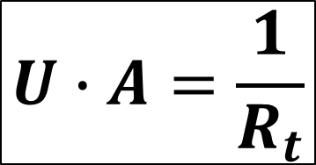

Overall Heat Transfer Coefficient
The temperature difference between hot and cold fluids ($∆T=T_{h}−T_{c}$) varies with the position in the heat exchanger.
Therefore, in the heat transfer analysis of heat exchangers, it is convenient to establish an appropriate mean value of the temperature difference between hot and cold fluids such that the total heat transfer rate Q between the fluids can be determined from the following equation:
$$U∙A=\frac{1}{R_{t}}$$
$$Q=U∙A∙{∆T}_{m}$$
Total Resistance
Average overall heat transfer coefficient (W/m²K)
Mean temperature difference (K)
$$Q=\frac{{∆T}_{m}}{R_{t}}$$
Total hot-side and cold-side heat transfer area (m²)

Slide 8
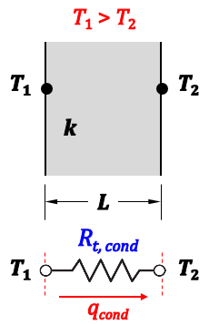

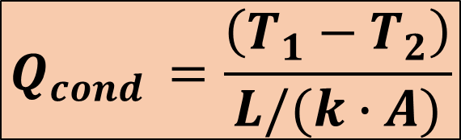
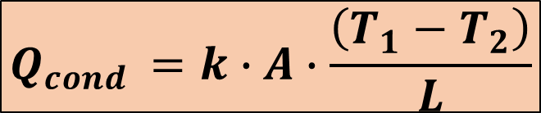
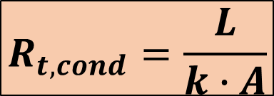
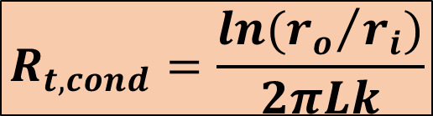
Overall Heat Transfer Coefficient
CONDUCTION:
Thermal conductivity (W/m-K)
$$Q_{cond }=k∙A∙\frac{\left(T_{1}−T_{2}\right)}{L}$$
Length (m)
$$Q_{cond }=\frac{\left(T_{1}−T_{2}\right)}{L/(k∙A)}$$
$$Q=\frac{{∆T}_{m}}{R_{t}}$$
$$R_{t,cond}=\frac{L}{k∙A}$$
For plane wall
$$R_{t,cond}=\frac{ln({r_{o}}/{r_{i}})}{2πLk}$$
For tubular wall

Slide 9
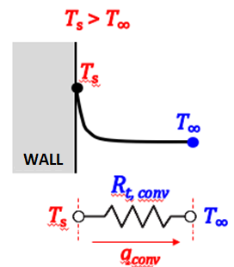

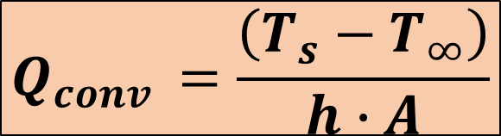


Overall Heat Transfer Coefficient
CONVECTION:
Heat Transfer Coefficient (W/m²-K)
Surface Area (m²)
$$Q_{conv }=h∙A∙\left(T_{s}−T_{∞}\right)$$
Fluid Temperature (K)
Surface Temperature (K)
$$Q_{conv }=\frac{\left(T_{s}−T_{∞}\right)}{h∙A}$$
$$Q=\frac{{∆T}_{m}}{R_{t}}$$
$$R_{t,conv}=\frac{1}{h∙A}$$

Slide 10
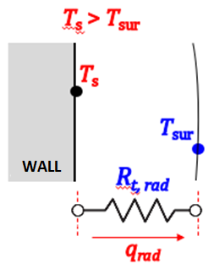

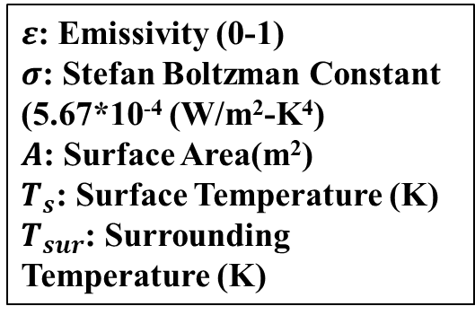



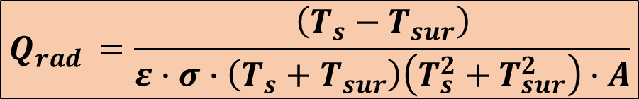
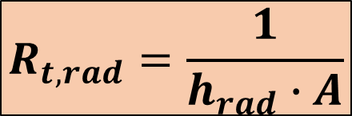

Overall Heat Transfer Coefficient
RADIATION:
$$Q_{rad }=ε∙σ∙A∙\left(T_{s}^{4}−T_{sur}^{4}\right)$$
$ε$: Emissivity (0-1)
$σ$: Stefan Boltzman Constant (5.67*10⁻⁴ (W/m²-K⁴)
$A$: Surface Area(m²)
$T_{s}$: Surface Temperature (K)
$T_{sur}$: Surrounding Temperature (K)
$$\left(T_{s}^{2}−T_{sur}^{2}\right)\left(T_{s}^{2}+T_{sur}^{2}\right)$$
$$\left(T_{s}−T_{sur}\right)\left(T_{s}+T_{sur}\right)$$
$$Q_{rad }=ε∙σ∙A∙\left(T_{s}−T_{sur}\right)\left(T_{s}+T_{sur}\right)\left(T_{s}^{2}+T_{sur}^{2}\right)$$
$$Q_{rad }=\frac{\left(T_{s}−T_{sur}\right)}{ε∙σ∙\left(T_{s}+T_{sur}\right)\left(T_{s}^{2}+T_{sur}^{2}\right)∙A}$$
$$Q=\frac{{∆T}_{m}}{R_{t}}$$
$$R_{t,rad}=\frac{1}{h_{rad}∙A}$$
$$h_{rad}=εσ\left(T_{s}+T_{sur}\right)\left(T_{s}^{2}−T_{sur}^{2}\right)$$

Slide 11
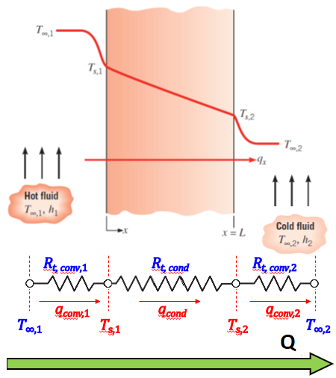
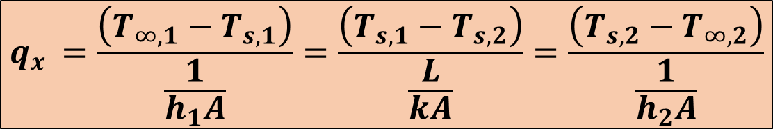
Overall Heat Transfer Coefficient
From Energy Conversion:
$$q_{x }=q_{conv,1}=q_{cond }=q_{conv,2}$$
$$q_{x }=\frac{\left(T_{∞,1}−T_{s,1}\right)}{\frac{1}{h_{1}A}}=\frac{\left(T_{s,1}−T_{s,2}\right)}{\frac{L}{kA}}=\frac{\left(T_{s,2}−T_{∞,2}\right)}{\frac{1}{h_{2}A}}$$

Slide 12
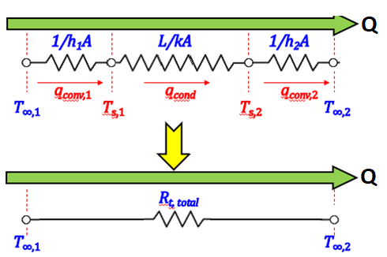
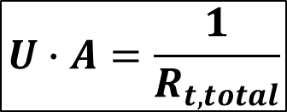
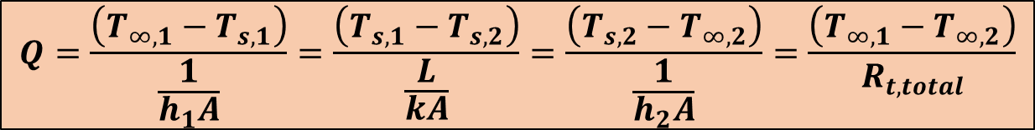

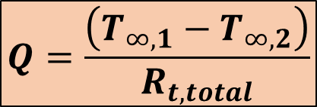
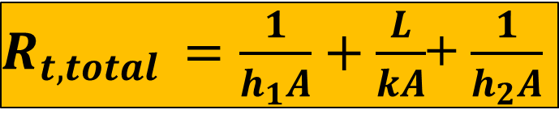
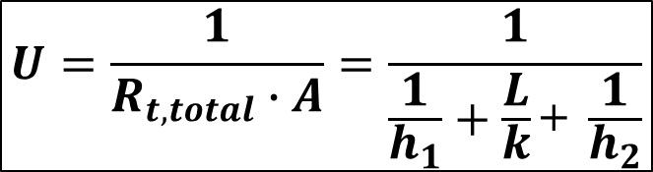
Overall Heat Transfer Coefficient
$$Q=\frac{\left(T_{∞,1}−T_{s,1}\right)}{\frac{1}{h_{1}A}}=\frac{\left(T_{s,1}−T_{s,2}\right)}{\frac{L}{kA}}=\frac{\left(T_{s,2}−T_{∞,2}\right)}{\frac{1}{h_{2}A}}=\frac{\left(T_{∞,1}−T_{∞,2}\right)}{R_{t, total}}$$
$R_{t,total }=\frac{1}{h_{1}A}+\frac{L}{kA}$+ $\frac{1}{h_{2}A}$
$$Q=\frac{\left(T_{∞,1}−T_{∞,2}\right)}{R_{t, total}}$$
$$U=\frac{1}{R_{t, total}∙A}=\frac{1}{\frac{1}{h_{1}}+\frac{L}{k}\text{+ }\frac{1}{h_{2}}}$$
$$U∙A=\frac{1}{R_{t, total}}$$
$$Q=U∙A∙{∆T}_{m}$$

Slide 13
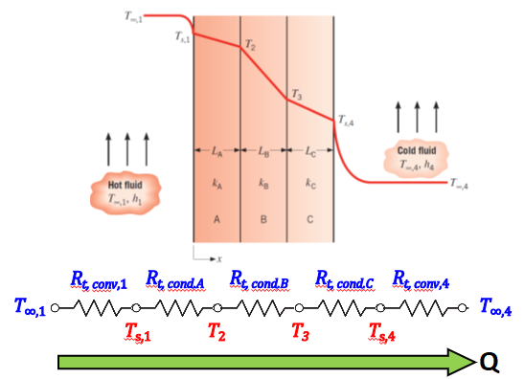
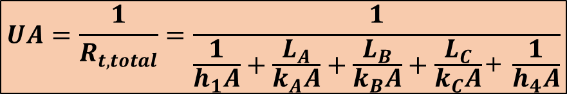
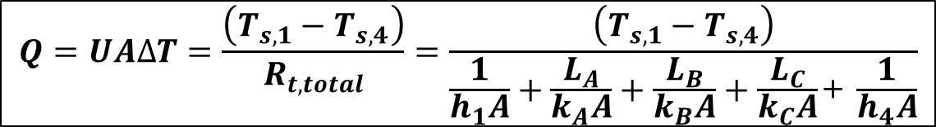
Overall Heat Transfer Coefficient
$$Q=UA∆T=\frac{\left(T_{s,1}−T_{s,4}\right)}{R_{t, total}}=\frac{\left(T_{s,1}−T_{s,4}\right)}{\frac{1}{h_{1}A}+\frac{L_{A}}{k_{A}A}+\frac{L_{B}}{k_{B}A}+\frac{L_{C}}{k_{C}A}\text{+ }\frac{1}{h_{4}A}}$$
$$UA=\frac{1}{R_{t, total}}=\frac{1}{\frac{1}{h_{1}A}+\frac{L_{A}}{k_{A}A}+\frac{L_{B}}{k_{B}A}+\frac{L_{C}}{k_{C}A}\text{+ }\frac{1}{h_{4}A}}$$

Slide 14
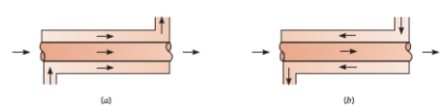


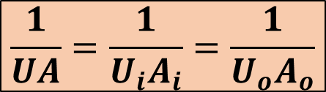
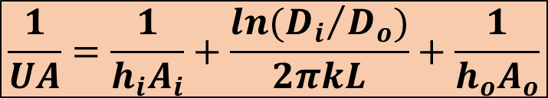
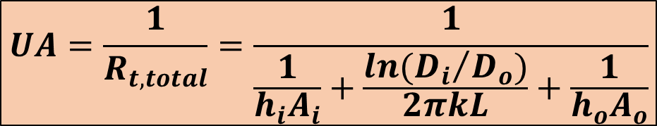
Overall Heat Transfer Coefficient
For tubular heat exchangers, we must take into account the conduction resistance in the wall and convection resistances of the fluids at the inner and outer tube surfaces.
$$UA=\frac{1}{R_{t, total}}=\frac{1}{\frac{1}{h_{i}A_{i}}+\frac{ln({D_{i}}/{D_{o}})}{2πkL}+\frac{1}{h_{o}A_{o}}}$$
$$\frac{1}{UA}=\frac{1}{h_{i}A_{i}}+\frac{ln({D_{i}}/{D_{o}})}{2πkL}+\frac{1}{h_{o}A_{o}}$$
Note that:
where inner tube surface:
$$A_{i}=πD_{i}L$$
$$\frac{1}{UA}=\frac{1}{U_{i}A_{i}}=\frac{1}{U_{o}A_{o}}$$
where outer tube surface:
$$A_{o}=πD_{o}L$$

Slide 15
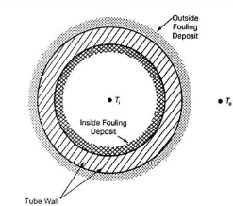
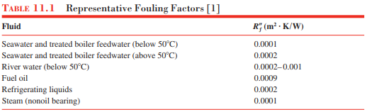
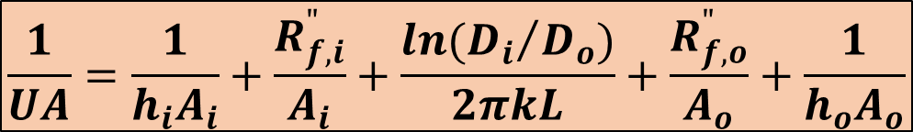
FOULING
Heat exchanger surfaces are subject to fouling by fluid impurities, rust formation, or other reactions between the fluid and the wall material. The subsequent deposition of a film or scale on the surface can greatly increase the resistance to heat transfer between fluids.
Additional thermal resistance can be introduced: The Fouling Factor, R_{f}.
  Depends on operating temperature, fluid velocity, and length of service of the heat exchanger. It is variable during the heat exchanger operation.
$$\frac{1}{UA}=\frac{1}{h_{i}A_{i}}+\frac{R_{f,i}^{"}}{A_{i}}+\frac{ln({D_{i}}/{D_{o}})}{2πkL}+\frac{R_{f,o}^{"}}{A_{o}}+\frac{1}{h_{o}A_{o}}$$

Slide 16
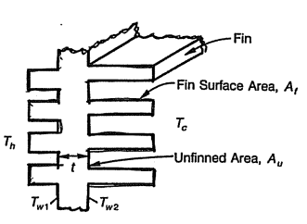
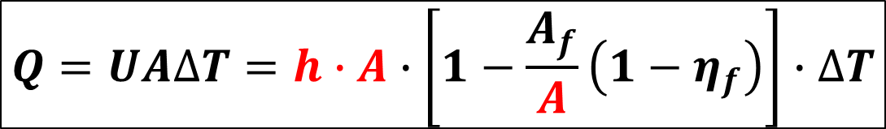


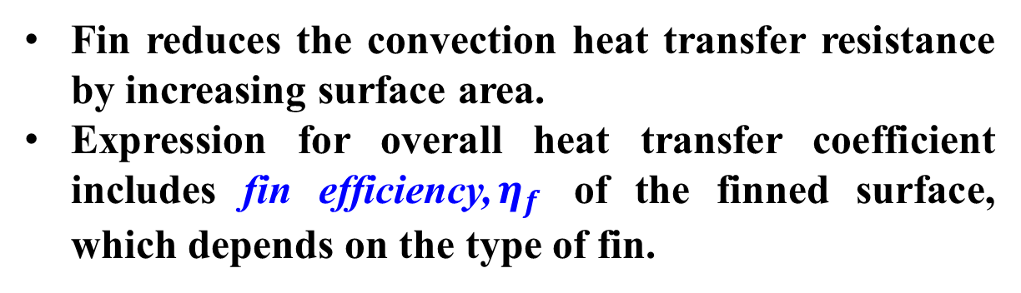

EXTENDED SURFACE (FIN) EFFECTS
Fin reduces the convection heat transfer resistance by increasing surface area.
Expression for overall heat transfer coefficient includes fin efficiency,$η_{f}$ of the finned surface, which depends on the type of fin.
$$Q=UA∆T=\left(η_{f}A_{f}h_{f}+A_{u}h_{u}\right)∙∆T$$
$∆T=\left(T_{h}−T_{w,1}\right)$ or $\left(T_{w, 2}−T_{c}\right)$
Subscript «f» fin
Subscript «u» unfinned
Subscript «c» cold stream
Subscript «h» hot stream
$$\left(h_{u}=h_{f}=h\right)$$
$$\left(A_{u}+A_{f}=A\right)$$
$$Q=UA∆T=h∙A∙\left[1−\frac{A_{f}}{A}\left(1−η_{f}\right)\right]∙∆T$$

Slide 17
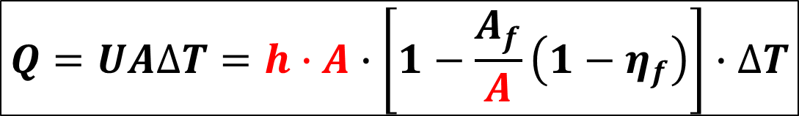
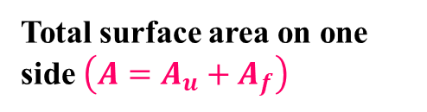




EXTENDED SURFACE (FIN) EFFECTS
$$Q=UA∆T=h∙A∙\left[1−\frac{A_{f}}{A}\left(1−η_{f}\right)\right]∙∆T$$
$$Q=UA∆T=η∙h∙A∙∆T$$
Total surface area on one side $\left({A=A}_{u}+A_{f}\right)$
$$η:Overall surface efficiency$$
$$R_{t}=\frac{1}{UA}=\frac{1}{U_{i}A_{i}}=\frac{1}{U_{o}A_{o}}=\frac{1}{{η_{i}h}_{i}A_{i}}+\frac{R_{f,i}^{"}}{{η_{i}A}_{i}}+R_{wall}+\frac{R_{f,o}^{"}}{{η_{o}A}_{o}}+\frac{1}{{η_{o}h}_{o}A_{o}}$$
$$A_{i}=Total surface area of the inner surface$$
$$R_{wall}=\frac{L}{kA}=for plane wall$$
$$A_{o}=Total surface area of the outer surface$$
$$R_{wall}=\frac{ln({r_{o}}/{r_{i}})}{2πLk}=for tube wall$$

Slide 18
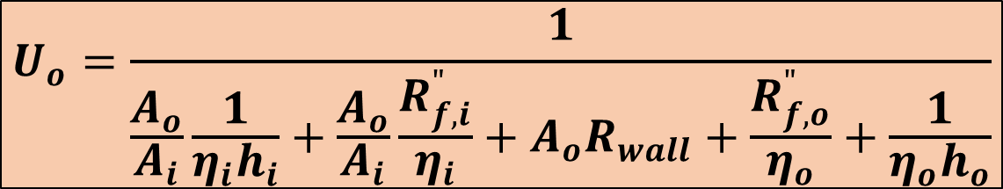
EXTENDED SURFACE (FIN) EFFECTS
$$R_{t}=\frac{1}{UA}=\frac{1}{U_{i}A_{i}}=\frac{1}{U_{o}A_{o}}=\frac{1}{{η_{i}h}_{i}A_{i}}+\frac{R_{f,i}^{"}}{{η_{i}A}_{i}}+R_{wall}+\frac{R_{f,o}^{"}}{{η_{o}A}_{o}}+\frac{1}{{η_{o}h}_{o}A_{o}}$$
Overall heat transfer coefficient based on the outside surface area of the wall $U_{o}$:
$$U_{o}=\frac{1}{\frac{A_{o}}{A_{i}}\frac{1}{{η_{i}h}_{i}}+\frac{A_{o}}{A_{i}}\frac{R_{f,i}^{"}}{η_{i}}+{A_{o}R}_{wall}+\frac{R_{f,o}^{"}}{η_{o}}+\frac{1}{{η_{o}h}_{o}}}$$
Note that: The overall heat transfer coefficient can be determined from knowledge of the inside and outside heat transfer coefficients, fouling factors, and appropriate geometric parameters.

Slide 19
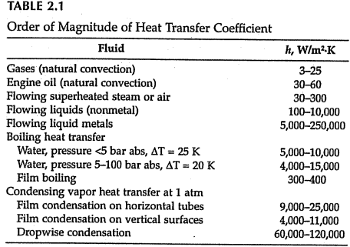
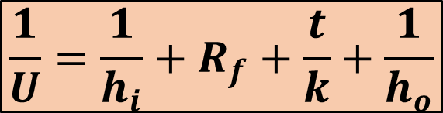
Order of Magnitude of Thermal Resistance
For a plane wall of thickness t, and heat transfer coefficients of inside and outside, h_{i} and h_{o} with fouling only on one side:
$$\frac{1}{U}=\frac{1}{h_{i}}+R_{f}+\frac{t}{k}+\frac{1}{h_{o}}$$
The order of magnitude and range of h for various conditions are given in Table.

Slide 20








EXAMPLE
Determine the overall heat transfer coefficient U for liquid-to-liquid heat transfer through 0.003 thick steel plates (k=50 W/m-K) for the following heat transfer coefficients and fouling factors on one side:
$$h_{i}=2500\frac{W}{m^{2}K}$$
$$h_{o}=1800\frac{W}{m^{2}K}$$
$$R_{f}=0.0002\frac{m^{2}K}{W}$$
Overall Heat Transfer Coefficient:
$$\frac{1}{U}=\frac{1}{h_{i}}+R_{f}+\frac{t}{k}+\frac{1}{h_{o}}$$
$$\frac{1}{U}=\frac{1}{2500}+0.0002+\frac{0.003}{50}+\frac{1}{1800}$$
$$\frac{1}{U}=0.004+0.0002+0.00006+0.00056$$
$$\frac{1}{U}=0.00122\frac{m^{2}K}{W}$$
$$U≅820\frac{W}{m^{2}K}$$

