Slide 1

ME 453
HEAT EXCHANGER DESIGN
2024-2025 / SPRING
LOG MEAN TEMPERATURE DIFFERENCE METHOD
Dr. Yağmur NALBANT ATAK
Atılım University
Department of Mechanical Engineering

Slide 2
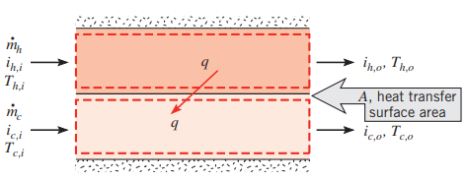


INTRODUCTION TO LMTD
To design or to predict the performance of a heat exchanger, it is essential to relate the total heat transfer rate to quantities such as the inlet and outlet fluid temperatures, the overall heat transfer coefficient, and the total surface area for heat transfer.
If q is the total rate of heat transfer between the hot and cold fluids and there is negligible heat transfer between the exchanger and its surroundings, as well as negligible potential and kinetic energy changes, the application of the steady flow energy equation
Enthalpy
$$q={\dot{m}}_{h}\left(h_{h,i}−h_{h,o}\right)$$
Subscripts:
c: Cold fluid,
h: Hot fluid,
i: Inlet
o: Outlet
$$q={\dot{m}}_{c}\left(h_{c,o}−h_{c,i}\right)$$

Slide 3





INTRODUCTION TO LMTD
HOT STREAM:
COLD STREAM:
Subscripts:
c: Cold fluid,
h: Hot fluid,
i: Inlet
o: Outlet
$$q={\dot{m}}_{h}\left(h_{h,i}−h_{h,o}\right)$$
$$q={\dot{m}}_{c}\left(h_{c,o}−h_{c,i}\right)$$
If the fluids are not undergoing a phase change and constant specific heats are assumed, these expressions reduce to
$$q={\dot{m}}_{h}∙c_{p,h}\left(T_{h,i}−T_{h,o}\right)$$
$$q={\dot{m}}_{c}∙c_{p,c}\left(T_{c,o}−T_{c,i}\right)$$
$$q=U∙A∙∆T_{m}$$
Mean temperature difference

Slide 4
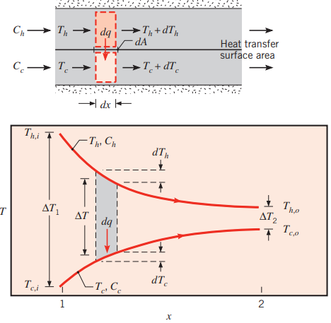




1. The Parallel-Flow Heat Exchanger
The energy balances and the subsequent analysis are subject to the following assumptions:
The heat exchanger is insulated from its surroundings, in which case the only heat exchange is between the hot and cold fluids.
Axial conduction along the tubes is negligible.
Potential and kinetic energy changes are negligible.
The fluid-specific heats are constant.
The overall heat transfer coefficient is constant.
$$T_{h,i}=T_{h,1}$$
$$T_{h, o}=T_{h,2}$$
$$T_{c,i}=T_{c,1}$$
$$T_{c,o}=T_{c,2}$$

Slide 5
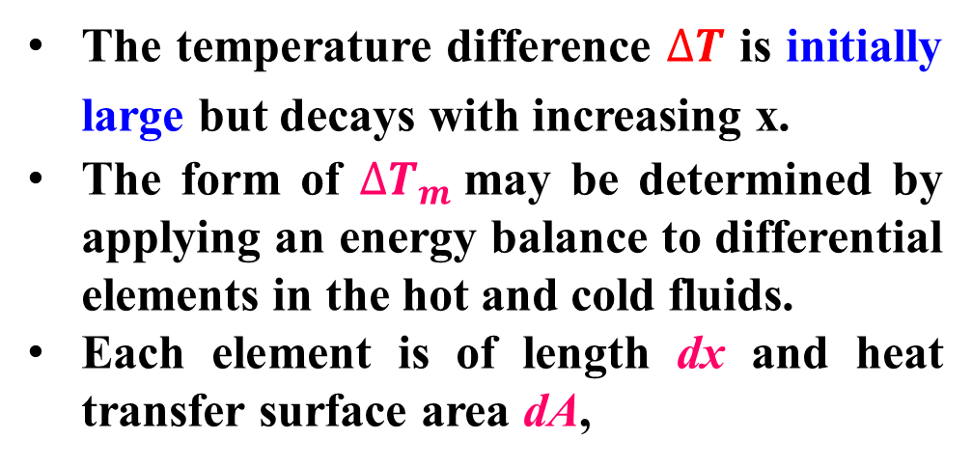
1. The Parallel-Flow Heat Exchanger
The temperature difference $∆T$ is initially large but decays with increasing x.
The form of $∆T_{m}$may be determined by applying an energy balance to differential elements in the hot and cold fluids.
Each element is of length dx and heat transfer surface area dA,

Slide 6

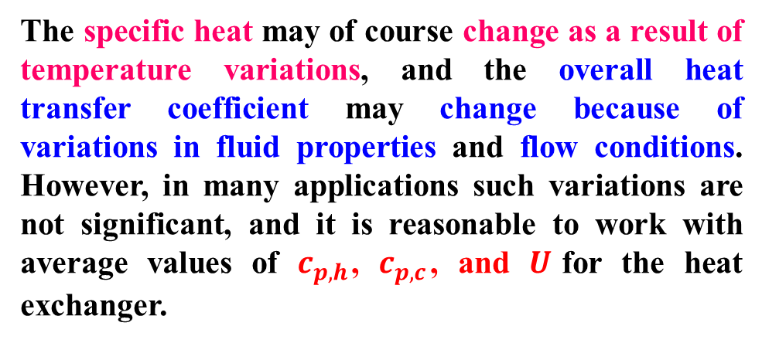


1. The Parallel-Flow Heat Exchanger
The specific heat may of course change as a result of temperature variations, and the overall heat transfer coefficient may change because of variations in fluid properties and flow conditions. However, in many applications such variations are not significant, and it is reasonable to work with average values of $c_{p,h}$, $c_{p,c}$, and $U$for the heat exchanger.
$dq={−\dot{m}}_{h}∙c_{p,h}∙{dT}_{h}=−C_{h}$ ${dT}_{h}$
$dq={\dot{m}}_{c}∙c_{p,c}∙{dT}_{c}=C_{c}$ ${dT}_{c}$
$C_{h}$ and $C_{c}:$ Hot and cold fluid heat capacity rates
$$C_{c}={\dot{m}}_{c}∙c_{p,c}$$
$$C_{h}={\dot{m}}_{h}∙c_{p,h}$$

Slide 7



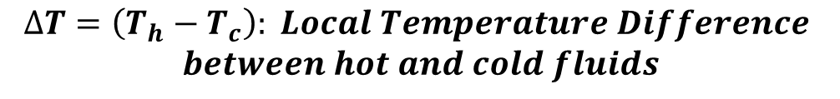

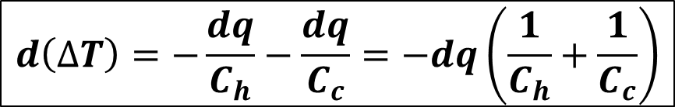
1. The Parallel-Flow Heat Exchanger
The heat transfer across the surface area dA may also be expressed as:
$$dq=U∙∆T∙dA$$
$$∆T=\left(T_{h}−T_{c}\right): Local Temperature Difference$$
$$between hot and cold fluids$$
$$d\left(∆T\right)={dT}_{h}−{dT}_{c}$$
$dq=−C_{h}$ ${dT}_{h}$
$dq=C_{c}$ ${dT}_{c}$
$$d\left(∆T\right)=−\frac{dq}{C_{h}}−\frac{dq}{C_{c}}=−dq\left(\frac{1}{C_{h}}+\frac{1}{C_{c}}\right)$$

Slide 8

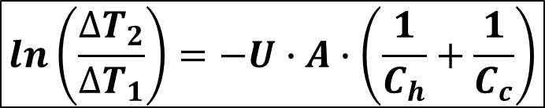
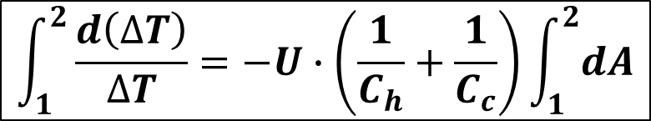
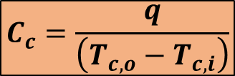
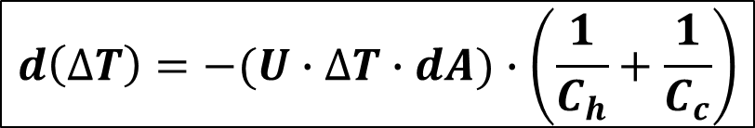
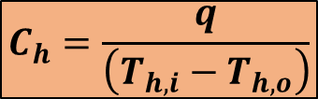
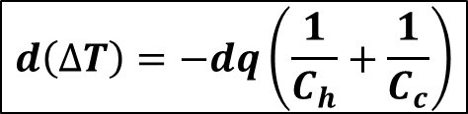
1. The Parallel-Flow Heat Exchanger
When the following equations are combined:
$$d\left(∆T\right)=−dq\left(\frac{1}{C_{h}}+\frac{1}{C_{c}}\right)$$
$$d\left(∆T\right)=−(U∙∆T∙dA)∙\left(\frac{1}{C_{h}}+\frac{1}{C_{c}}\right)$$
$$dq=U∙∆T∙dA$$
$$\int_{1}^{2}{\frac{d\left(∆T\right)}{∆T}}=−U∙\left(\frac{1}{C_{h}}+\frac{1}{C_{c}}\right)\int_{1}^{2}{dA}$$
$$ln\left(\frac{{∆T}_{2}}{∆T_{1}}\right)=−U∙A∙\left(\frac{1}{C_{h}}+\frac{1}{C_{c}}\right)$$
$$C_{h}=\frac{q}{\left(T_{h,i}−T_{h,o}\right)}$$
$q={\dot{m}}_{h}∙c_{p,h}\left(T_{h,i}−T_{h,o}\right)=C_{h}$ $\left(T_{h,i}−T_{h,o}\right)$
$$q={\dot{m}}_{c}∙c_{p,c}\left(T_{c,o}−T_{c,i}\right)=C_{c} \left(T_{c,o}−T_{c,i}\right)$$
$$C_{c}=\frac{q}{\left(T_{c,o}−T_{c,i}\right)}$$

Slide 9
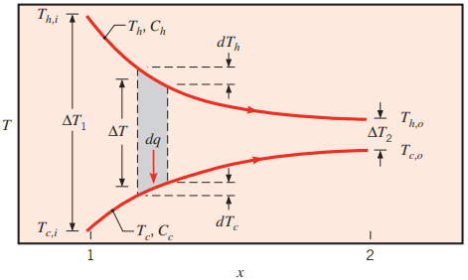
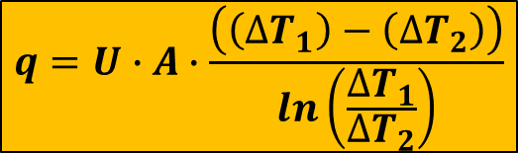
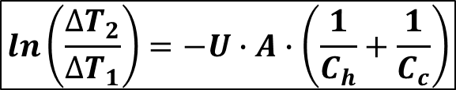
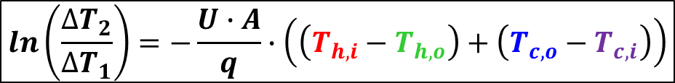
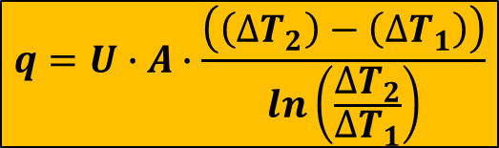
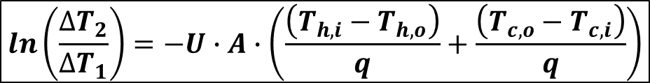
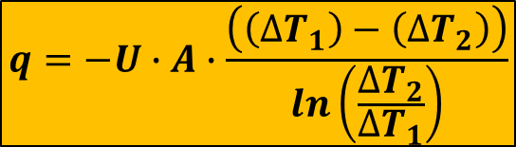
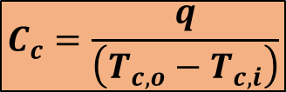



1. The Parallel-Flow Heat Exchanger
$$ln\left(\frac{{∆T}_{2}}{∆T_{1}}\right)=−U∙A∙\left(\frac{1}{C_{h}}+\frac{1}{C_{c}}\right)$$
$$C_{h}=\frac{q}{\left(T_{h,i}−T_{h,o}\right)}$$
$$C_{c}=\frac{q}{\left(T_{c,o}−T_{c,i}\right)}$$
$$ln\left(\frac{{∆T}_{2}}{∆T_{1}}\right)=−U∙A∙\left(\frac{\left(T_{h,i}−T_{h,o}\right)}{q}+\frac{\left(T_{c,o}−T_{c,i}\right)}{q}\right)$$
$$ln\left(\frac{{∆T}_{2}}{∆T_{1}}\right)=−\frac{U∙A}{q}∙\left(\left(T_{h,i}−T_{h,o}\right)+\left(T_{c,o}−T_{c,i}\right)\right)$$
$$∆T_{1}=T_{h,i}−T_{c,i}$$
$$∆T_{2}=T_{h,o}−T_{c,o}$$
$$q=−U∙A∙\frac{\left(\left(∆T_{1}\right)−\left(∆T_{2}\right)\right)}{ln\left(\frac{{∆T}_{2}}{∆T_{1}}\right)}$$
$$q=U∙A∙\frac{\left(\left(∆T_{2}\right)−\left(∆T_{1}\right)\right)}{ln\left(\frac{{∆T}_{2}}{∆T_{1}}\right)}$$
$$q=U∙A∙\frac{\left(\left(∆T_{1}\right)−\left(∆T_{2}\right)\right)}{ln\left(\frac{{∆T}_{1}}{∆T_{2}}\right)}$$

Slide 10
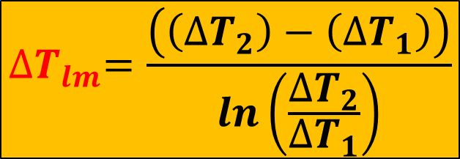

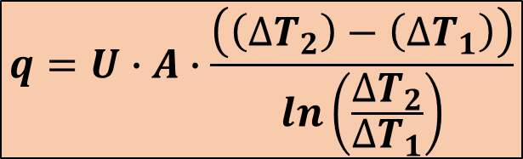
1. The Parallel-Flow Heat Exchanger
$$q=U∙A∙\frac{\left(\left(∆T_{2}\right)−\left(∆T_{1}\right)\right)}{ln\left(\frac{{∆T}_{2}}{∆T_{1}}\right)}$$
$$q=U∙A∙{∆T}_{lm}$$
$${∆T}_{lm}=\frac{\left(\left(∆T_{2}\right)−\left(∆T_{1}\right)\right)}{ln\left(\frac{{∆T}_{2}}{∆T_{1}}\right)}$$
Remember!!!! For Parallel Flow:
$$∆T_{1}=T_{h,i}−T_{c,i}=T_{h,1}−T_{c,1}$$
$$∆T_{2}=T_{h,o}−T_{c,o}=T_{h,2}−T_{c,2}$$

Slide 11
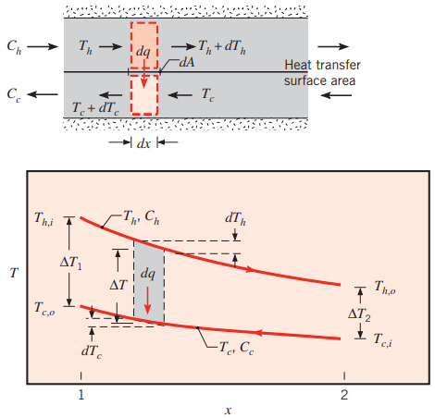


2. The Counter-Flow Heat Exchanger
$$q=U∙A∙{∆T}_{lm}$$
$${∆T}_{lm}=\frac{\left(\left(∆T_{2}\right)−\left(∆T_{1}\right)\right)}{ln\left(\frac{{∆T}_{2}}{∆T_{1}}\right)}$$
Remember!!!! For Counter Flow:
$$∆T_{1}=T_{h,i}−T_{c,o}=T_{h,1}−T_{c,2}$$
$$∆T_{2}=T_{h,o}−T_{c,i}=T_{h,2}−T_{c,1}$$

Slide 12
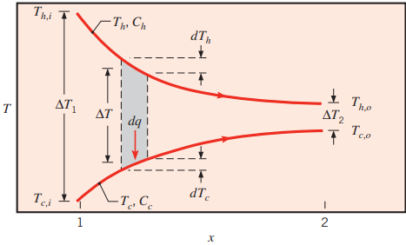
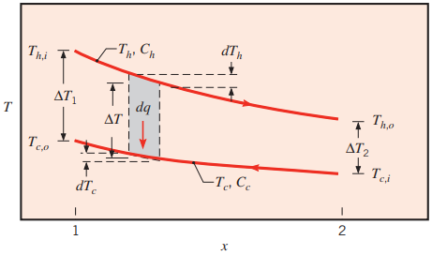

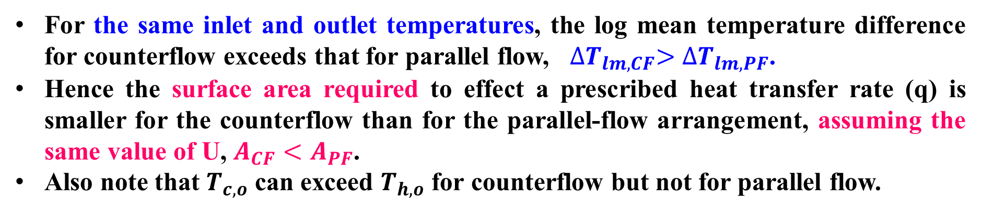



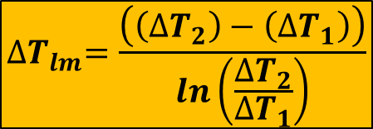

Comparison of Parallel and Counter Flows
PARALLEL
COUNTER
$$q=U∙A∙{∆T}_{lm}$$
$${∆T}_{lm}=\frac{\left(\left(∆T_{2}\right)−\left(∆T_{1}\right)\right)}{ln\left(\frac{{∆T}_{2}}{∆T_{1}}\right)}$$
$$∆T_{1}=T_{h,i}−T_{c,i}=T_{h,1}−T_{c,1}$$
$$∆T_{1}=T_{h,i}−T_{c,o}=T_{h,1}−T_{c,2}$$
$$∆T_{2}=T_{h,o}−T_{c,o}=T_{h,2}−T_{c,2}$$
$$∆T_{2}=T_{h,o}−T_{c,i}=T_{h,2}−T_{c,1}$$
For the same inlet and outlet temperatures, the log mean temperature difference for counterflow exceeds that for parallel flow, ${∆T}_{lm,CF}>{∆T}_{lm,PF}$.
Hence the surface area required to effect a prescribed heat transfer rate (q) is smaller for the counterflow than for the parallel-flow arrangement, assuming the same value of U, $A_{CF}<A_{PF}$.
Also note that $T_{c,o}$ can exceed $T_{h,o}$ for counterflow but not for parallel flow.

Slide 13
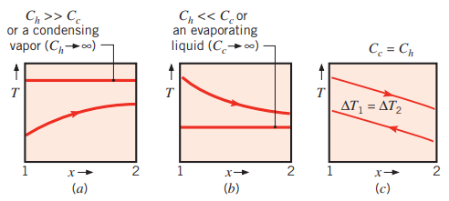




SPECIAL OPERATING CONDITIONS
Single Stream Heat Exchanger
L’Hospital’s rule
$$C_{h}={\dot{m}}_{h}∙c_{p,h}$$
$$∆T_{1}=∆T_{2}$$
$$∆T_{lm}=∆T_{1}=∆T_{2}$$
$$C_{c}={\dot{m}}_{c}∙c_{p,c}$$

Slide 14


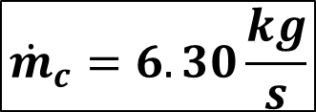
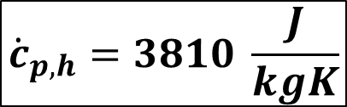
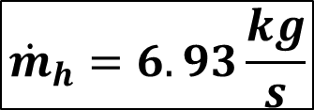
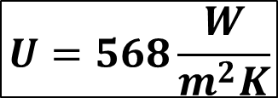

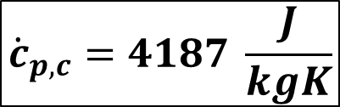
EXAMPLE-1
Consider a shell-and-tube heat exchanger that will be constructed from a 0.0254 m O.D (outer diameter) tube to cool 6.93 kg/s of a 95% ethyl alcohol solution (cp=3810 J/kg-K) from 66 to 42°C, using 6.30 kg/s of water available at 10°C (cp=4187 J/kg-K). In the heat exchanger, 72 tubes will be used. Assume that the overall coefficient of heat transfer based on the outer-tube area is 568 W/m²K. Calculate the surface area and the length of the heat exchanger for each of the following arrangements:
Parallel-flow
Counter-flow
Hot Stream (Ethyl alcohol solution)
Cold Stream (water)
$$U=568\frac{W}{m^{2}K}$$
$$T_{h,i}=66°C$$
$$T_{h,o}=42°C$$
$$T_{c,i}=10°C$$
$${\dot{m}}_{h}=6.93\frac{kg}{s}$$
$${\dot{c}}_{p,h}=3810 \frac{J}{kgK}$$
$${\dot{m}}_{c}=6.30\frac{kg}{s}$$
$${\dot{c}}_{p,c}=4187 \frac{J}{kgK}$$

Slide 15
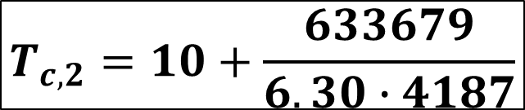
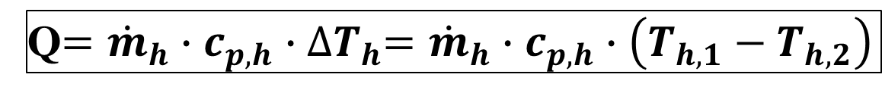
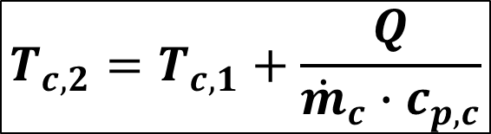
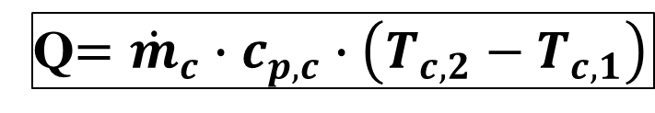
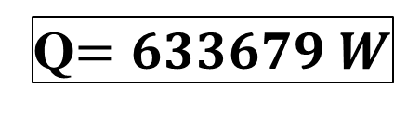
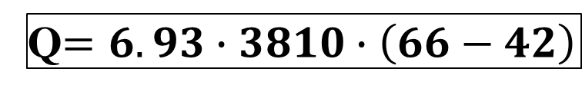

EXAMPLE-1-Solution
The heat transfer rate may be obtained from the overall energy balance for the hot fluid:
Q$={\dot{m}}_{h}∙c_{p,h}∙{∆T}_{h}={\dot{m}}_{h}∙c_{p,h}∙\left(T_{h,1}−T_{h,2}\right)$
Q$=6.93∙3810∙\left(66−42\right)$
Q$=633679 W$
Since the heat transfer from the hot fluid is given to the cold fluid, the two heat transfers are equal. The cold fluid (water) temperature can be calculated as follows:
$$T_{c,2}=T_{c,1}+\frac{Q}{{\dot{m}}_{c}∙c_{p,c}}$$
Q$={\dot{m}}_{c}∙c_{p,c}∙\left(T_{c,2}−T_{c,1}\right)$
$$T_{c,2}=10+\frac{633679}{6.30∙4187}$$
$$T_{c,2}=34°C$$

Slide 16
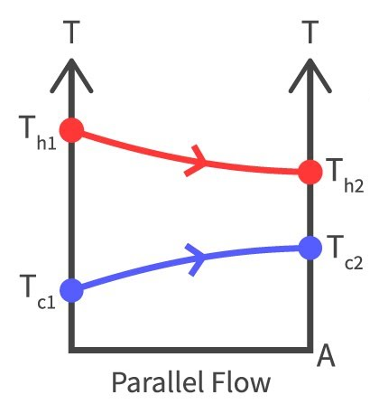
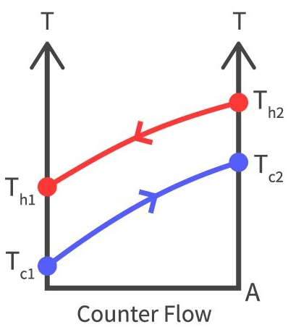












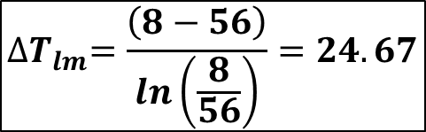



EXAMPLE-1-Solution
LMTD method can be obtained from the given equations:
$${∆T}_{lm}=\frac{\left(\left(∆T_{2}\right)−\left(∆T_{1}\right)\right)}{ln\left(\frac{{∆T}_{2}}{∆T_{1}}\right)}$$
$$q=U∙A∙{∆T}_{lm}$$
$$T_{h,1}=66°C$$
$$T_{h,2}=42°C$$
$$T_{c,1}=10°C$$
$$T_{c,2}=34°C$$
For Parallel Flow:
For Counter Flow:
$$∆T_{1}=T_{h,1}−T_{c,1}$$
$$∆T_{1}=T_{h,1}−T_{c,2}$$
$$∆T_{2}=T_{h,2}−T_{c,2}$$
$$∆T_{2}=T_{h,2}−T_{c,1}$$
$$∆T_{1}=56$$
$$∆T_{1}=32$$
$$∆T_{2}=8$$
$$∆T_{2}=32$$
$${∆T}_{lm}=\frac{\left(8−56\right)}{ln\left(\frac{8}{56}\right)}=24.67$$
$${∆T}_{lm}=32$$

Slide 17
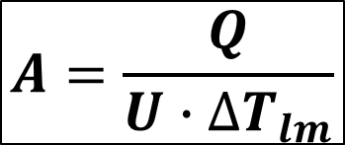













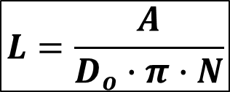
EXAMPLE-1-Solution
$$q=U∙A∙{∆T}_{lm}$$
These values were calculated in the previous slide according to the flow type
Q$=633679 W$
$$U=568\frac{W}{m^{2}K}$$
$$A=\frac{Q}{U∙{∆T}_{lm}}$$
$$L=\frac{A}{D_{o}∙π∙N}$$
For Parallel Flow:
For Counter Flow:
$${∆T}_{lm}=24.67$$
$${∆T}_{lm}=32$$
$$A_{PF}=\frac{633679}{568∙24.67}$$
$$A_{PF}=45.22 m^{2}$$
$$A_{CF}=\frac{633679}{568∙32}$$
$$A_{CF}=34.86 m^{2}$$
$$L_{PF}=\frac{45.22}{0.0254∙π∙72}$$
$$L_{PF}=\frac{34.86}{0.0254∙π∙72}$$
$$L_{PF}=7.87 m$$
$$L_{PF}=6.07 m$$

Slide 18
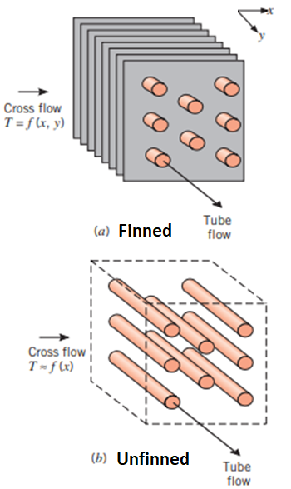
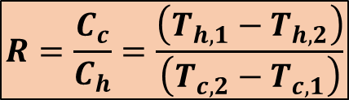
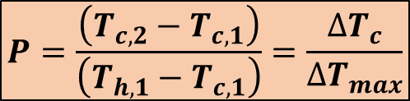
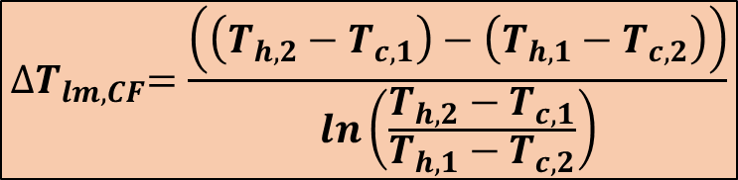
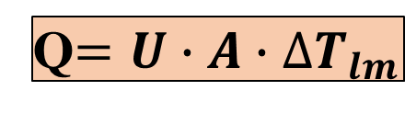
3. Multipass and Crossflow Heat Exchangers
The LMTD developed previously is not applicable for heat transfer analysis of crossflow and multipass flow heat exchangers.
Q$=U∙A∙{∆T}_{lm}$
$${∆T}_{lm,CF}=\frac{\left(\left(T_{h,2}−T_{c,1}\right)−\left(T_{h,1}−T_{c,2}\right)\right)}{ln\left(\frac{T_{h,2}−T_{c,1}}{T_{h,1}−T_{c,2}}\right)}$$
Log mean temperature difference for a counterflow arrangement
$$P=\frac{\left(T_{c,2}−T_{c,1}\right)}{\left(T_{h,1}−T_{c,1}\right)}=\frac{∆T_{c}}{{∆T}_{max}}$$
Temperature effectiveness of the heat exchanger on the cold-fluid side.
$$R=\frac{C_{c}}{C_{h}}=\frac{\left(T_{h,1}−T_{h,2}\right)}{\left(T_{c,2}−T_{c,1}\right)}$$
Heat capacity rate ratio

Slide 19
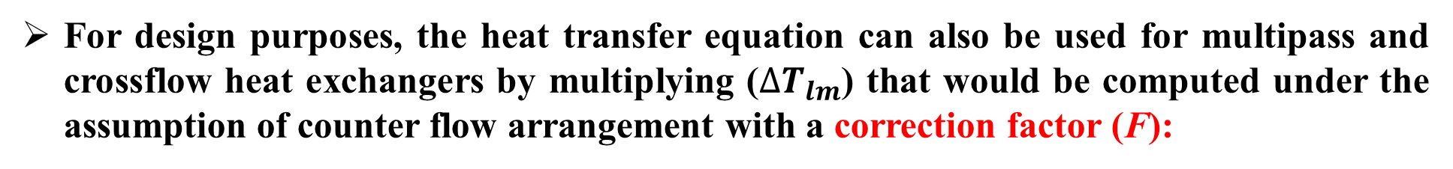

3. Multipass and Crossflow Heat Exchangers
For design purposes, the heat transfer equation can also be used for multipass and crossflow heat exchangers by multiplying (${∆T}_{lm}$) that would be computed under the assumption of counter flow arrangement with a correction factor (F):
Q$=U∙A∙{F∙∆T}_{lm}$
F is nondimensional; it depends on the temperature effectiveness (P), the heat capacity rate ratio (R), and the flow arrangement.
$$F =f(P,R,flow arrangement)$$
The correction factor (F) is less than 1 for crossflow and multipass arrangements; it is 1 for a true counterflow heat exchanger. It represents the degree of departure of the true mean temperature difference from the LMTD for a counterflow arrangement.

Slide 20

3. Multipass and Crossflow Heat Exchangers
One shell pass and two or multiples of two tube passes

Slide 21

3. Multipass and Crossflow Heat Exchangers
Two shell passes and four or multiples of four tube passes

Slide 22

3. Multipass and Crossflow Heat Exchangers
Three shell passes and six or multiples of six tube passes

Slide 23

3. Multipass and Crossflow Heat Exchangers
One divided flow shell pass and even number of tube passes

Slide 24

3. Multipass and Crossflow Heat Exchangers
One split flow shell pass and two tube passes

Slide 25
















EXAMPLE-2
Repeat EXAMPLE-1 for a shell-and-tube heat exchanger with one-shell pass and multiples of two tube passes.
Hot Stream (Ethyl alcohol solution)
Cold Stream (water)
$$U=568\frac{W}{m^{2}K}$$
$$T_{h,1}=66°C$$
$$T_{h,2}=42°C$$
$$T_{c,1}=10°C$$
$$T_{c,2}=34°C$$
$${\dot{m}}_{h}=6.93\frac{kg}{s}$$
$${\dot{c}}_{p,h}=3810 \frac{J}{kgK}$$
$${\dot{m}}_{c}=6.30\frac{kg}{s}$$
$${\dot{c}}_{p,c}=4187 \frac{J}{kgK}$$
Q$=U∙A∙F∙{∆T}_{lm}$
$$P=\frac{\left(T_{c,2}−T_{c,1}\right)}{\left(T_{h,1}−T_{c,1}\right)}=\frac{∆T_{c}}{{∆T}_{max}}$$
$$P=\frac{\left(34−10\right)}{\left(66−10\right)}=\frac{24}{56}$$
$$P=0.43$$
$$R=\frac{C_{c}}{C_{h}}=\frac{\left(T_{h,1}−T_{h,2}\right)}{\left(T_{c,2}−T_{c,1}\right)}$$
$$R=\frac{\left(66−42\right)}{\left(34−10\right)}=\frac{24}{24}$$
$$R=1$$

Slide 26








EXAMPLE-2-Solution
$$P=0.43$$
$$R=1$$
0.89
one-shell pass and multiples of two-tube passes
$$F=0.89$$
$${∆T}_{lm,CF}=32$$
0.43
It was calculated in Example-1 for counterflow
Q$=U∙A∙F∙{∆T}_{lm}$
$$A =\frac{Q}{U∙F∙{∆T}_{lm}}$$
$$A =\frac{633679}{568∙0.89∙32}$$
$$A =39.17 m^{2}$$

Slide 27










EXAMPLE-3
A heat exchanger with two-shell passes and four-tube passes is used to heat water with hot exhaust gas. Water enters the tubes at 50°C and leaves 125°C with a flow rate of 10 kg/s (c_{p}=4203 J/kg-K), while the hot exhaust gas enters the shell side at 300°C and leaves at 125°C. The total heat transfer surface is 800 m². Calculate the overall heat transfer coefficient.
Cold Stream (water)
Hot Stream (Hot exhaust gas)
$$A=800m^{2}$$
$$T_{c,1}=50°C$$
$$T_{c,2}=125°C$$
$$T_{h,1}=300°C$$
$${\dot{m}}_{c}=10\frac{kg}{s}$$
$$c_{p,c}=4203\frac{J}{kgK}$$
$$T_{h,2}=125°C$$
Q$={\dot{m}}_{c}∙c_{p,c}∙\left(T_{c,2}−T_{c,1}\right)$
Q$=10∙4203∙\left(125−50\right)$
Q$=3152250 W$

Slide 28















EXAMPLE-3-Solution
The overall heat transfer coefficient can be calculated from
Q$=U∙A∙F∙{∆T}_{lm}$
$$T_{c,1}=50°C$$
$$T_{h,1}=300°C$$
$$F =f(P,R,flow arrangement)$$
$$T_{c,2}=125°C$$
$$T_{h,2}=125°C$$
$$P=\frac{\left(T_{c,2}−T_{c,1}\right)}{\left(T_{h,1}−T_{c,1}\right)}=\frac{∆T_{c}}{{∆T}_{max}}$$
$$P=\frac{\left(125−50\right)}{\left(300−50\right)}=\frac{75}{250}$$
$$P=0.3$$
$$R=\frac{C_{c}}{C_{h}}=\frac{\left(T_{h,1}−T_{h,2}\right)}{\left(T_{c,2}−T_{c,1}\right)}$$
$$R=\frac{\left(300−125\right)}{\left(125−50\right)}=\frac{175}{75}$$
$$R=2.33$$
$${∆T}_{lm,CF}=\frac{\left(\left(T_{h,2}−T_{c,1}\right)−\left(T_{h,1}−T_{c,2}\right)\right)}{ln\left(\frac{T_{h,2}−T_{c,1}}{T_{h,1}−T_{c,2}}\right)}$$
$${∆T}_{lm,CF}=\frac{\left(\left(125−50\right)−\left(300−125\right)\right)}{ln\left(\frac{125−50}{300−125}\right)}$$
$${∆T}_{lm,CF}=118$$
For two-shell passes and four-tube passes, we will use Figure 2.8

Slide 29







EXAMPLE-2-Solution
$$P=0.3$$
$$R=2.33$$
0.96
two-shell passes and four-tube passes
$$F=0.96$$
Q$=U∙A∙F∙{∆T}_{lm}$
$$U =\frac{Q}{A∙F∙{∆T}_{lm}}$$
$$U =\frac{3152250}{800∙0.96∙118}$$
$$U =34.78\frac{W}{m^{2}K}$$

Slide 30

3. Multipass and Crossflow Heat Exchangers
In a multipass or a crossflow arrangement, the fluid temperature may not be uniform at a particular location in the exchanger unless the fluid is well mixed along the path length.
For example, in crossflow (as in Figure) the hot and cold fluids may enter at uniform temperatures, but if there are channels in the flow path (with or without corrugated spacers) to prevent mixing, the exit temperature distributions will be shown in Figure.
If such channels are not present, the fluids may be well mixed along the path length and the exit temperatures are more nearly uniform as in the flow normal to the tube bank.
A similar stratification of temperatures occurs in the shell-and-tube multipass exchanger.
A series of baffles may be required if mixing of the shell fluid is to be obtained. Charts are presented for both mixed and unmixed fluids in Figures 2.13 and 2.14.

Slide 31

3. Multipass and Crossflow Heat Exchangers
Unmixed fluids

Slide 32

3. Multipass and Crossflow Heat Exchangers
One fluid mixed and the other unmixed

Slide 33






EXAMPLE-4
A finned-tube, single-pass, crossflow heat exchanger with both fluids unmixed as shown in Figure 2.13 is used to heat air with hot water. The total heat transfer rate is 200 kW. The water enters the tube at 85°C and leaves at 30°C, while the air enters the finned side at 15°C and leaves at 50°C. The overall heat transfer coefficient is 75 W/m²K. Calculate the surface area required.
Cold Stream (air)
Hot Stream (Hot water)
Q$=200000 W$
$$T_{c,1}=15°C$$
$$T_{h,1}=85°C$$
$$U=75\frac{W}{m^{2}K}$$
$$T_{c,2}=50°C$$
$$T_{h,2}=30°C$$

Slide 34








EXAMPLE-4-Solution
The desired heat transfer can be determined from:
Q$=U∙A∙F∙{∆T}_{lm,CF}$
$$A =\frac{Q}{U∙F∙{∆T}_{lm,CF}}$$
The surface area required:
To find the correction factor (F), firstly we will define the temperature effectiveness (P) and heat capacity rate ratio (R):
$$P=\frac{\left(T_{c,2}−T_{c,1}\right)}{\left(T_{h,1}−T_{c,1}\right)}=\frac{∆T_{c}}{{∆T}_{max}}$$
$$P=\frac{\left(50−15\right)}{\left(85−15\right)}=\frac{35}{70}$$
$$P=0.5$$
$$R=\frac{C_{c}}{C_{h}}=\frac{\left(T_{h,1}−T_{h,2}\right)}{\left(T_{c,2}−T_{c,1}\right)}$$
$$R=\frac{\left(85−30\right)}{\left(50−15\right)}=\frac{55}{35}$$
$$R=1.57$$

Slide 35



EXAMPLE-4-Solution
$$P=0.5$$
$$R=1.57$$
finned-tube, single-pass, crossflow and both fluids unmixed
0.785
$$F=0.785$$

Slide 36












EXAMPLE-4-Solution
To find the log mean temperature difference for counter-flow (${∆T}_{lm,CF}$):
$${∆T}_{lm,CF}=\frac{\left(\left(∆T_{1}\right)−\left(∆T_{2}\right)\right)}{ln\left(\frac{{∆T}_{1}}{∆T_{2}}\right)}$$
$${∆T}_{1}=\left(T_{h,1}−T_{c,2}\right)$$
$${∆T}_{1}=\left(85−50\right)$$
$${∆T}_{1}=35$$
$${∆T}_{2}=\left(T_{h,2}−T_{c,1}\right)$$
$${∆T}_{2}=\left(30−15\right)$$
$${∆T}_{2}=15$$
$${∆T}_{lm,CF}=\frac{\left(35−15\right)}{ln\left(\frac{35}{15}\right)}$$
$${∆T}_{lm,CF}=23.6$$
The surface area required:
$$A =\frac{Q}{U∙F∙{∆T}_{lm,CF}}$$
$$A =\frac{200000}{75∙0.785∙23.6}$$
$$A =143.94 m^{2}$$

Slide 37








EXAMPLE-5
Air flowing at a rate of 5 kg/s is to be heated in a shell-and-tube heat exchanger from 20 to 50°C with hot water entering at 90°C and exiting at 60°C. The overall heat transfer coefficient is 400 W/m²K. The length of the heat exchanger is 2 m. Tube’s nominal diameter is equal to 2.6667 cm. Determine the surface area of the heat exchanger and the number of tubes required by using:
1-) 1 to 2 shell-and-tube type
2-) 2 to 4 shell-and-tube type
Hot Stream (Hot water)
Cold Stream (air)
$$T_{h,1}=90°C$$
$$T_{c,1}=20°C$$
$${\dot{m}}_{c}=5\frac{kg}{s}$$
$$U=400\frac{W}{m^{2}K}$$
$$T_{h,2}=60°C$$
$$T_{c,2}=50°C$$
$$c_{p,c}=1008 \frac{J}{kgK}$$
$$L=2 m$$
From Table B-1, at 35°C:

Slide 38






EXAMPLE-5-Solution
The desired heat transfer can be determined from:
Q$=U∙A∙F∙{∆T}_{lm,CF}$
The heat transfer can be calculated from:
Q$={\dot{m}}_{h}∙c_{p,h}∙\left(T_{h,1}−T_{h,2}\right)={\dot{m}}_{c}∙c_{p,c}∙\left(T_{c,2}−T_{c,1}\right)$
Q$={\dot{m}}_{c}∙c_{p,c}∙\left(T_{c,2}−T_{c,1}\right)=5∙$1008 $∙\left(50−20\right)$
Q$=151200 W$
The surface area required:
$$A =\frac{Q}{U∙F∙{∆T}_{lm,CF}}$$
The heat transfer surface area of one tube:
$$A_{i}=πD_{o}L=π∙0.02667∙2$$
$$A_{i}=0.1676 m^{2}$$
$$N_{tubes} =\frac{A}{A_{i}}$$
The number of tubes:

Slide 39










EXAMPLE-5-Solution
$$T_{c,1}=20°C$$
$$T_{c,2}=50°C$$
$$T_{h,1}=90°C$$
$$T_{h,2}=60°C$$
To find the correction factor (F), firstly we will define the temperature effectiveness (P) and heat capacity rate ratio (R):
$$P=\frac{\left(T_{c,2}−T_{c,1}\right)}{\left(T_{h,1}−T_{c,1}\right)}=\frac{∆T_{c}}{{∆T}_{max}}$$
$$P=\frac{\left(50−20\right)}{\left(90−20\right)}=\frac{30}{70}$$
$$P=0.43$$
$$R=\frac{C_{c}}{C_{h}}=\frac{\left(T_{h,1}−T_{h,2}\right)}{\left(T_{c,2}−T_{c,1}\right)}$$
$$R=\frac{\left(90−60\right)}{\left(50−20\right)}=\frac{30}{30}$$
$$R=1$$

Slide 40













EXAMPLE-5-Solution
$$T_{c,1}=20°C$$
$$T_{c,2}=50°C$$
$$T_{h,1}=90°C$$
$$T_{h,2}=60°C$$
To find the log mean temperature difference for counter-flow (${∆T}_{lm,CF}$):
$${∆T}_{lm,CF}=\frac{\left(\left(∆T_{1}\right)−\left(∆T_{2}\right)\right)}{ln\left(\frac{{∆T}_{1}}{∆T_{2}}\right)}$$
$${∆T}_{1}=\left(T_{h,1}−T_{c,2}\right)$$
$${∆T}_{1}=\left(90−50\right)$$
$${∆T}_{1}=40$$
$${∆T}_{2}=\left(T_{h,2}−T_{c,1}\right)$$
$${∆T}_{2}=\left(60−20\right)$$
$${∆T}_{2}=40$$
If ${∆T}_{1}={∆T}_{2},$ the log mean temperature difference is equal to these values.
$${∆T}_{lm,CF}={∆T}_{1}={∆T}_{2}$$
$${∆T}_{lm,CF}=40$$

Slide 41







EXAMPLE-5-Solution
(a) 1 to 2 shell-and-tube type:
$$P=0.43$$
$$R=1$$
$$F=0.90$$
0.43
The surface area required:
The number of tubes:
$$A =\frac{Q}{U∙F∙{∆T}_{lm,CF}}$$
$$A =\frac{151200}{400∙0.90∙40}=10.5 m^{2}$$
$$N_{tubes} =\frac{A}{A_{i}}$$
$$N_{tubes} =\frac{10.5}{0.1676}=63$$

Slide 42



EXAMPLE-5-Solution
(a) 2 to 4 shell-and-tube type:
0.975
$$P=0.43$$
$$R=1$$
$$F=0.975$$
0.43
The surface area required:
The number of tubes:
$$A =\frac{Q}{U∙F∙{∆T}_{lm,CF}}$$
$$A =\frac{151200}{400∙0.975∙40}=9.69 m^{2}$$
$$N_{tubes} =\frac{A}{A_{i}}$$
$$N_{tubes} =\frac{9.69}{0.1676}=58$$

