Slide 1
PSY 520 REBT
Neşe Alkan
2022-2023 Spring
On-line course notes

Slide 2
The situational ‘ABC’ model of rational emotive behaviour therapy
When assessing clients’ psychological problems, REBT therapists employ a situational ‘ABC’ framework and we will now discuss each element of this framework in turn

Slide 3
The situational ‘ABC’ model of rational emotive behaviour therapy
Situations are viewed in the ‘situational ABC’ model as descriptions of actual events about which you form inferences.
Inferences go beyond the data at hand and may be accurate or inaccurate.
Situations are descriptions of events and do not include inferential meaning.

Slide 4
Situations
‘Situations’ exist in time & can describe
  external actual events
  past actual events
  present actual events
  future events
  internal actual events (thoughts, feelings, sensations, images, fantasies, emotions and memories)

Slide 5
«A’s» «Critical A»
‘As’ are usually aspects of situations which your client is potentially able to discern and attend to; can trigger his beliefs at ‘B’.
‘Critical A’ represents that actual or psychological event in his life which activates, at that moment, the beliefs that he holds (at ‘B’)and which lead to his emotional and behavioral responses (at ‘C’).

Slide 6
A ‘critical A’
activates or triggers beliefs
is usually an aspect of the situation that your client was in when he experienced an emotional response
‘non-critical As’ do not trigger beliefs in the situation

Slide 7
Features of ‘Critical As’
Critical As’ can be actual events
Critical As’ can be inferred events
Critical As’ can be external
Critical As’ can be internal

Slide 8
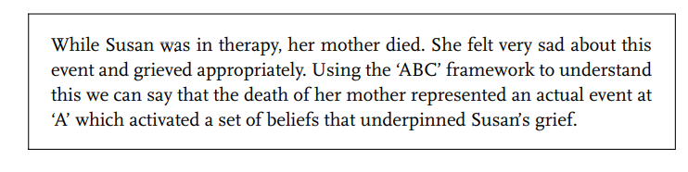
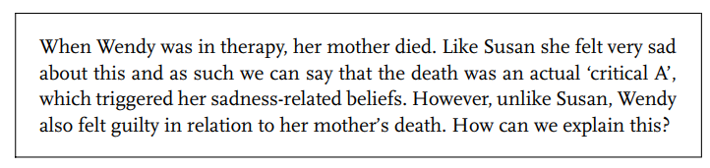
Features of ‘Critical As’
Critical As’ can be actual events
Critical As’ can be inferred events

Slide 9
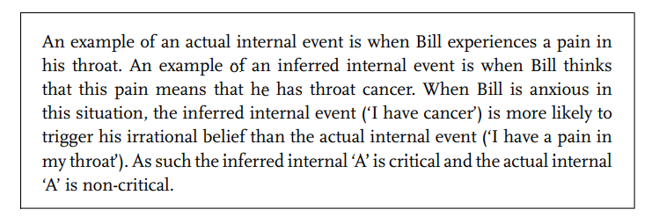
Features of ‘Critical As’
‘Critical As’ can be external or internal
Internal events can actually occur or their existence can be inferred

Slide 10
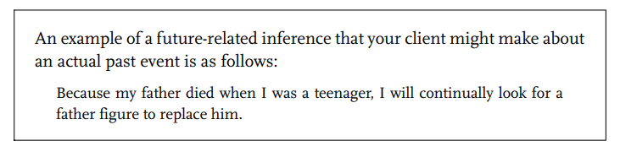
Features of ‘Critical As’
‘Critical As’ can refer to past, present and future events
Clients will bring inferential meaning to past events
Your client may infer that her father’s death meant that she was deprived in some way

Slide 11
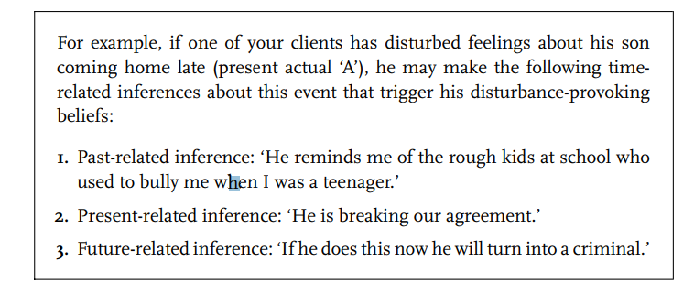
Features of ‘Critical As’
Clients can make past-, present- or future-related inferences about present events

Slide 12
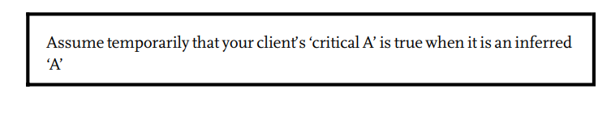
The importance of assuming temporarily that the ‘critical A’ is true
You encourage your client to assume temporarily that the ‘critical A’ is true when it is an inferred ‘A’.
The reason for doing this is to help your client to identify the beliefs that the ‘critical A’ triggered.
You may well be tempted to help your client to challenge the inferred ‘critical A’ if it is obviously distorted,
resist this temptation if you are to proceed to assess B accurately

Slide 13
B’s
Beliefs are at the core of clients’ emotions and significant behaviours.
Beliefs are the only cognitions that constitute the ‘B’ in the ‘ABC’ framework in REBT
Other approaches which use an ‘ABC’ framework lump all cognitive activity under ‘B’, REBT reserves B for beliefs and places inferences, for example, under ‘A’.
It is possible to hold two different types of beliefs at ‘B’ about the same inferred ‘As’.
It is the type of belief that determines the nature of the person’s emotional response at ‘C’

Slide 14
Rational beliefs: Characteristics
5 defining characteristics:
1. Flexible or non-extreme
2. Consistent with reality
3. Logical
4. Largely functional in their emotional, behavioural and cognitive consequences
5. Largely helpful to the individual in pursuing his basic goals and purposes

Slide 15
Rational beliefs: Types
Four types of rational beliefs:
1. Non-dogmatic preferences: Wishes, desires, wants
2. Non-awfulising beliefs
3. High frustration tolerance (HFT) beliefs
4. Self-acceptance/Other-acceptance/Life-acceptance beliefs

Slide 16
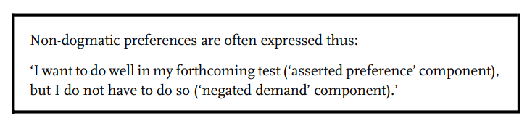
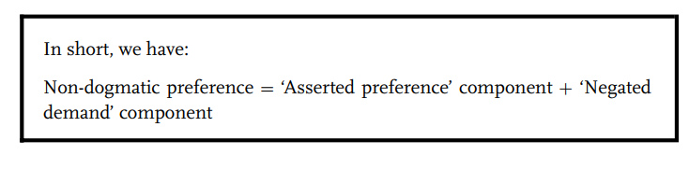
1. Non-dogmatic preferences:
According to REBT, our non-dogmatic preferences are at the core of psychological health.
According to Albert Ellis, a non-dogmatic preference is a primary rational belief and three other rational beliefs are derived from it.
Two components:
  ‘Asserted preference’ (‘I want to do well in my forthcoming test’)
  ‘Negated demand’ (‘but I do not have to do so’)

Slide 17
Rational beliefs: Characteristics
5 defining characteristics:
1. Flexible or non-extreme
2. Consistent with reality
3. Logical
4. Largely functional in their emotional, behavioural and cognitive consequences
5. Largely helpful to the individual in pursuing his basic goals and purposes

Slide 18
1. Non-dogmatic preferences: Rationality check
1. It is flexible in that your client allows for the fact that he might not do well.
2. It is consistent with reality in that (a) your client really does want to do well in the forthcoming test and (b) there is no law of the universe dictating that he has to do well
3. It is logical in that both the ‘asserted preference’ component and the ‘negated demand’ component are not rigid and thus the latter follows from the former.
4. It will help your client to have immediate functional emotions, behaviours and cognitions and help him pursue his longer-term goals.
5. The rational belief will motivate (help) him to focus on what he is doing as opposed to how well he is doing it.

Slide 19
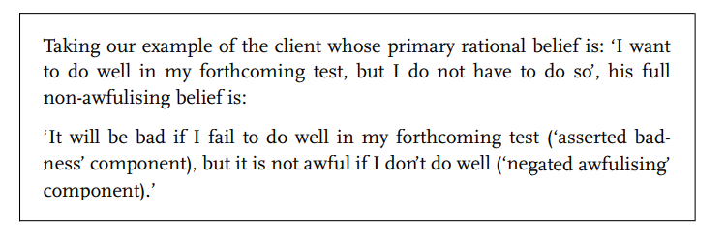
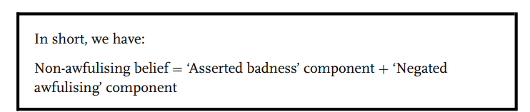
2. Non-awfulising belief
Bad but not awful
When your client does not get his non-dogmatic preference met, then it is rational for him to conclude that it is bad, but not awful that he has failed to get what he wanted.
‘Asserted badness’ (‘It will be bad if I fail to do well in my forthcoming test’),
‘Negated awfulising’, (‘but it is not awful if I don’t do well’)

Slide 20
2. Non-awfulising belief
Philosophy: ‘Nothing is truly awful in the universe’

Slide 21
Rational beliefs: Characteristics
5 defining characteristics:
1. Flexible or non-extreme
2. Consistent with reality
3. Logical
4. Largely functional in their emotional, behavioural and cognitive consequences
5. Largely helpful to the individual in pursuing his basic goals and purposes

Slide 22
2. Non-awfulising belief: Rationality check
1. It is non-extreme in that your client allows for the fact that there are things that can be worse than not doing well on the test.
2. It is consistent with reality in that your client really can prove that it would be bad for him not to do well and that it isn’t awful.
3. It is logical in that both the ‘asserted badness’ component and the ‘negated awfulising’ component are non-extreme and thus the latter follows logically from the former.
4. It will help your client to have immediate functional emotions, behaviours and cognitions and help him pursue his longer-term goals.
5. Non-awfulising belief will again motivate (help) him to focus on what he is doing as opposed to how well he is doing it.

Slide 23
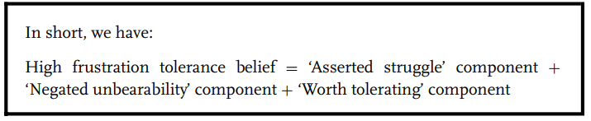
3. High frustration tolerance belief
Struggle but not unberable
Difficult to bear but not intolerable
When your client does not get his nondogmatic preference met, then it is rational for him to conclude that while this is difficult to bear, it is not intolerable to do.
‘asserted struggle’, (‘If I don’t do well in my forthcoming test, that will be difficult to bear’)
‘negated unbearability’, (‘but I can stand it, It will not be intolerable’)
‘worth tolerating’ (‘it is worth it for me to tolerate it’)

Slide 24
3. High frustration tolerance belief
Philosophy: It helps people to pursue their goals, not because tolerating frustration is in itself good for people

Slide 25
Rational beliefs: Characteristics
5 defining characteristics:
1. Flexible or non-extreme
2. Consistent with reality
3. Logical
4. Largely functional in their emotional, behavioural and cognitive consequences
5. Largely helpful to the individual in pursuing his basic goals and purposes

Slide 26
3. High frustration tolerance belief: Rationality check
1. It is non-extreme in that the person allows for the fact that not doing well is tolerable as opposed to the extreme position that it is unbearable.
It is consistent with reality in that the person (i) recognises the struggle involved in putting up with the adversity, (ii) acknowledges the truth that he really can bear that which is difficult to tolerate and (iii) can see the truth that it is in his interests to put up with the adversity.
It is logical in that the ‘asserted struggle’ component and the ‘negated unbearability’ component are both non-extreme and thus the latter follows logically from the former.
It will help him to have immediate functional emotions, behaviour and thoughts and help him pursue his longer-term goals.
Thus, it will help him to do well in the sense that it will lead him to focus on what he needs to do to avoid the ‘difficult to tolerate’ situation of not doing well rather than on the ‘intolerable’ aspects of doing poorly.

Slide 27
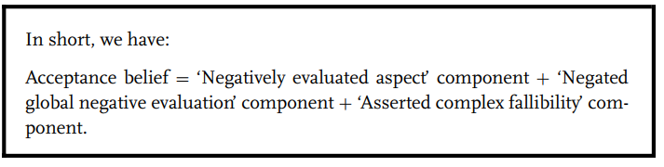
4. Self-, other- and life-acceptance beliefs
Negative evaluation of the aspect of the self but not the global negative evaluation of the self
When your client does not get his non-dogmatic preference met and this failure can be attributed to himself, for example, then it is rational for him not to like his behaviour, but to accept himself as a fallible human being who has acted poorly.
‘negatively evaluated aspect’, (‘I don’t like the fact that I messed up on the test’)
‘negated global negative evaluation’, (but I am not unworthy for my poor performance.’)
‘asserted complexity/unrateability/fallibility’ (‘Rather I am a fallible human being too complex to be rated on the basis of my test performance’)

Slide 28
4. Self-, other- and life-acceptance beliefs
Philosophy: Will encourage your client to focus on what needs to be done to correct his own behaviour.

Slide 29
4. Self-, other- and life-acceptance beliefs: Rationality check
It is non-extreme in that the person sees that he is able to perform well and also poorly.
It is consistent with reality in that whilst he can prove that he did not do well on the test (remember that at this point we have assumed temporarily that his inferred A is true), he can also prove that he is a fallible human being and that he is not unworthy as a person.
It is logical in that the person is not making the part-whole error. He is clear in asserting that the whole of himself is not defined by a part of himself.
It will lead to immediate functional emotions, behaviours and thoughts and help him pursue his longer-term goals.
It will help him to do well in the future in the sense that he will be motivated to learn from his previous errors and translate this learning to plan what he needs to do to improve his performance on the next test rather than dwell unfruitfully on his past poor performance.

Slide 30
Apply
Think about a positive experience:
Specify the event/situation
Specify the critical A’s
Specify type of the critical A’s
Identify the B’s
Identify the types of B’s
Check rationality on 5 criteria
Rate the rationality of each belief on 0-100 scale (100 rational).
State your reflections in 2-3 sentences
1 page, Word format, send via e-mail (2pts. Bonus).

Slide 31
7.03.2023

Slide 32
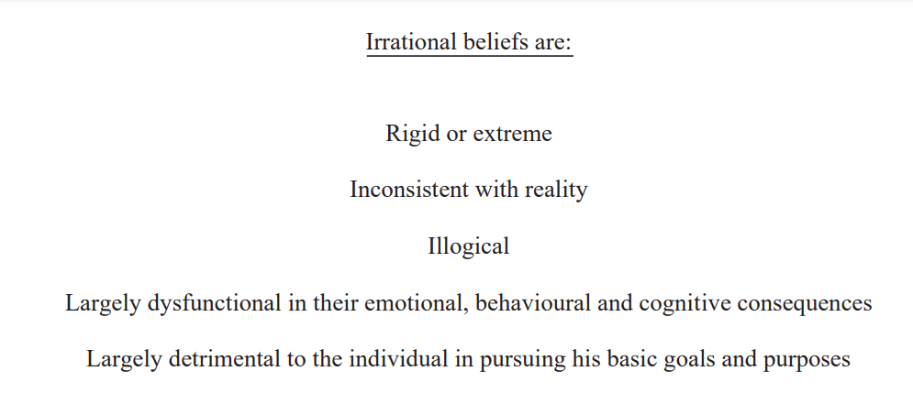
Irrational Beliefs

Slide 33
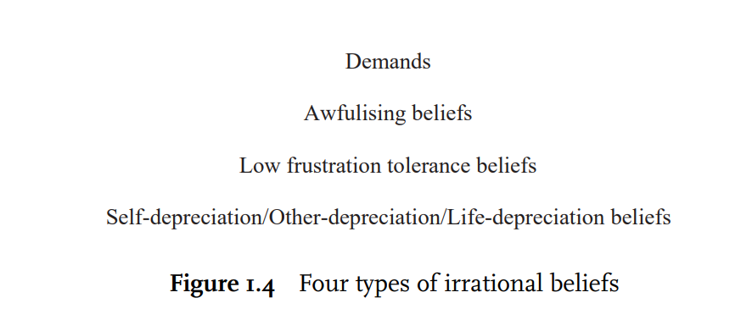
Irrational beliefs: Characteristics

Slide 34
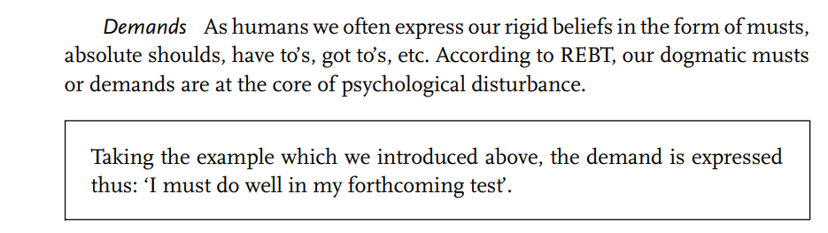
Demands

Slide 35
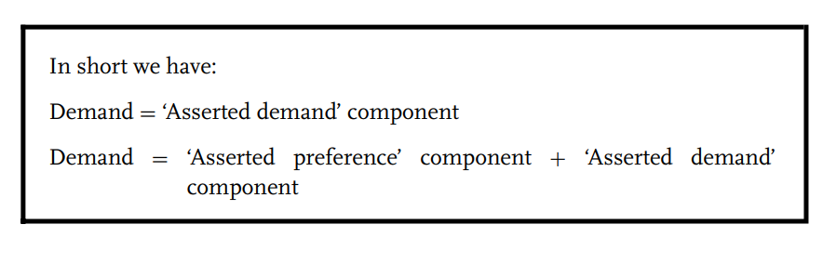
Demands

Slide 36
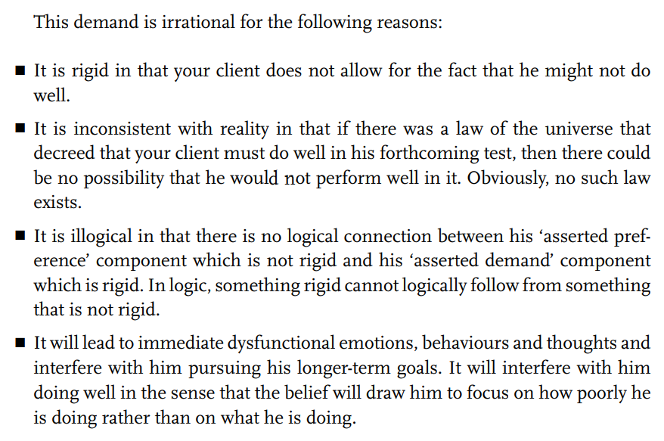
Demands: Rationality check

Slide 37
Types of ‘shoulds’
Recommendatory
Predictive
Ideal
Empirical
Preferential
Conditional
Absolute should

Slide 38
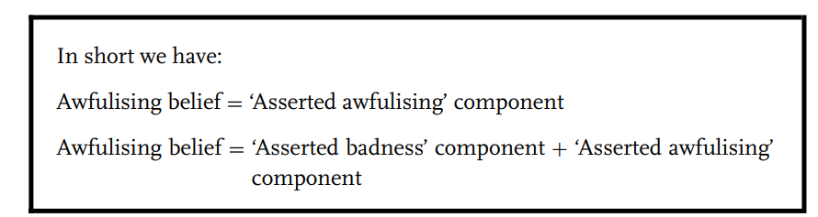
Awfulising belief
‘It would be awful if I fail to do well in my forthcoming test.’

Slide 39
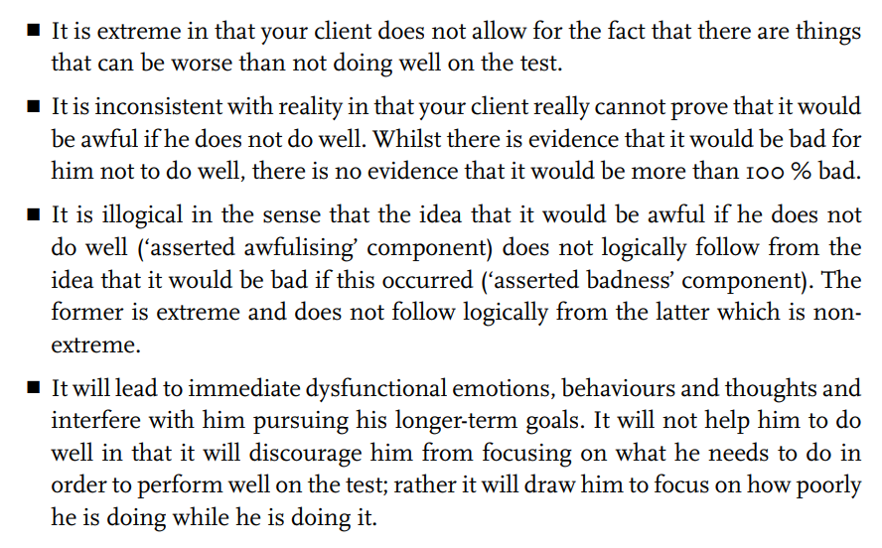
Awfulising belief: Rationality check

Slide 40
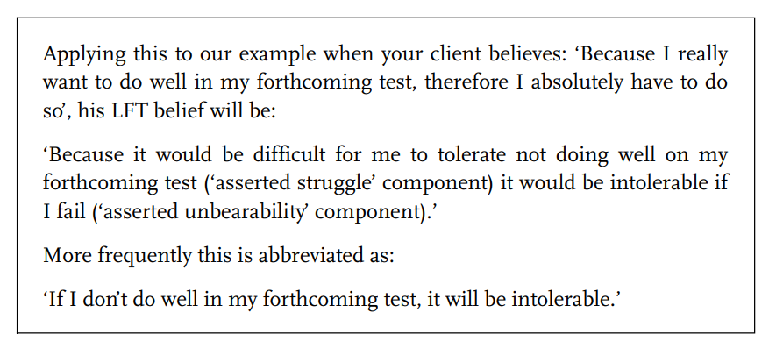
Low frustration tolerance beliefs

Slide 41
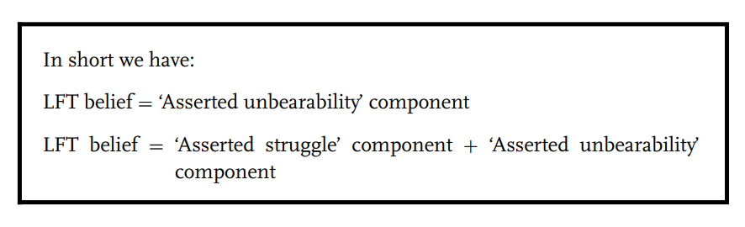
Low frustration tolerance beliefs

Slide 42
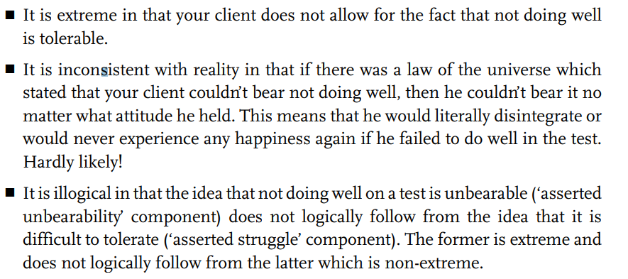
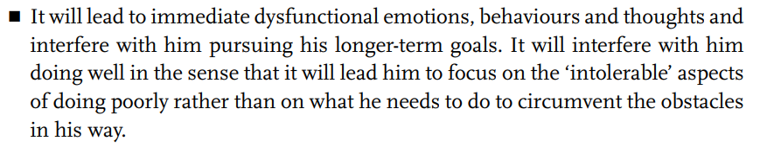
Low frustration tolerance beliefs: Rationality check

Slide 43
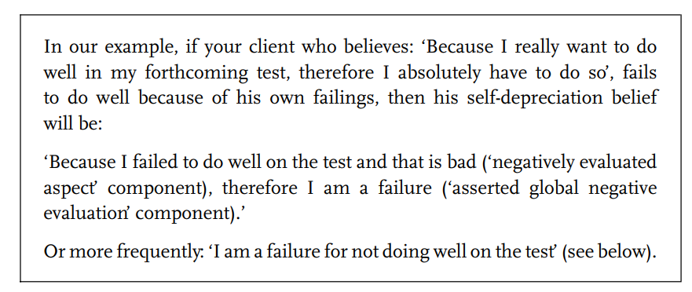
Self-, other- and life-depreciation beliefs

Slide 44
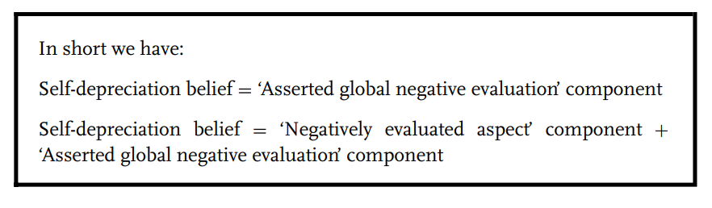
Self-, other- and life-depreciation beliefs

Slide 45
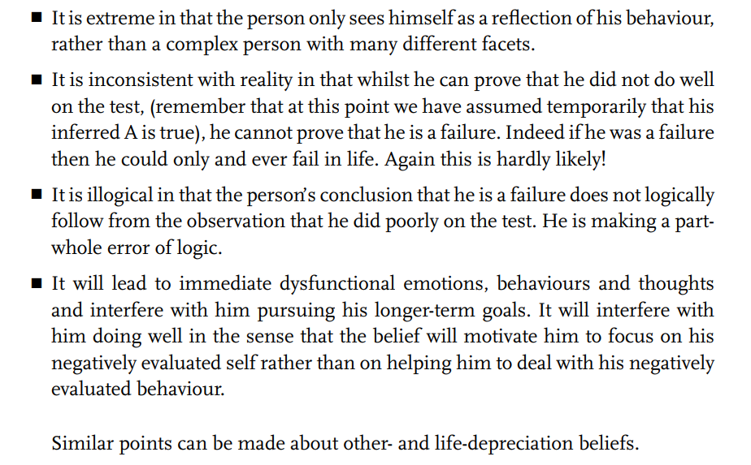
Self-, other- and life-depreciation beliefs: Rationality check

Slide 46
Emotional consequences of beliefs: C’s
The REBT theory of emotions is distinctive both in the field of psychotherapy and even within the tradition of cognitive behaviour therapy (CBT).
It is a qualitative theory of emotions rather than a quantitative theory in that it distinguishes between healthy and unhealthy negative emotions.

Slide 47
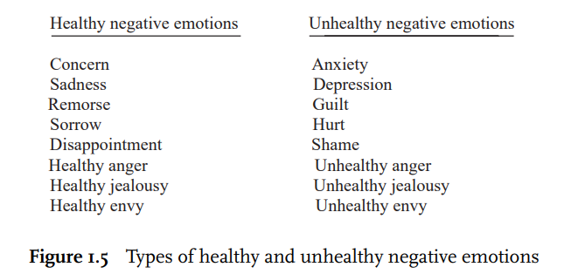
Healthy and unhealthy negative emotions
REBT theory holds that your clients experience healthy negative emotions when their preferences are not met.
These negative emotions are healthy because they encourage your clients to change what can be changed or make a constructive adjustment when the situations that they face cannot be changed.
Alternatively, your clients experience unhealthy negative emotions when they get what they demand they must not get or when they do not get what they demand they must get.

Slide 48
Mixed emotions
While assessing a target problem, you will ask for a concrete example of its occurrence.
You need to realise at this point that it is likely that your client will have a mixture of emotions about the situation in which her problem occurred, rather than having a single, unalloyed emotion.

Slide 49
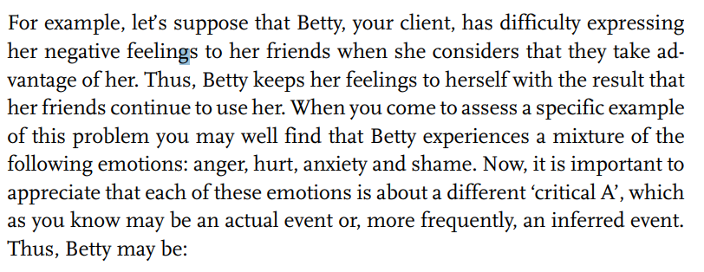
Mixed emotions

Slide 50
Mixed emotions
unhealthily angry when focusing on the selfish aspects of her friends’ behaviour
hurt when focusing on the uncaring aspects of their behavior
anxious when thinking about the possible rejection that might follow any assertion
ashamed when focusing on her own weakness for not having the courage to speak up

Slide 51
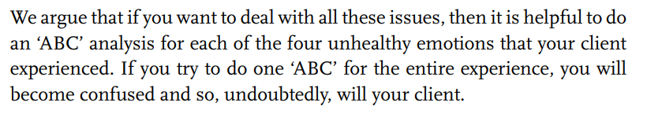
Important

Slide 52
Meta-emotions: emotions about emotions
As human beings, your clients have the ability to reflect on their experiences and think about their thoughts, feelings and behaviours. Thus, a client’s emotion can serve as a ‘critical A’ in an ‘ABC’ episode in which her beliefs determine what subsequent emotions she will have about her prior emotion. We call these emotions about emotions, ‘meta-emotions’

Slide 53
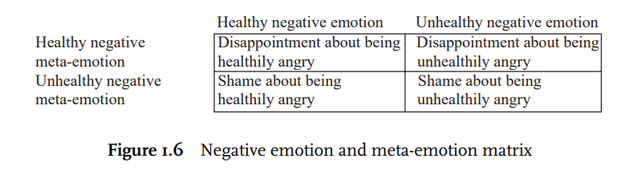
Meta-emotions

Slide 54
Behavioural consequences of beliefs
REBT theory distinguishes between an overt action and an action tendency.
Whenever your client holds a belief then he has a tendency to act in a certain way.
Whether or not your client actualises that tendency and goes on to execute a behaviour consistent with it depends mainly on whether or not he makes a conscious decision to go against the tendency.

Slide 55
Behavioural consequences of beliefs
One major task that you have as an REBT therapist is
to help your client to see the purpose of going against the action tendencies that are based on irrational beliefs and
to develop alternative behaviours that are consistent with action tendencies based on the corresponding rational beliefs.
Before you can do this you need to help your client to identify and dispute his irrational beliefs and to develop and strengthen his alternative rational beliefs.

Slide 56
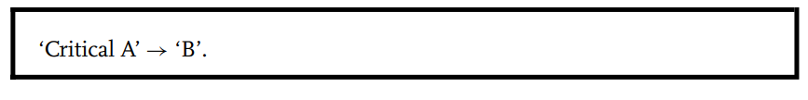
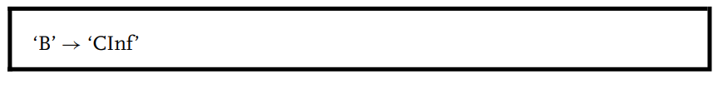
Thinking consequences of beliefs
Although inferences are cognitions, they are best considered as ‘As’ in that when critical, they trigger your client’s beliefs at ‘B’.

Slide 57
Example
Sarah, a 34-year-old woman, came into therapy because she was depressed about her facial appearance. At the beginning of therapy she held the following irrational belief:
‘I must be more attractive than I am and I am worthless because I am less attractive than I must be.’
At this point she thought that everybody that she met would consider her ugly and that no man would want to go out with her. You will note that these latter statements are her inferences about the reactions of people in general and men in particular and that these inferences are the thinking consequences of her irrational beliefs.

Slide 58
Example
During therapy I (WD) worked predominantly at the belief level and at no time did I target her distorted inferences for change.
As a result of my interventions, Sarah came to hold the following rational belief:
‘I would like to be more attractive than I am, but there is no reason why I must be. I don’t like the fact that I am less attractive than I would like to be, but I can accept myself as a fallible, complex human being with this lack. I am not worthless and my looks are just one part of me, not the total whole.’
As a result of this belief change, Sarah reduced markedly her inferences that others would consider her ugly and that men would not want to go out with her. In fact, soon her after therapy ended she started dating a man whom she later married. This clinical vignette shows quite clearly, we believe, the influence of beliefs on inferences.

Slide 59
The principle of psychological interactionism
‘ABCs’ interact in complex ways
However, while in therapy it is important to deal with the ‘ABCs’ as if they were separate components – because otherwise your clients will end up confused – in reality, REBT theory has, right from the outset, advocated the principle of psychological interactionism.
Deal with one A, one B, one C at a time.

Slide 60
The principle of psychological interactionism
This principle states that the events that we choose to focus on, our interpretations and inferences, the beliefs that we hold and the emotions, behaviours and thoughts that stem from these beliefs are all interrelated and reciprocally influence one another often in complex ways.

Slide 61
Apply
Think about a negative experience:
Specify the event/situation
Specify the critical A’s
Specify the type of the critical A’s
Identify the IB’s
Identify the types of IB’s
Check rationality on 5 criteria
Rate the rationality of each belief on 0-100 scale (100 rational).
State your reflections in 2-3 sentences
1 page, Word format, send via e-mail (2pts. Bonus).

