Slide 1
MDES600
RESEARCH METHODOLOGY & COMMUNICATION SKILLS
(Section 02)
Assist. Prof. Dr. Ozan ÖZKAN
Fall 2025-2026

Slide 2
Starting the Research Process
When you have to write a thesis, dissertation or a research project, it can be hard to know where to begin, but there are some clear steps you can follow.
The research process often begins with a very broad idea for a topic you’d like to know more about.
You do some preliminary research to identify a problem.
After refining your research questions, you can lay out the foundations of your research design, leading to a proposal that outlines your ideas and plans.

Slide 3
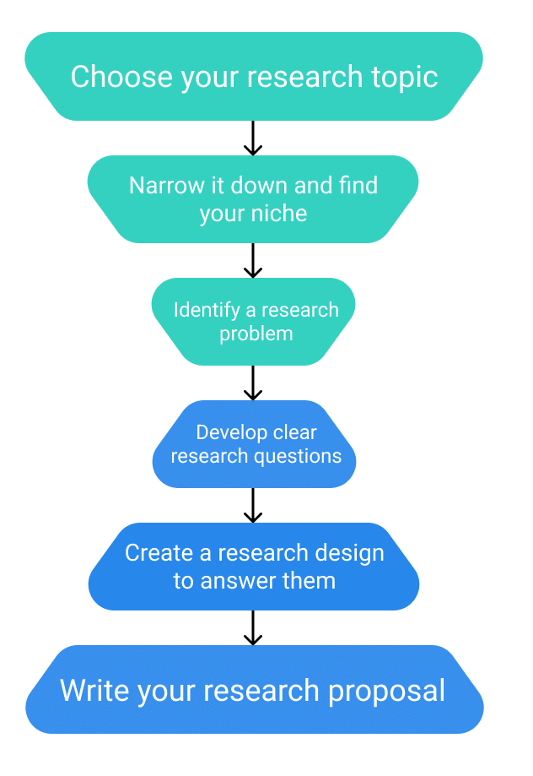
Starting the Research Process

Slide 4
Step 1: Choose Your Topic
Come up with some ideas.
Topic can start out very broad. Think about the general area or field you’re interested in—maybe you already have specific research interests based on classes you’ve taken, or maybe you had to consider your topic when applying to graduate school and writing a statement of purpose.
Read widely to build background knowledge and begin narrowing down your ideas.
Conduct an initial literature review to begin gathering relevant sources. As you read, take notes and try to identify problems, questions, debates, contradictions and gaps.

Slide 5
Step 1: Choose Your Topic
Narrow down from a broad area of interest to a specific niche. This can be a gradual process, and your topic should get more and more specific. For example, from the ideas above, you might narrow it down like this:
Twentieth-century literature → Twentieth-century Irish literature → Post-war Irish poetry
Economic history → European economic history → German labor union history
Health policy → Reproductive health policy → Reproductive rights in South America
Online marketing → Social media marketing → Social media engagement strategies
Make sure to consider the practicalities: the requirements of your programme, the amount of time you have to complete the research, and how difficult it will be to access sources and data on the topic.
Discuss the topic with your supervisor.

Slide 6
Step 2: Identify a Problem
So you’ve settled on a topic and found a niche—but what exactly will your research investigate, and why does it matter?
To give your project focus and purpose, you have to define a research problem.
The problem might be a practical issue — for example, a process or practice that isn’t working well, an area of concern in an organization’s performance, or a difficulty faced by a specific group of people in society.

Slide 7
Step 2: Identify a Problem
Alternatively, you might choose to investigate a theoretical problem — for example, an underexplored phenomenon or relationship, a contradiction between different models or theories, or an unresolved debate among scholars.
To put the problem in context and set your objectives, you can write a problem statement.
This describes who the problem affects, why research is needed, and how your research project will contribute to solving it.

Slide 8
Step 3: Formulate Research Questions
Next, based on the problem statement, you need to write one or more research questions.
These target exactly what you want to find out.
They might focus on describing, comparing, evaluating, or explaining the research problem.

Slide 9
Step 3: Formulate Research Questions
A strong research question should be specific enough that you can answer it thoroughly using appropriate qualitative or quantitative research methods.
It should also be complex enough to require in-depth investigation, analysis, and argument.
Questions that can be answered with “yes/no” or with easily available facts are not complex enough for a thesis or dissertation.
In some types of research, at this stage you might also have to develop a conceptual framework and testable hypotheses.

Slide 10
Step 4: Create a Research Design
The research design is a practical framework for answering your research questions.
It involves making decisions about the type of data you need, the methods you’ll use to collect and analyze it, and the location and timescale of your research.
There are often many possible paths you can take to answering your questions.
The decisions you make will partly be based on your priorities.
For example, do you want to determine causes and effects, draw generalizable conclusions, or understand the details of a specific context?

Slide 11
Step 4: Create a Research Design
You need to decide whether you will use primary or secondary data and qualitative or quantitative methods.
You also need to determine the specific tools, procedures, and materials you’ll use to collect and analyze your data, as well as your criteria for selecting participants or sources.

Slide 12
Step 5: Write a Research Proposal
Finally, after completing these steps, you are ready to complete a research proposal.
The proposal outlines the context, relevance, purpose, and plan of your research.
As well as outlining the background, problem statement, and research questions, the proposal should also include a literature review that shows how your project will fit into existing work on the topic.
The research design section describes your approach and explains exactly what you will do.
You might have to get the proposal approved by your supervisor before you get started, and it will guide the process of writing your thesis or dissertation.

Slide 13
How to Define Your Research Problem?
A research problem is a specific issue, difficulty, contradiction, or gap in knowledge that you will aim to address in your research.
You might look for practical problems aimed at contributing to change, or theoretical problems aimed at expanding knowledge.
Bear in mind that some research will do both of these things, but usually the research problem focuses on one or the other.
The type of research problem you choose depends on your broad topic of interest and the type of research you want to do.
When writing your research proposal or introduction, you will have to formulate it as a problem statement and/or research questions.

Slide 14
Why Is The Research Problem Important?
Your topic is interesting and you have lots to say about it, but this isn’t a strong enough basis for academic research.
Without a well-defined research problem, you are likely to end up with an unfocused and unmanageable project.
You might end up repeating what other people have already said, trying to say too much, or doing research without a clear purpose and justification.
You need a problem in order to do research that contributes new and relevant insights.
Whether you’re planning your thesis, starting a research paper or writing a research proposal, the research problem is the first step towards knowing exactly what you’ll do and why.

Slide 15
Step 1: Identify a Broad Problem Area
As you discuss and read about your topic, look for under-explored aspects and areas of concern, conflict or controversy.
Your goal is to find a gap that your research project can fill.

Slide 16
Practical Research Problems
If you are doing practical research, you can identify a problem by reading reports, following up on previous research, and talking to people who work in the relevant field or organization. You might look for:
  Issues with performance or efficiency in an organization
  Processes that could be improved in an institution
  Areas of concern among practitioners in a field
  Difficulties faced by specific groups of people in society
If your research is connected to a job or internship, you will need to find a research problem that has practical relevance for the organization.

Slide 17
Examples of Practical Research Problems
  Voter turnout in region X has been decreasing, in contrast to the rest of the country.
  Department A of Company B has a high staff turnover rate, affecting productivity and team cohesion.
  Non-profit organization Y faces a funding gap that means some of its programs will have to be cut.

Slide 18
Theoretical Research Problems
Theoretical research focuses on expanding knowledge and understanding rather than directly contributing to change. You can identify a research problem by reading recent research, theory and debates on your topic to find a gap in what is currently known about it. You might look for:
  A phenomenon or context that has not been closely studied
  A contradiction between two or more perspectives
  A situation or relationship that is not well understood
  A troubling question that has yet to be resolved
Theoretical problems often have practical consequences, but they are not focused on solving an immediate issue in a specific place (though you might take a case study approach to the research).

Slide 19
Examples of Theoretical Research Problems
  The effects of long-term Vitamin D deficiency on cardiovascular health are not well understood.
  The relationship between gender, race and income inequality has yet to be closely studied in the context of the millennial gig economy.
  Historians of Scottish nationalism disagree about the role of the British Empire in the development of Scotland’s national identity.

Slide 20
Step 2: Learn More About the Problem
Next, you have to find out what is already known about the problem, and pinpoint the exact aspect that your research will address.

Slide 21
Context and Background
  Who does the problem affect?
  Has it been an issue for a long time, or is it a newly discovered problem?
  What research has already been done?
  Have any solutions been proposed?
  What are the current debates about the problem, and what do you think is missing from them?

Slide 22
Specificity and Relevance
  What particular place, time and/or people will you focus on?
  What aspects will you not be able to tackle?
  What will be the consequences if the problem is not resolved?
  Whose will benefit from resolving the problem (e.g. the management of an organization or future researchers)?

Slide 23
Example of a Specific Research Problem
Non-profit organization X has been focused on retaining its existing support base, but lacks understanding of how best to target potential new donors. To be able to continue its work, the organization requires research into more effective fundraising strategies.
When you have narrowed down your problem, the next step is to formulate a problem statement and research questions or hypotheses.

Slide 24
Developing Strong Research Questions
A good research question is essential to guide your research paper, project or thesis.
It pinpoints exactly what you want to find out and gives your work a clear focus and purpose.

Slide 25
Developing Strong Research Questions
All research questions should be:
Focused on a single problem or issue
Researchable using primary and/or secondary sources
Feasible to answer within the timeframe and practical constraints
Specific enough to answer thoroughly
Complex enough to develop the answer over the space of a paper or thesis
Relevant to your field of study and/or society more broadly.

Slide 26
Developing Strong Research Questions
In a research paper or essay, you will usually write a single research question to guide your reading and thinking. The answer that you develop is your thesis statement — the central assertion or position that your paper will argue for.
In a bigger research project, such as a thesis or dissertation, you might have multiple research questions, but they should all be clearly connected and focused around a central research problem.

Slide 27
How to Write a Research Question
The process of developing your research question follows several steps:
Choose a broad topic
Do some preliminary reading to find out about topical debates and issues
Narrow down a specific niche that you want to focus on
Identify a practical or theoretical research problem that you will address.
When you have a clearly-defined problem, you need to formulate one or more questions. Think about exactly what you want to know and how it will contribute to resolving the problem.

Slide 28
How to Write a Research Question
The way you frame your question depends on what your research aims to achieve. The table below shows some examples of how you might formulate questions for different purposes.
Research aims | Research question formulations
Describing and exploring | What are the characteristics of X? How has X changed over time? What are the main factors in X? How does X experience Y? How has X dealt with Y?
Explaining and testing | What is the relationship between X and Y? What is the role of X in Y? What is the impact of X on Y? How does X influence Y? What are the causes of X?
Evaluating and acting | What are the advantages and disadvantages of X? How effective is X? How can X be achieved? What are the most effective strategies to improve X? How can X be used in Y?

Slide 29
How to Write a Research Question
Depending on the scope of your research, you may identify just one question or several. You may also have one primary research question and several secondary questions or sub-questions that relate to the same problem.
Example research problem | Example research question(s)
The teachers at school X do not have the skills to recognize or properly guide gifted children in the classroom. | What practical techniques can teachers at school X use to better identify and guide gifted children?
Under-30s increasingly engage in the “gig economy” instead of traditional full-time employment, but there is little research into young people’s experiences of this type of work. | What are the main factors that influence young people’s decisions to engage in the gig economy? What do workers perceive as its advantages and disadvantages? Do age and education level have an effect on how people experience this type of work?

Slide 30
What Makes a Strong Research Question?
Writing questions isn’t a difficult task in itself, but it can be hard to work out if you have a good research question.
Research questions anchor your whole project, so it’s important to spend some time refining them.
The following criteria can help you evaluate the strength of your research question.

Slide 31
What Makes a Strong Research Question?
Focused and Researchable
Criteria | Explanation
Focuses on a single topic and problem | Your central research question should follow from your research problem to keep your work focused. If you have multiple questions, they should all clearly relate to this central aim.
Answerable using primary or secondary data | You must be able to find an answer by collecting quantitative and/or qualitative data, or by reading scholarly sources on the topic to develop an argument. If such data is impossible to access, you will have to rethink your question and ask something more concrete.
Does not ask for a subjective value judgement | Avoid subjective words like good, bad, better and worse, as these do not give clear criteria for answering the question. If your question is evaluating something, use terms with more measurable definitions. ✗ Is X or Y a better policy? ✓ How effective are X and Y policies at reducing rates of Z?

Slide 32
What Makes a Strong Research Question?
Feasible and Specific
Criteria | Explanation
Answerable within practical constraints | Make sure you have enough time and resources to do the research required to answer the question. If you think you might struggle to gain access to enough data, consider narrowing down the question to be more specific.
Uses specific, well-defined concepts | All the terms you use in the research question should have clear meanings. Avoid vague language and broad ideas, and be clear about what, who, where and when your question addresses. ✗ What effect does social media have on people’s minds? ✓ What effect does daily use of Twitter have on the attention span of under-16s?
Does not ask for a conclusive solution, policy, or course of action | Research is about informing, not instructing. Even if your project is focused on a practical problem, it should aim to improve understanding and suggest possibilities rather than asking for a ready-made solution. ✗ What should the government do about low voter turnout? ✓ What are the most effective communication strategies for increasing voter turnout among under-30s?

Slide 33
What Makes a Strong Research Question?
Complex and Arguable
Criteria | Explanation
Cannot be answered with yes or no | Closed yes/no questions are too simple to work as good research questions — they don’t provide enough scope for investigation and discussion. ✗ Has there been an increase in homelessness in the UK in the past ten years? ✓ How have economic and political factors affected patterns of homelessness in the UK over the past ten years?
Cannot be answered with easily found facts and figures | If you can answer the question through a Google search or by reading a single book or article, it is probably not complex enough. A good research question requires original data, synthesis of multiple sources, interpretation and/or argument to provide an answer.
Provides scope for debate and deliberation | The answer to the question should not just be a simple statement of fact: there needs to be space for you to discuss and interpret what you found. This is especially important in an essay or research paper, where the answer to your question often takes the form of an argumentative thesis statement.

Slide 34
What Makes a Strong Research Question?
Relevant and Original
Criteria | Explanation
Addresses a problem relevant to your field or discipline | The research question should be developed based on initial reading around your topic, and it should focus on addressing a problem or gap in the existing knowledge.
Contributes to a topical social or academic debate | The question should aim to contribute to an existing debate — ideally one that is current in your field or in society at large. It should produce knowledge that future researchers or practitioners can build on.
Has not already been answered | You don’t have to ask something groundbreaking that nobody has ever thought of before, but the question should have some aspect of originality (for example, by focusing on a specific location or taking a new angle on a long-running debate).

