Slide 1
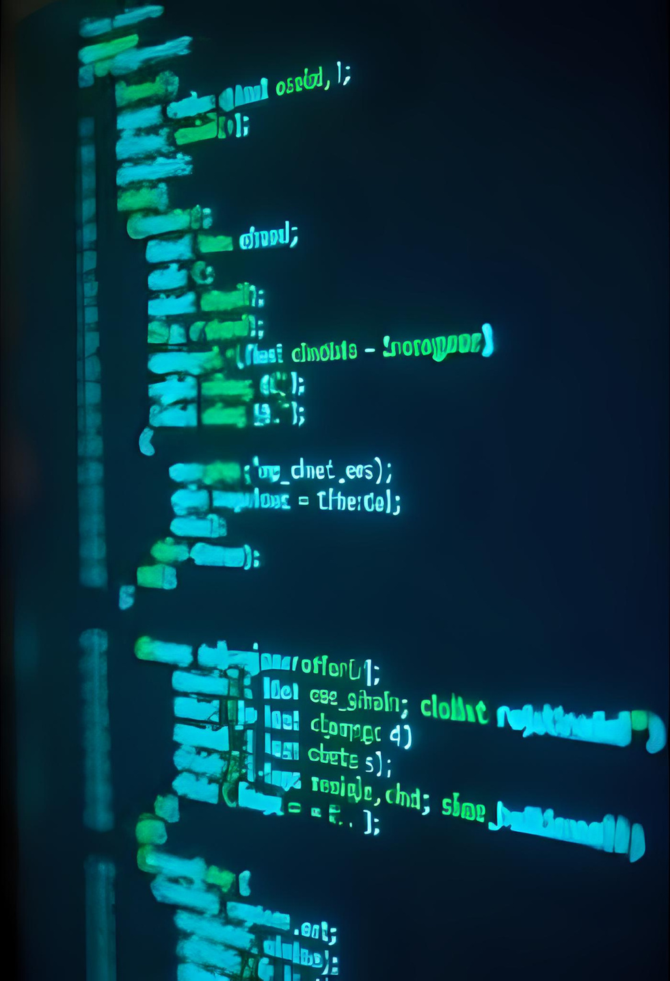
Atılım University
Welcome to
Software Quality Assurance!

Slide 2

SE345 Syllabus
Atılım University
Dept of Software Engineering
Asst. Prof. Dr. Aylin AKCA-OKAN

Slide 3



Course Overview
Objective
Prerequisites
to provide knowledge and practical applications of concepts of software quality, quality models, standards and methodologies used in software industry.
SE112
Good command of English

Slide 4
Course Outcomes
Outcome 1
Outcome 2
Outcome 3
Gaining knowledge in various Software Quality Assurance (SQA) fundamental concepts, definitions, objectives and activities performed during the development and maintenance of software systems
Discuss software quality assurance system components such as reviewing, configuration process, work instructions and their practical aspects during software development life cycle
Gaining knowledge in software quality management components such as quality metrics and software quality costs

Slide 5

Tentative Course Schedule
Wk Subjects Chapter
1 Introduction to Software Quality and Assurance Chapter 1
2 Introduction to Software Quality and Assurance Chapter 1
3 Software Quality Factors Chapter 3
4 Overview of Components of the SQA System Chapter 4
5 Overview of Components of the SQA System Chapter 4
6 Presentation Chapter 9
7 Midterm
8 Integrating Quality Activities in Project Life Cycle Chapter 7
9 Software Quality Metrics Chapter 21
10 Reviews, Inspection and Audits Chapter 8
11 Procedures and Work Instructions Chapter 14
12 In-class Project
13 Software Change Process Chapter 18
14 SQA Process Standards Chapter 23

Slide 6
Required Books and References
Software Quality: Concepts and Practice: Concepts and Practice, Daniel Galin, 2018, Print ISBN:9781119134497 |Online ISBN:9781119134527 DOI:10.1002/9781119134527
Software Quality: Producing Practical, Consistent Software, by Ben-Menachem M, and Marliss G.S., Thompson Computer Press, ISBN: 1-85032-326-7, 1997. Metrics and Models in Software Quality Engineering, Kan S.H., , ISBN: 0201729156, Addison-Wesley, 2002. Software Quality Management and ISO 9001, Jenner M., ISBN: 0471118885, John-Wiley & Sons, 1995. Software Metrics: A Rigorous and Practical Approach, N.Fenton and Shari Pfleeger, ISBN: 0-534-95425-1, Thomson Computer Press, 1996,. Software Engineering by Ian Sommerville (7th and 8th Edition) ISBN: 0-321-21026-3, Pearson (Addison Wesley), 2004 and 2006. The Capability Maturity Model Report, M.C. Paulk et al., available at http://www.sei.cmu.edu/pub/documents/93.reports/

Slide 7
Course Evaluation
Homeworks
Midterm and Final Exams
30%
30%
40%

Slide 8
Course Policies
Attendance
Communication Mandatories
Attend the classes as much as you can. Most of the details, hints and tips will be told there.
Should be >70%!
No talking with each other in the class
Respect all!
Use of Electronic Devices
No mobile or electronic device in the class or in the exam!

Slide 9

Contact Me
Phone Number
(312) 586 83 77
Email Address
aylin.okan@atilim.edu.tr
Office
Engineering Faculty – A12

Slide 10
Teacher Resources Page
Use these icons and illustrations
in your Canva Presentation.
Happy designing!

