Slide 1
THREE VIEWS IN TECHNICAL DRAWING / ORTHOGRAPHIC DRAWING
ME 108 – COMPUTER AIDED SOLID MODELLING / SECTION 01
Assistant Professor Dr. Yagmur Nalbant Atak
Mechanical Engineering Department
Atılım University

Slide 2
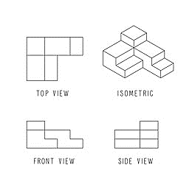
WHAT IS ORTHOGRAPHIC DRAWING?
Orthographic drawing is mainly used to display dimensions, as well as to show an object from a number of different sides.
Usually, an orthographic drawing contains four different views of the object:
Top/Bottom
Front
Side
Isometrıc

Slide 3
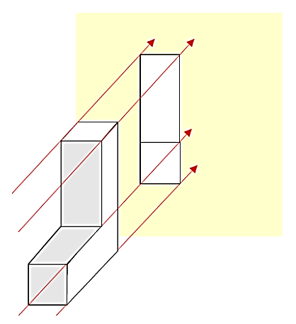
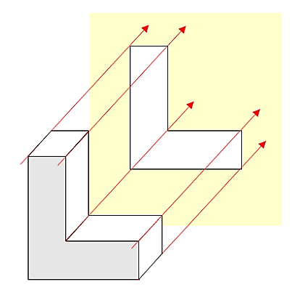
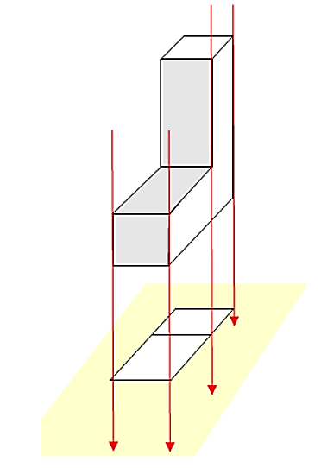
EXAMPLES-1
It is an example of the side view.
It is an example of the front view.
It is an example of the top view.

Slide 4
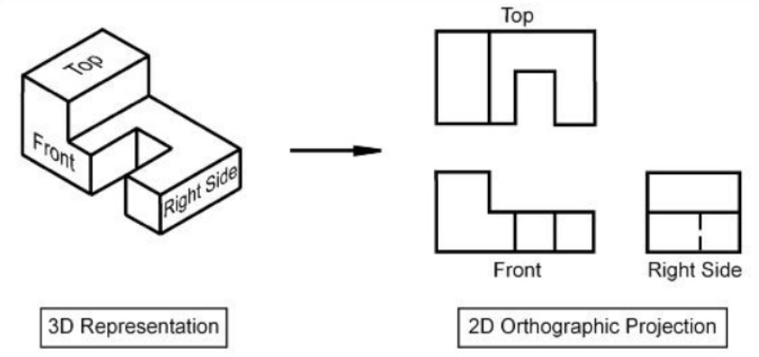
EXAMPLES-2

Slide 5
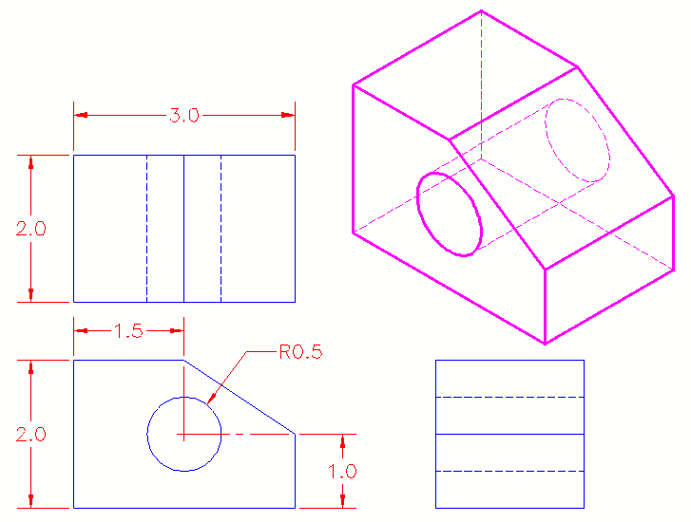
HIDDEN DETAIL
This information is important to read any orthographic drawing. Sometimes detail on a drawing cannot be displayed on some views. Dashed lines are used in this scenario.

Slide 6
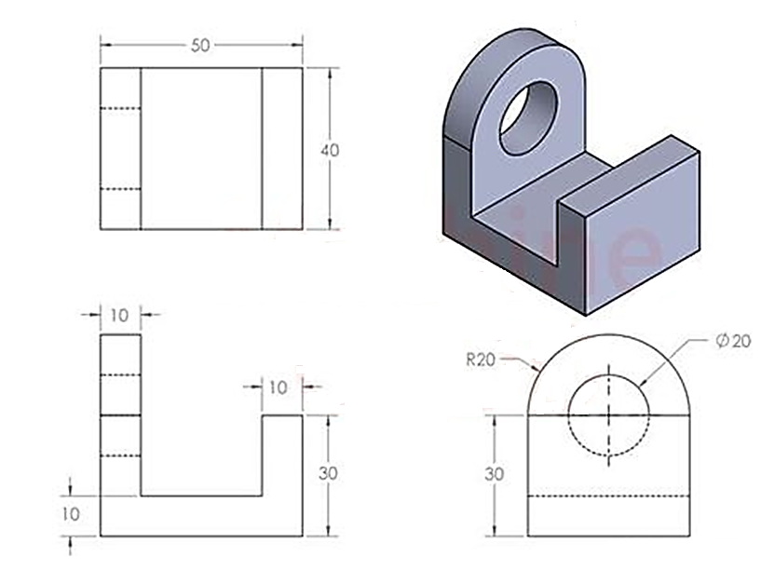

Slide 7
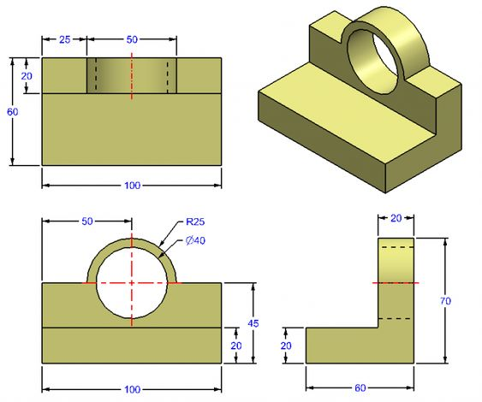

Slide 8
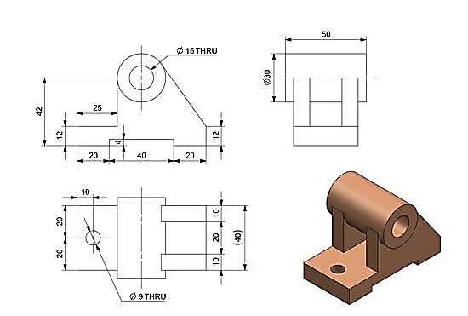

Slide 9
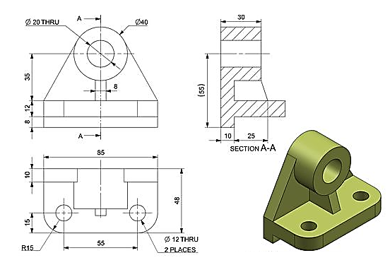

Slide 10
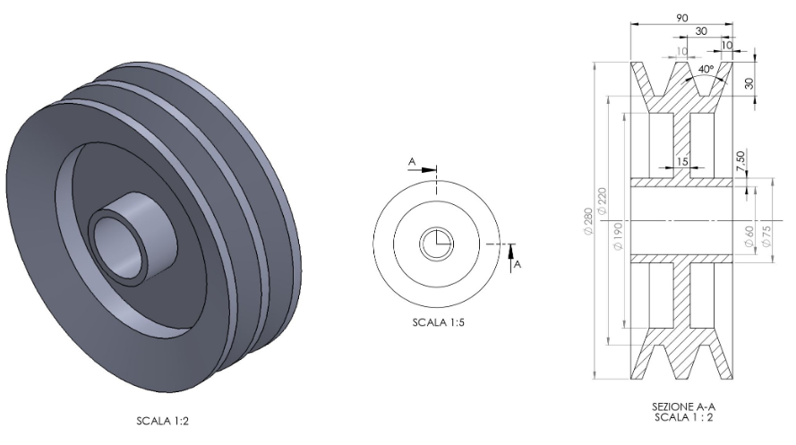

Slide 11
