Slide 1
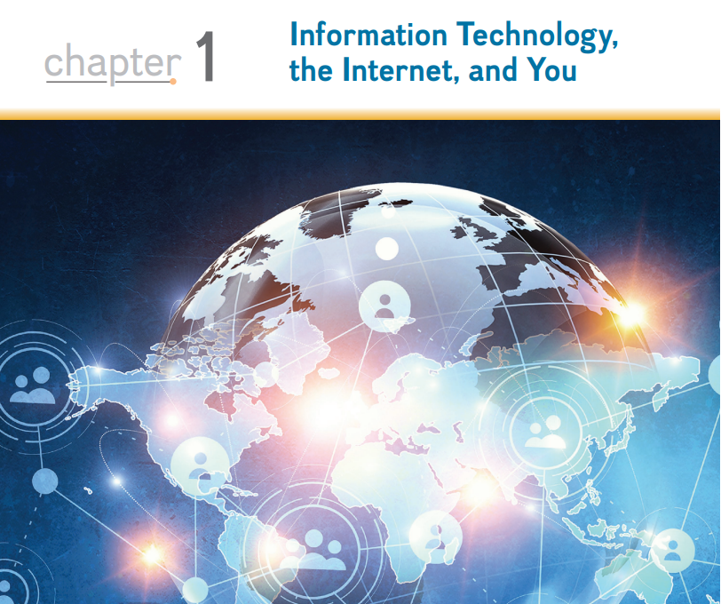
CMPE 105

Slide 2
Information Systems
An information system has several parts: people, procedures, software, hardware, data, and the Internet.
People: It is easy to overlook people as one of the parts of an information system. Yet this is what personal computers are all about—making people, end users like you, more productive.
Procedures: The rules or guidelines for people to follow when using software, hardware, and data are procedures. These procedures are typically documented in manuals written by computer specialists.
Software: A program consists of the step-by-step instructions that tell the computer how to do its work. Software is another name for a program or programs. The purpose of software is to convert data (unprocessed facts) into information (processed facts).

Slide 3
Information Systems
Hardware: The equipment that processes the data to create information is called hardware. It includes smartphones, tablets, keyboards, mice, displays, system units, and other devices. Hardware is controlled by software.
Data: The raw, unprocessed facts, including text, numbers, images, and sounds, are called data. Processed data yields information.
Internet: Almost all information systems provide a way to connect to other people and computers, typically using the Internet. This connectivity greatly expands the capability and usefulness of information systems.

Slide 4
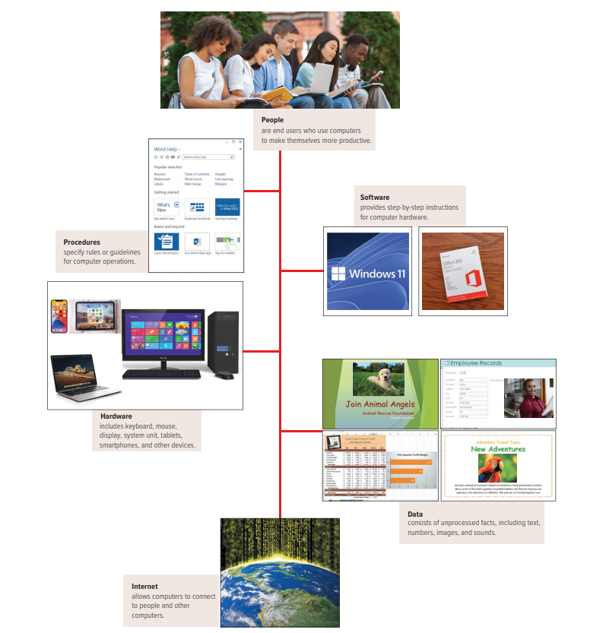
Part of an Information System

Slide 5
People
People are surely the most important part of any information system. Our lives are touched every day by computers and information systems. Many times, the contact is direct and obvious, such as when we create documents using a word processing program or when we connect to the Internet. Other times, the contact is not as obvious.

Slide 6
Software
Programs are the instructions that tell the computer how to process data into the form you want. In most cases, the words software and programs are interchangeable.
System Software
Application Software
Notes:
There are two major kinds of software: system software and application software. You can think of application software as the kind you use. Think of system software as the kind the computer uses

Slide 7
1-System Software
The user interacts primarily with application software. System software enables the application software to interact with the computer hardware. System software is “background” software that helps the computer manage its own internal resources.
System software is not a single program. Rather, it is a collection of programs, including the following:
Operating systems are programs that coordinate computer resources, provide an interface between users and the computer, and run applications. Smartphones, tablets, and many other mobile devices use embedded operating systems, also known as real-time operating systems (RTOS). Desktop computers use standalone operating systems like Windows 10 or macOS. Networks use network operating systems (NOS).
Utilities perform specific tasks related to managing computer resources. One of the most essential utility programs that every computer system should have is an antivirus program.
Notes:
These programs protect your computer system from viruses or malicious programs that are all too often deposited onto your computer from the Internet. These programs can damage software and hardware, as well as compromise the security and privacy of your personal data. If your computer does not have an antivirus program installed on it, you need to get one

Slide 8
2-Application Software
Application software might be described as end-user software. Three types of application software are general-purpose, specialized, and apps.
General-purpose applications are widely used in nearly all career areas. They are the kinds of programs you have to know to be considered an efficient and effective end user.
Specialized applications include thousands of other programs that are more narrowly focused on specific disciplines and occupations. Two of the best known are graphics and web authoring programs.
Mobile apps, also known as mobile applications or simply apps, are small programs primarily designed for mobile devices such as smartphones and for tablets.
Notes:
There are over 5 million apps. The most popular mobile apps are for social networking, playing games, and downloading music and videos.

Slide 9
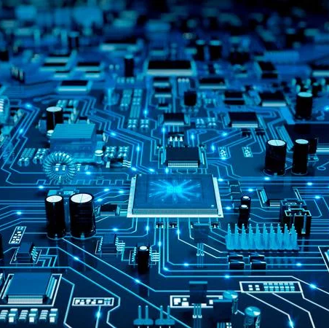
Hardware
Computers are electronic devices that can follow instructions to accept input, process that input, and produce information.

Slide 10
Types of Computers
Supercomputers are the most powerful type of computer. These machines are special, high-capacity computers used by very large organizations. Supercomputers are typically used to process massive amounts of data.
Mainframe computers occupy specially wired, air-conditioned rooms. Although not nearly as powerful as supercomputers, mainframe computers are capable of great processing speeds and data storage.
Midrange computers, also referred to as servers, are computers with processing capabilities less powerful than a mainframe computer yet more powerful than a personal computer.
Personal computers, also known as PCs, are the least powerful, yet the most widely used and fastest-growing type of computer. There are five types of personal computers: desktops, laptops, tablets, smartphones, and wearables.
Notes:
Supercomputers: For example, they are used to analyze and predict worldwide weather patterns. IBM’s Blue Gene supercomputer is one of the fastest computers in the world
Mainframe computers: For example, insurance companies use mainframes to process information about millions of policyholders.
Midrange computers: Originally used by medium-size companies or departments of large companies to support their processing needs, today midrange computers are most widely used to support or serve end users for such specific needs as retrieving data from a database or supplying access to application software
Personal Computers: Desktop computers are small enough to fit on top of or alongside a desk yet are too big to carry around. Laptop computers, also known as notebook computers, are portable and lightweight and fit into most briefcases. Tablets, also known as tablet computers, are smaller, lighter, and generally less powerful than laptops. Like a laptop, tablets have a flat screen but typically do not have a standard keyboard. Instead, tablets typically use a virtual keyboard that appears on the screen and is touch-sensitive. Smartphones are the most widely used personal computer. Smartphones are cell phones with wireless connections to the Internet and processing capabilities. Other mobile computers include wearable devices like Apple’s Watch.

Slide 11
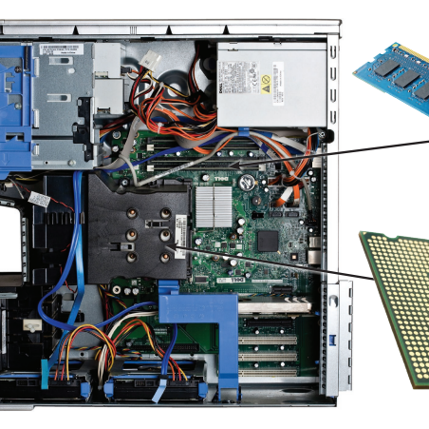
Personal Computer Hardware
Hardware for a personal computer system consists of a variety of different devices. This physical equipment falls into four basic categories: system unit, input/output, secondary storage, and communication.

Slide 12
Personal Computer Hardware
System unit: The system unit is a container that houses most of the electronic components that make up a computer system. Two important components of the system unit are microprocessors and memory. The microprocessor controls and manipulates data to produce information. Memory is a holding area for data, instructions, and information. One type, random-access memory (RAM), holds the program and data that are currently being processed. This type of memory is sometimes referred to as temporary storage because its contents will typically be lost if the electric power to the computer is disrupted.

Slide 13
Personal Computer Hardware
Input/output: Input devices translate data and programs that humans can understand into a form that the computer can process. The most common input devices are the keyboard and the mouse. Output devices translate the processed information from the computer into a form that humans can understand. The most common output device is the display, also known as a monitor

Slide 14
Personal Computer Hardware
Secondary storage: Unlike memory, secondary storage holds data and programs even after electric power to the computer system has been turned off. The most important kinds of secondary media are hard disks, solid-state storage, and optical discs.
  Hard disks are typically used to store programs and very large data files. Using rigid metallic platters and read/write heads that move across the platters, data and information are stored using magnetic charges on the disk’s surface.
  In contrast, solid-state storage does not have any moving parts, is more reliable, and requires less power. It saves data and information electronically similar to RAM except that it is not volatile.
  Optical discs use laser technology to store data and programs. Three types of optical discs are compact discs (CDs), digital versatile (or video) discs (DVDs), and Blu-ray discs (BD)

Slide 15
Personal Computer Hardware
Communication: At one time, it was uncommon for a personal computer system to communicate with other computer systems. Now, using communication devices, a personal computer routinely communicates with other computer systems located as near as the next office or as far away as halfway around the world, using the Internet. A modem is a widely used communication device that modifies audio, video, and other types of data into a form that can be transmitted across the Internet.

Slide 16
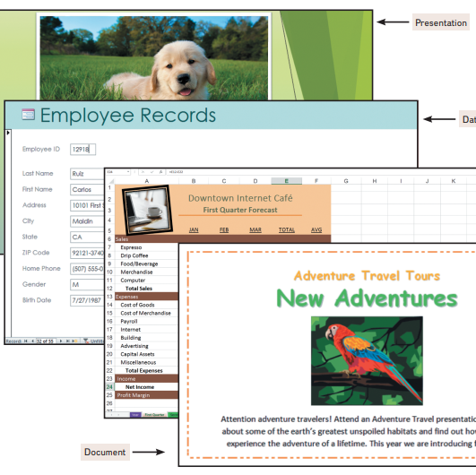
Data
Data is raw, unprocessed facts, including text, numbers, images, and sounds. As we mentioned earlier, processed data becomes information. When stored electronically in files, data can be used directly as input for the system unit.

Slide 17
Data – File Types
Document files, created by word processors to save documents such as memos, term papers, and letters.
Worksheet files, created by electronic spreadsheets to analyze things like budgets and to predict sales.
Database files, typically created by database management programs to contain highly structured and organized data.
Presentation files, created by presentation software to save presentation materials.
Notes:
Database files, For example, an employee database file might contain all the workers’ names, Social Security numbers, job titles, and other related pieces of information
Presentation files, For example, a file might contain audience handouts, speaker notes, and electronic slides.

Slide 18
Connectivity and the Mobile Internet
Connectivity is the capability of your personal computer to share information with other computers. Central to the concept of connectivity is the network. A network is a communications system connecting two or more computers. The largest network in the world is the Internet. It is like a giant highway that connects you to millions of other people and organizations located throughout the world. The web provides a multimedia interface to the numerous resources available on the Internet.
The Internet has driven the evolution of computers and their impact on our daily lives. The rate of technological change is accelerating at an ever faster pace. Along with the Internet, three things that are driving the impact of technology on our lives are cloud computing, wireless communication, and the Internet of Things.

Slide 19
Connectivity and the Mobile Internet
Cloud computing uses the Internet and the web to shift many computer activities from a user’s computer to computers on the Internet. Rather than relying solely on their computer, users can now use the Internet to connect to the cloud and access more powerful computers, software, and storage.
Wireless communication has changed the way we communicate with one another. The rapid development and widespread use of wireless communication devices like tablets, cell phones, and wearable devices have led many experts to predict that wireless applications are just the beginning of the wireless revolution, a revolution that will dramatically affect the way we communicate and use computer technology.

Slide 20
Connectivity and the Mobile Internet
The Internet of Things (IoT) is the continuing development of the Internet that allows everyday objects embedded with electronic devices to send and receive data over the Internet. It promises to connect all types of devices, from computers to cell phones, to watches, to any number of everyday devices.

Slide 21
computer competency
Computer competency refers to a person's ability to effectively use computers and related technology to perform tasks, solve problems, and communicate efficiently. It includes a range of skills, from basic usage to advanced technical abilities.
Key Areas of Computer Competency:
Basic Computer Skills:
  Using operating systems (e.g., Windows, macOS, Linux)
  Managing files and folders
  Typing and using input devices like keyboard and mouse
Software Proficiency:
  Word processing (e.g., Microsoft Word, Google Docs)
  Spreadsheets (e.g., Excel)
  Presentation tools (e.g., PowerPoint)
  Email and communication tools (e.g., Outlook, Gmail)

Slide 22
computer competency
Internet and Networking:
  Browsing the internet safely
  Using search engines effectively
  Understanding basic networking concepts
  Online communication (e.g., social media, video conferencing)
Security Awareness:
  Identifying and avoiding phishing attacks
  Using strong passwords and managing them securely
  Understanding basic cybersecurity practices
Advanced Skills (optional but beneficial):
  Programming and coding
  Troubleshooting hardware and software issues
  Using specialized software (e.g., graphic design tools, data analysis software

Slide 23
computer competency
Why is Computer Competency Important?
Workplace Efficiency: Most jobs require some level of computer usage.
Communication: Email, messaging apps, and video calls are standard communication tools.
Learning and Research: Access to online educational resources and research tools.
Productivity and Creativity: Using software for productivity (e.g., MS Office Suite) or creative tasks (e.g., photo editing).
It is an essential skill set in today’s digital world, contributing to both personal and professional growth.

